Slide 1
10-Year Housing & Homelessness Plan 2020-2030
May 7, 2025
Kale Brown
Interim Director, Housing & Homelessness Services
Notes:
Can you draft a ~15 slide presentation on the 10 Year Plan Update? The audience will be nonprofit EDs, Senior Mangers 1-2 BOD members and other sector partners. We are doing a presentation on May 7th with the Alliance on HHLT plus 10 Year Plan.
Webinar – level setting – more so orientation on current plan itself
Process/approach – themes…current state asset

Slide 2

Agenda
Background
Development of the Current 10-Year Plan
Current 10-Year Plan
Goals & Objectives
Targets
Strategies
Tactics & Actions
Reporting on Progress

Slide 3

Background
Every municipality in Ontario is required to have a 10-Year Housing and Homelessness Plan (10-Year Plan)
10-Year Plans guide efforts to address local housing and homelessness needs
Plans must be 10 years in length, updated every 5-years, and include:
  Housing Needs Assessment
  Objectives
  Targets
  Measures
  How progress will be measured
Notes:
Has been a requirement since 2014.

Slide 4



City of Ottawa Role & Context
Shared Responsibility:
  Housing & Homelessness Services, CSSD
  Housing Solutions & Investments, SI
Service Manager, Provincial Housing Services Act
Community Entity, Federal Reaching Home
Other long term City strategies
Notes:
The City of Ottawa is the designated SM under the Provincial HSA and the Designated CE under the Federal RH. This comes with a host of responsibilities and accountability as it relates to developing and delivering housing and homelessness services, including the 10-Year Plan, across the City.
Other City Strats:
CSWBP 6 priority areas one of which is housing
Anti-Racism Strategy includes Recommendations and Actions aimed at allocating dediated funding for Indigenous, Black and other racialized communities, improving access to affordable housing supports for these groups, and developing culturally responsive housing services and supports
WGES
Poverty Reduction

Slide 5
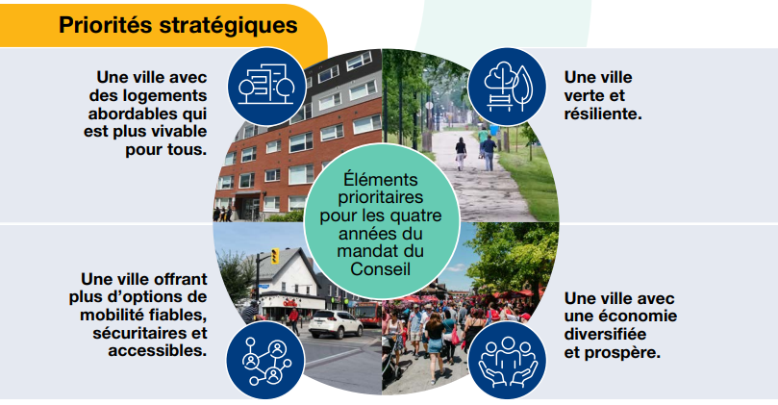
City of Ottawa Strategic Plan 2023-2026
Notes:
City context for the Refresh:
The City’s mandate as it relates to housing and homelessness services is primarily set by other levels of government – Service Manager provincially and Community Entity Federally which comes with specific roles and responsibilities in terms of programs and services we deliver
Within the City, we have the Strategic Plan which is established for every term of council and was most recently approved in 2023 and spans through the year 2026. The City Strat Plan was informed by the City’s long term strategies including the 10-Year Plan (also LRFP, OP, CSWBP which has housing as a priority area). The City Strat Plan has 4 key priorities, one of which is “A city that has affordable housing and is more liveable for all’ which is directly related to the work we do.

Slide 6
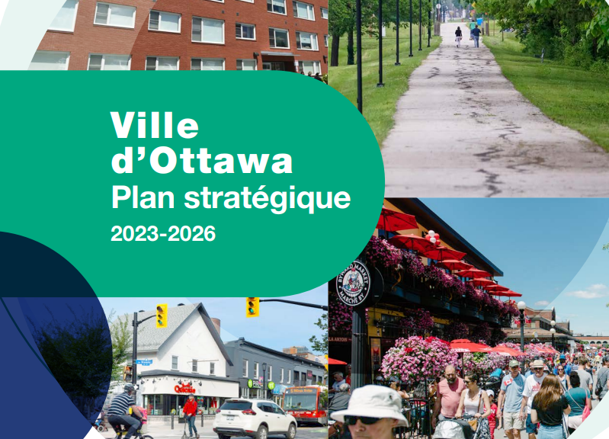
City of Ottawa Strategic Plan
Objective 1: Increase housing options including below market and deeply affordable near transit, leverage City land and seek sustainable funding
Objective 2: Support increased housing supply and intensification
Objective 3: Create and advance along a clear path to eliminate chronic homelessness
Notes:
The City Strat Plan breaks down its priorities into 25 strategic objectives
The objectives relating to the priority of a city that has affordable housing and is more livable for all are showcased on the slide. In the Strat Plan, each objective includes outcomes (results we want to achieve by 2026) and KPIs
(Results we want to achieve by 2026 by Objective are:
Objective 1:
Increased affordable housing options for singles and families of various sizes
Culturally responsive supports for the Indigenous homeless population
Improved governance and systems management with housing providers
Created opportunities with Ottawa Community Lands Development Corporation, Ottawa Community Housing and partners
Objective 2 (led by PRED but related to our work)
Increased housing units built of all types
Streamlined approvals and adopt a more efficient, effective and equitable Zoning By-law
Increased diversity of housing across all neighbourhoods, including within or on transit hubs, protected major transit stations and corridors
Objective 3:
Developed resources to assist chronically homelessness individuals to access appropriate, permanent housing with the supports they need to stay housed and reduced inflow into chronic homelessness
Reduced chronic homelessness
KPIs for all 3:
# of households housed from Registry waitlist
# of new affordable housing units completed
# of new supportive housing units completed
# of housing benefits added
#, location and types of units approved through development applications and building permits
# of individuals with a history of chronic homelessness that were housed
# of individuals that are actively chronically homeless
# of individuals matched to Housing First supports

Slide 7

Development of the Current 10-Year Plan
2020 refresh completed in partnership with the Housing Systems Working Group and the housing and homelessness sector
Consultation included in-person focus groups with a broad cross section of partners, stakeholders, academics, advocates, the public and people with lived experience of poverty, housing insecurity and homelessness
Engage Ottawa page solicited feedback from the public and complemented in-person consultations
Notes:
HSWG sunsetted in 2023 shortly before the interim HHLT was established
Project governance structure brought together over 60 local organizations/associations

Slide 8
Current 10-Year Plan (2020-2030)
Approved by Council July 15, 2020
147-page document organized into 3 parts
Annual progress reports
Part 1: Where we are now | Part 2: Where we want to be | Part 3: How we’ll achieve our goals
Housing needs assessment | Goals | Strategies
Overview of housing system | Objectives | Tactics & Actions
Definitions | Targets | Reporting on progress
Notes:
10-Year Plan is 147 page document approved by City Council in July 2020. The Plan is organized into 3 parts: Where are we now, where we and to be, how we’ll achieve our goals.
Part 1: overview of current housing system and spectrum of housing options, definitions, overview of Housing Services Service Area (housing, homelessnesss), overview of funding, accomplishments to date, housing needs assessment
Part 2: goals and objectives, outcomes, targets
Part 3: strategies and tactics for achieving the plan, reporting on progress

Slide 9
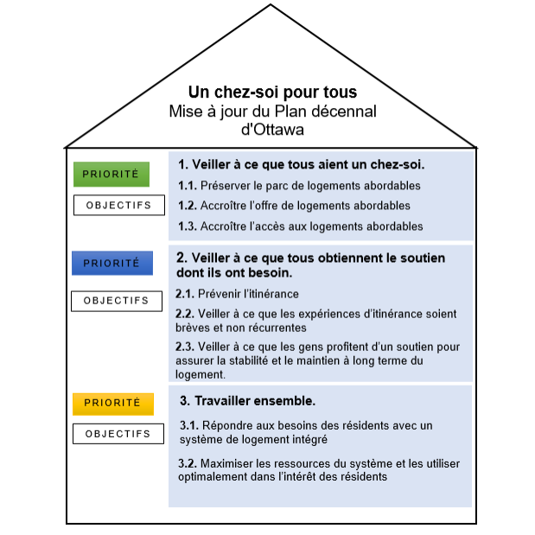
10-Year Plan Goals & Objectives
Notes:
The vision for the 10-Year Plan is in the roof – a home for everyone
As you can see, the 10-Year Plan is comprised of 3 overarching goals, 8 objectives and a series of measurable targets and actions
The goals and objectives were initially developed through the planning process in 2014 and revisited and refined by City of Ottawa staff, the Housing System Working Group, and the other working groups convened to support the Plan.
The goals and objectives were initially developed through the planning process in 2014 and revisited and refined by City of Ottawa staff, the Housing System Working Group, and the other working groups convened to support the Plan for the 2020 refresh.

Slide 10
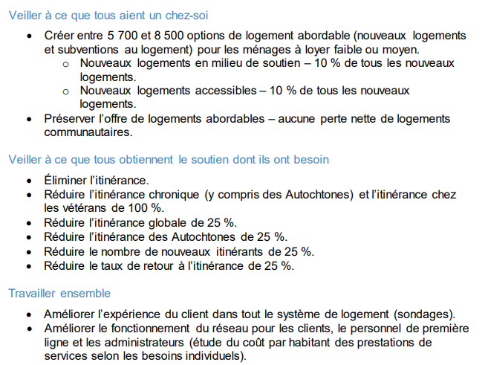
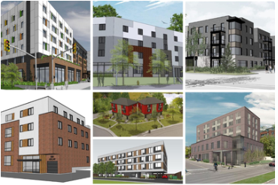
10-Year Plan Targets
Notes:
Targets (outcomes) associated with the 3 goals – clarify 5,700-8,500 is over the 10-years of the plan – annual number is 570-850
Pictured L-R, top to bottom some of our new developments.
1. Mixed development 811 Gladstone (OCH, some seniors, 140 affordable units ranging in size from bachelor to four bedrooms including seniors across 3 bldgs.)
2. SH development located at 765 Montreal Road (SGH, singles, 42 units)
3. Mixed development at 3865 Richmond Road (The Anglican Diocese of Ottawa, one, two, three bedrooms, 35 units)
4. SH development located at 494 Lisgar Street (JHS, for adult women experiencing homelessness, 28 bachelor units)
5. Red – Families 455 Wanaki Road (Habitat for Humanity, 8 townhomes) Brown – 159 Forward Ave (CCOC, studio to 3 bedroom; 31 affordable units)
6. SH development 289 Carling (JHS, people experiencing homelessness, 40 units including accessible units)

Slide 11
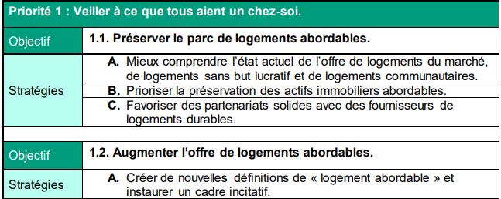
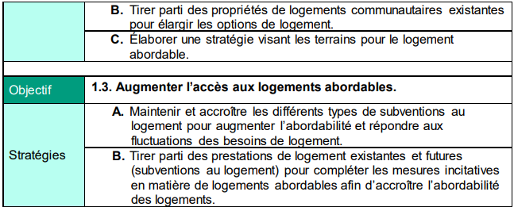
Strategies Under Goal 1
Notes:
Strategies, tactics and actions are what identifies how we’ll achieve our goals (3rd part of the plan)
Re: mix of strategies, there are:
8 strategies under the 3 objectives in Goal 1 (current slide)
5 strategies under the 3 objectives in Goal 2 (next slide)
5 strategies under the 2 objectives in Goal 3 (next slide)

Slide 12
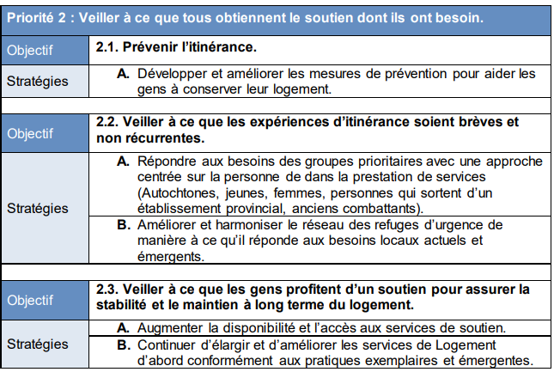
Strategies Under Goal 2

Slide 13
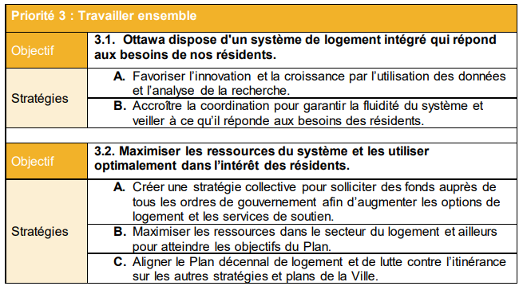
Strategies Under Goal 3

Slide 14
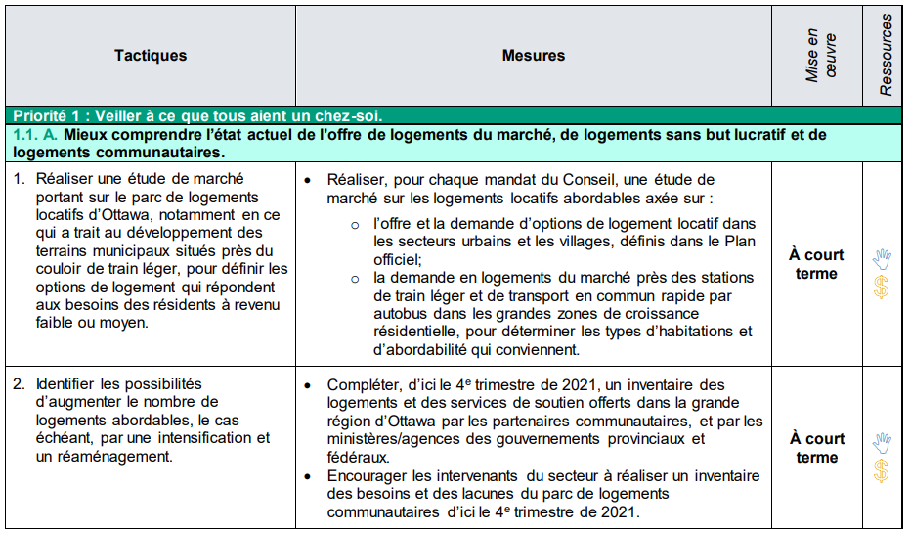
Tactics & Actions (Examples)
Notes:
In addition to the set of strats, there are tactics that and actions developed for each strategy organized by term (short (1-2yrs), medium (3-5 yrs) and long term (5-10)) and whether resources are required to implement the tactics/actions (new financial resources required (to study/review/implement the action); partnership and collective resources/commitment from others required; legislative/regulation/policy changes required
Series of tactics for each strategcy
mmitment of others required; and/or change in legislation, regulation and/or policy required.

Slide 15

Reporting on Progress
The City needs to report to the Province on 10-Year Plan progress annually
Progress Reports are available on Ottawa.ca
Progress Reports include updates on the 10-Year Plan targets and covers what’s happening within the housing and homelessness sector

Slide 16
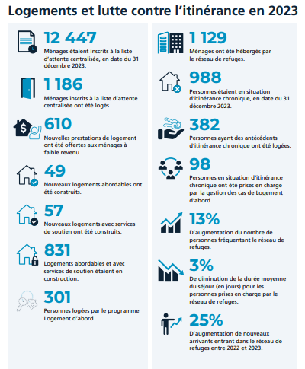
2023 Progress Report
34-page report organized by the 3 overarching goals to demonstrate progress made during the 2023 calendar year
Includes information about changing context and new opportunities that have emerged
Key accomplishments are showcased by housing and homelessness service area
Notes:
Speak to digestible visual nature of Progress Report – data but also pictures and success stories
2023 context touched on increasing rents, higher interest rates and steep inflation, opiod crisis, increase in unsheltered homelessness, and influx of newcomers.
2023 opportunities focused on collaboration with partners to create new strategies and initiatives including ITHS, EHAB, new transitional housing facilities, supportive housing community hub, and HHLT
Service area: ie: Goal 1 – community housing, affordable and supportive housing development, supportive housing, residential services homes, rooming houses. Goal 2: homelessness programs and housing first, community shelters, indigenous housing and homelessness. Goal 3: ITHS, Governance Review, Community Capacity Building Training, Data Improvements
Shot at right is the ‘executive summary’ or ‘highlights reel’ of the Progress Report

Slide 17
10-Year Plan Refresh: Project Phases
Current State Assessment
Point-in-Time Count
Housing Needs Assessment
Learnings from recent consultations
Consultation
Sector
People with lived experience
Members of Council
City staff
Public
Strategy Development
Vision, mission & goals
Objectives, targets & measures
Draft and revise plan
Implementation plan
Implementation
Present Plan to Council
Disseminate Plan
Implement Plan
Monitor Plan
Q1
Q 2-3
Q 2-4
2026

Slide 18

Questions

