Slide 1
EAL Nexus Resource
At the seaside
Flashcards
Subject(s): | Geography
Key Stage: | KS1
Topic: | Seaside

Slide 2
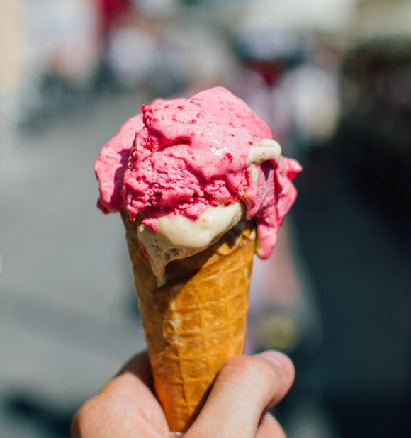
an ice cream

Slide 3
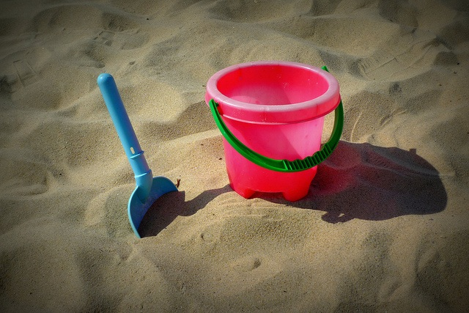
a bucket and spade

Slide 4
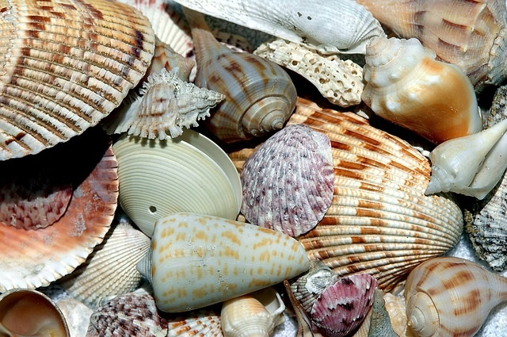
some seashells

Slide 5
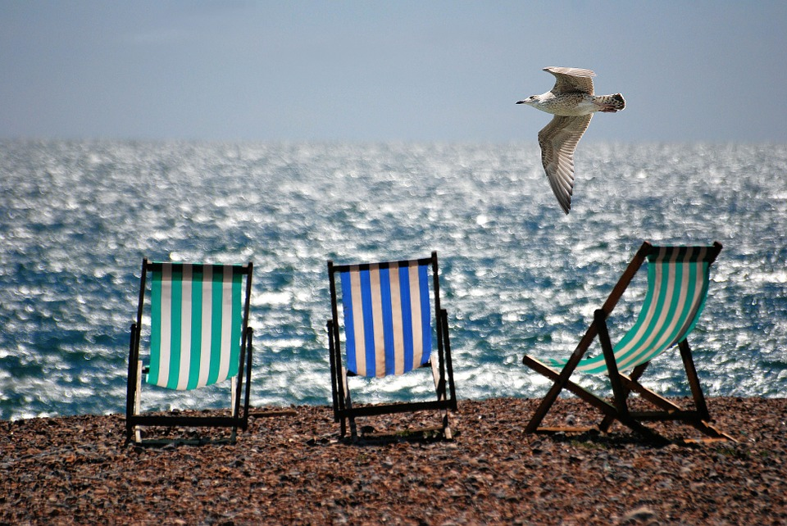
some deckchairs

Slide 6
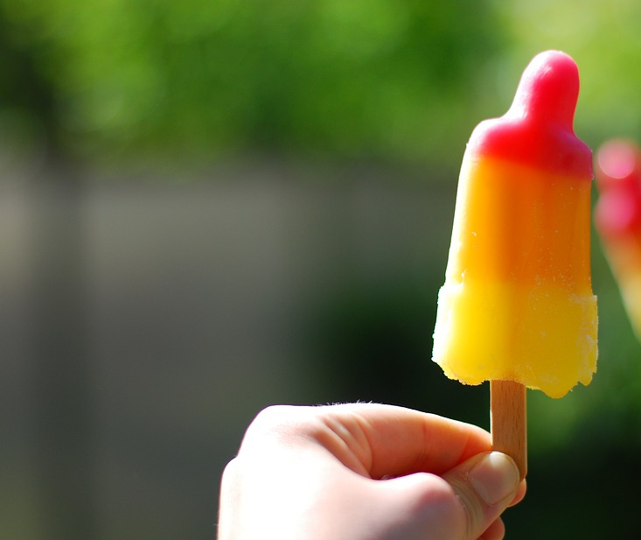
an ice lolly

Slide 7
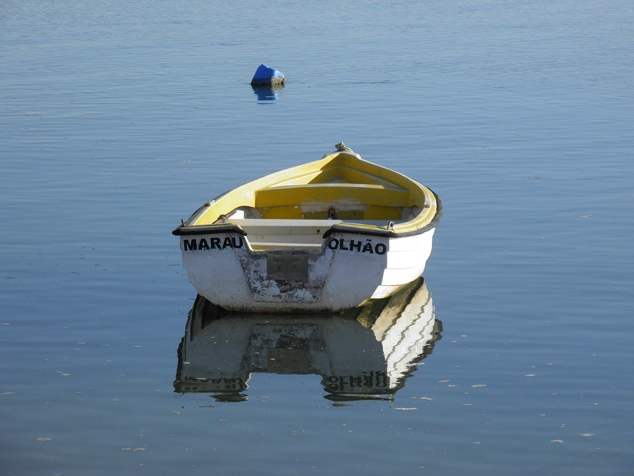
a boat

Slide 8
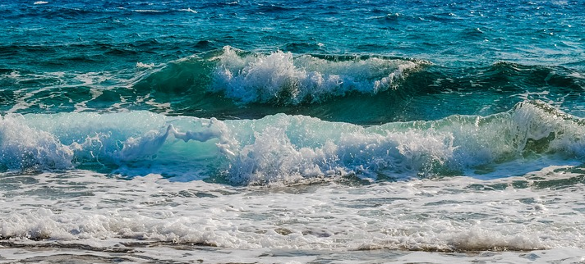
the waves

Slide 9
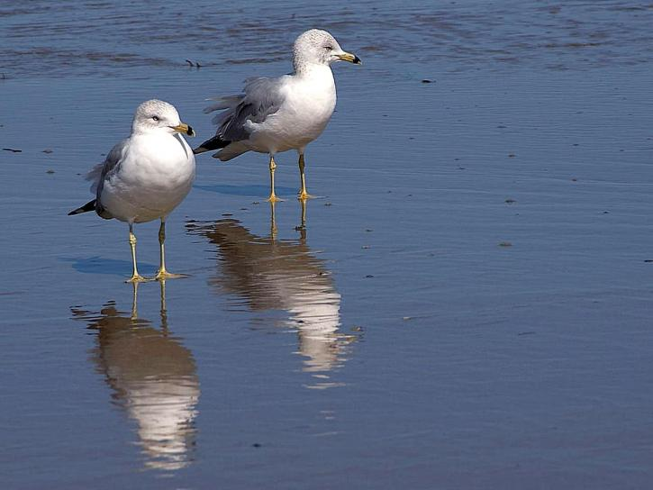
the seagulls

Slide 10
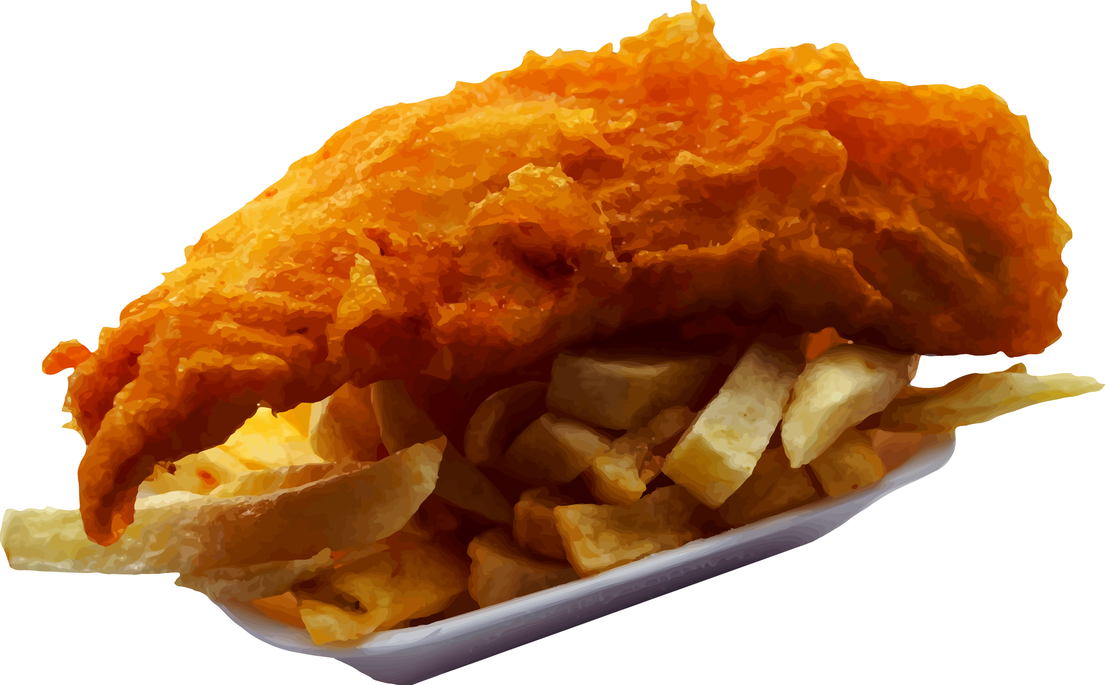
some fish and chips

Slide 11
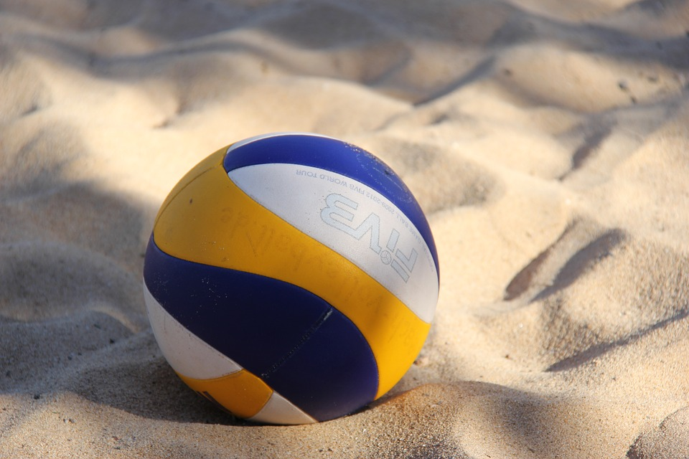
a ball

Slide 12
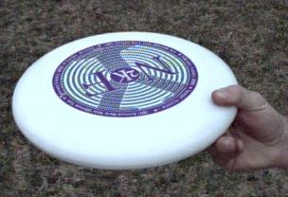
a frisbee

Slide 13
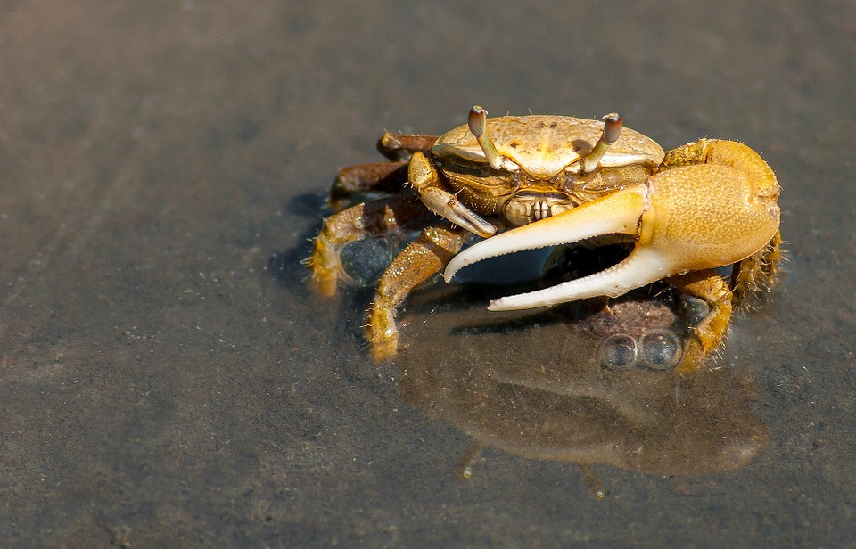
a crab

Slide 14
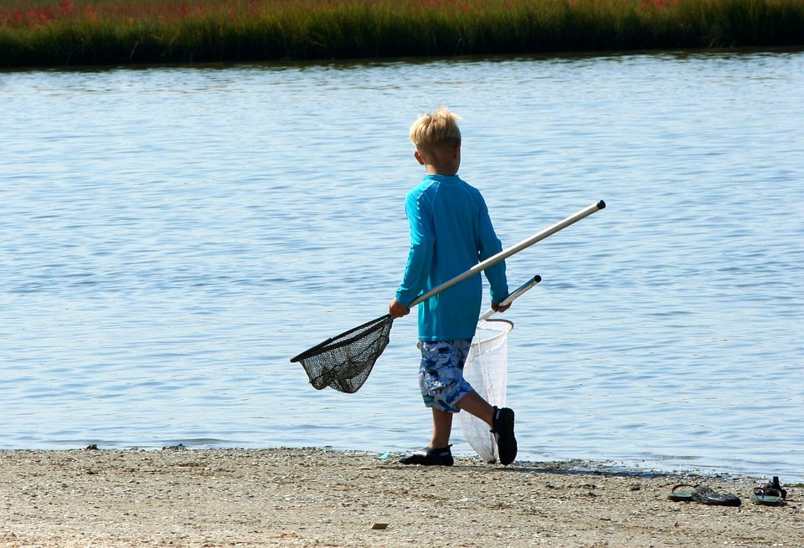
a fishing net

Slide 15
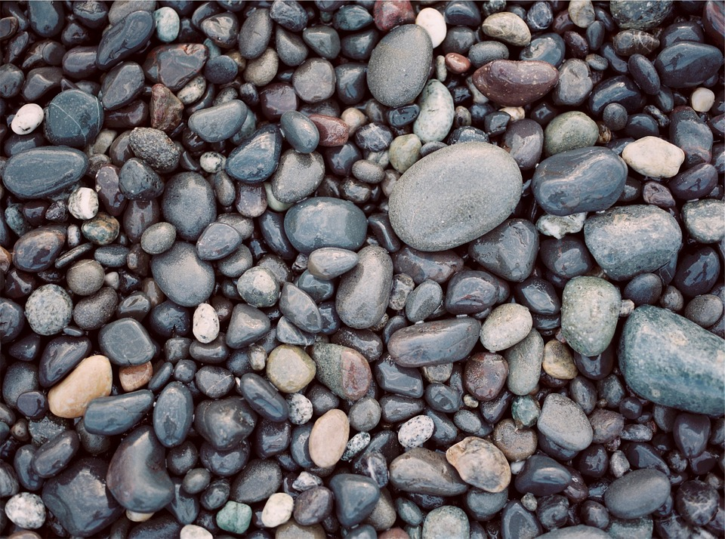
some pebbles

Slide 16
Things I will see
Things I will eat
Things I will play with

Slide 17
Image attributions
Ice cream: https://www.pexels.com/photo/food-ice-cream-ice-cream-cone-8374/ by Tookapic, CCO, no attribution required
Bucket and spade: https://www.flickr.com/photos/foilman/6977728792 by Henry Burrows, CCO via Flikr, with permission to use if attributed.
Seashells: https://pixabay.com/en/sea-shells-shell-beach-shell-1886613/ by paulbr75, CCO via Pixabay, no attribution required
Deckchairs: https://pixabay.com/en/deckchairs-sea-beach-seaside-355596/ by Stevbidmead, CCO via Pixabay, no attribution required
Ice lolly: http://maxpixel.freegreatpicture.com/Play-Rocket-Ice-Lolly-1429151 by Max Pixel, CCO, public domain.
Boat: https://pixabay.com/en/boat-small-boat-tender-faro-olhao-1785895/ by Realme, CCO via Pixabay, no attribution required
Waves: https://pixabay.com/en/waves-foam-spray-water-sea-blue-2769735/ by demitrisvetsikas, CCO via Pixabay, no attribution required
Seagulls: https://pixnio.com/fauna-animals/birds/seagull-bird-pictures/seagulls-at-ocean-beach by Jon Sullivan, CCO via Pixnio. Public domain.
Fish and chips: https://www.goodfreephotos.com/vector-images/fish-and-chips-vector-clipart.png.php by Firkin, CCO in public domain.
Ball: https://pixabay.com/en/volleyball-sport-team-sport-2639700/ by wolfganggerth CCO via Pixabay, no attribution required
Frisbee: https://commons.wikimedia.org/wiki/File:Frisbee-forehand-top.jpg by Jot Powers, CCO, with permission to re-use
Crab: https://pixabay.com/en/crab-crustacean-sea-ocean-water-79156/ by 12019, CCO via Pixabay, no attribution required
Fishing net: https://pixabay.com/en/fishing-nets-crabbing-youth-boy-60142/ by JamesDeMers, CCO via Pixabay, no attribution required
Pebbles: https://pixabay.com/en/rocks-stones-pebbles-nature-691717/ By Free-photos Cco via Pixabay no attribution required

