Slide 1

EAL Nexus Resource
Coastal towns
Flashcards
Subject(s): | Geography
Key Stage: | KS2
Topic: | Coastal towns
© Bell Educational Trust 2020
This resource was originally developed by L. Webster and has been adapted for EAL Nexus.

Slide 2
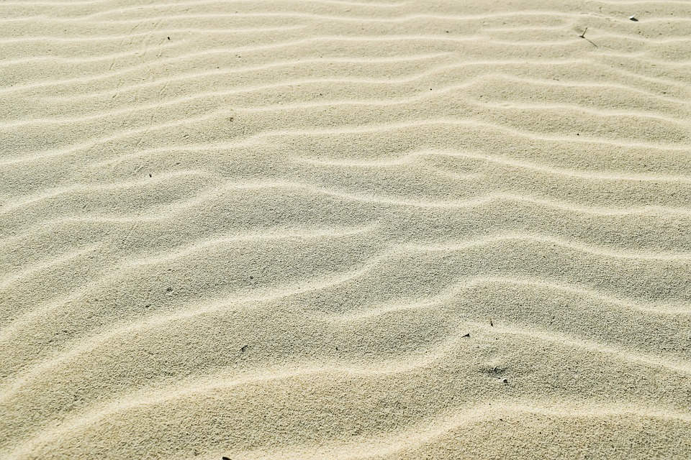
sand

Slide 3
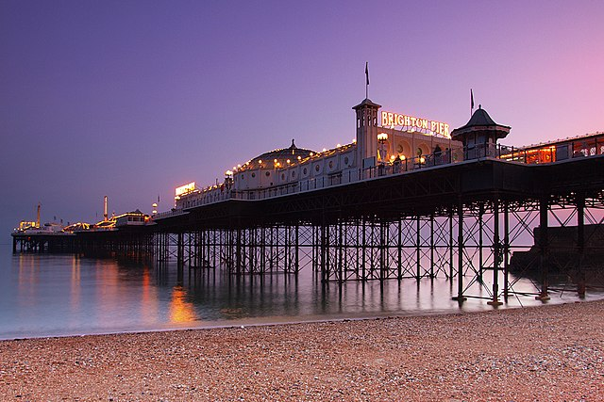
a pier

Slide 4
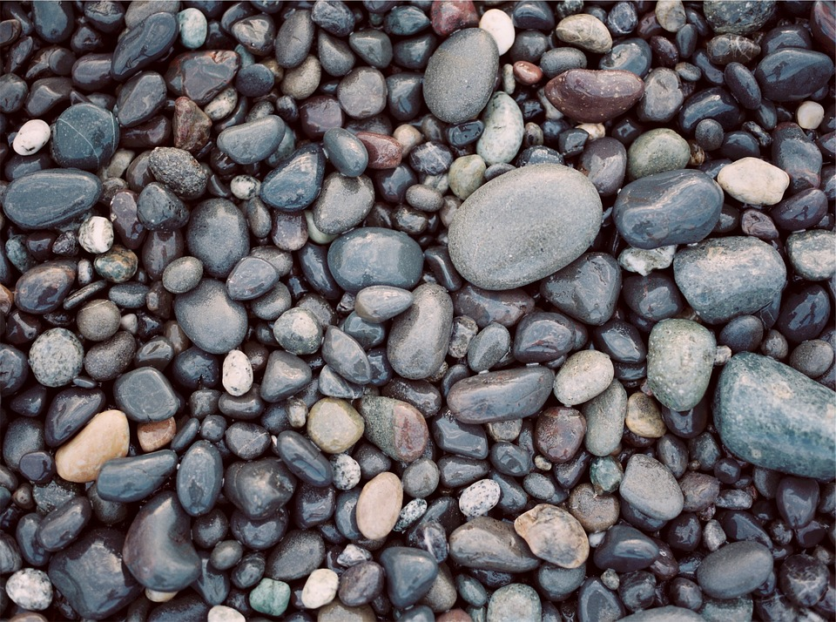
pebbles

Slide 5
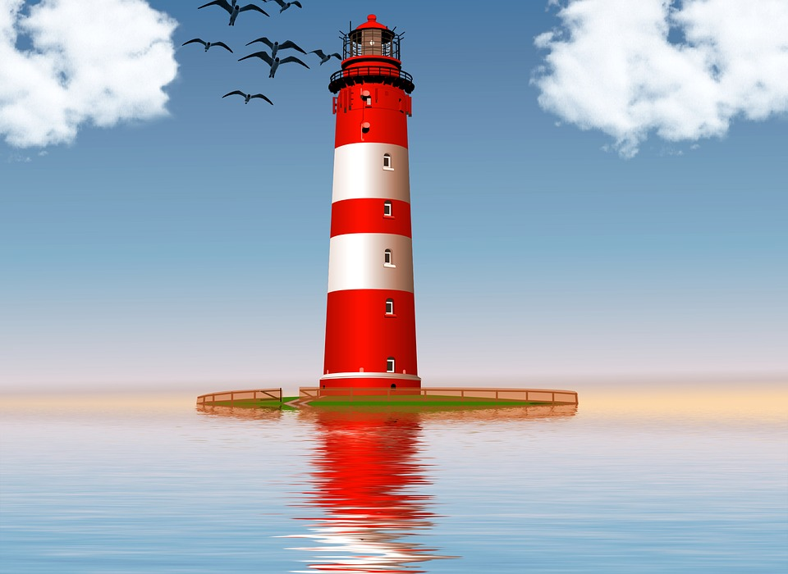
a lighthouse

Slide 6
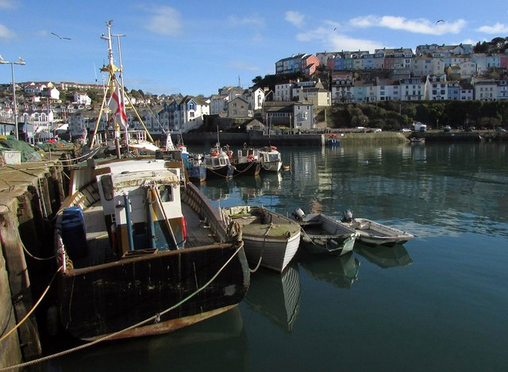
a harbour

Slide 7
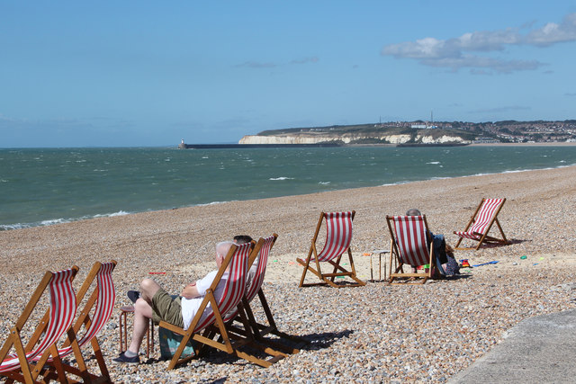
a beach

Slide 8
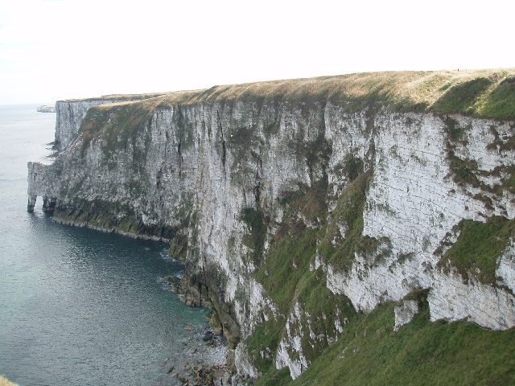
cliffs

Slide 9
Image attributions
Appendix – Images in this resource
1.Sand
Sand Waves Beach Dunes
https://pixabay.com/en/sand-waves-beach-dunes-2050026/
By Dmitrisvetsikas1969 https://pixabay.com/users/dimitrisvetsikas1969-1857980/
Available under Pixabay Licence. For more information see https://pixabay.com/service/license/
2. Pier
Nice clear evening. Used a Hitech 0.9 Hard GND to hold back the Pier lights. https://commons.wikimedia.org/wiki/File:Brighton_Pier_at_dusk.jpg
By hozinja (https://commons.wikimedia.org/wiki/User:BaldBoris
Available under CC BY 2.0 License. For more information see http://creativecommons.org/licenses/by/2.0
3. Pebbles
Rocks Stones Pebbles Nature Tranquil Meditation
https://pixabay.com/en/rocks-stones-pebbles-nature-691717/
By Free-photos https://pixabay.com/users/free-photos-242387/
Available under Pixabay Licence. For more information see https://pixabay.com/service/license/
4. Lighthouse
Lighthouse Ocean Sea Red White Architecture Light
https://pixabay.com/p-1227177/?no_redirect
By Kalhh Cco https://pixabay.com/users/kalhh-86169/
Available under Pixabay Licence. For more information see https://pixabay.com/service/license/

Slide 10
Image attributions
Appendix – Images in this resource
5. Harbour
Brixham Harbour From the base of New Pier (left), looking across to King's Quay and the Custom House. http://www.geograph.org.uk/photo/5296766
By Derek Harper https://www.geograph.org.uk/profile/5089
Available under CC BY-SA 2.0 License. For more information see http://creativecommons.org/licenses/by/2.0
6. Deck chairs at Seaford Beach
Deck chairs at Seaford Beach http://www.geograph.org.uk/photo/5110017
By Oast House Archive https://www.geograph.org.uk/profile/10354
Available under CC BY-SA 2.0 License. For more information see http://creativecommons.org/licenses/by/2.0
7. Bempton Cliffs
Bempton Cliffs. Tide retreating, approx. 3 hrs to low tide. http://www.geograph.org.uk/photo/45067
By Tony Lumb https://www.geograph.org.uk/profile/2044
Available under CC BY-SA 2.0 License. For more information see http://creativecommons.org/licenses/by/2.0

