Slide 1

EAL Nexus Resource
Coastal towns
Pictures of coastal towns
Subject(s): | Geography
Key Stage: | KS2
Topic: | Coastal towns
© Bell Educational Trust 2020
This resource was originally developed by L. Webster and has been adapted for EAL Nexus.

Slide 2
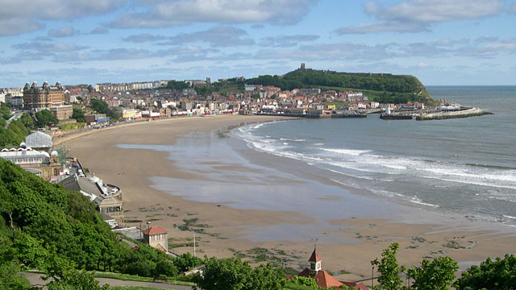
Scarborough

Slide 3
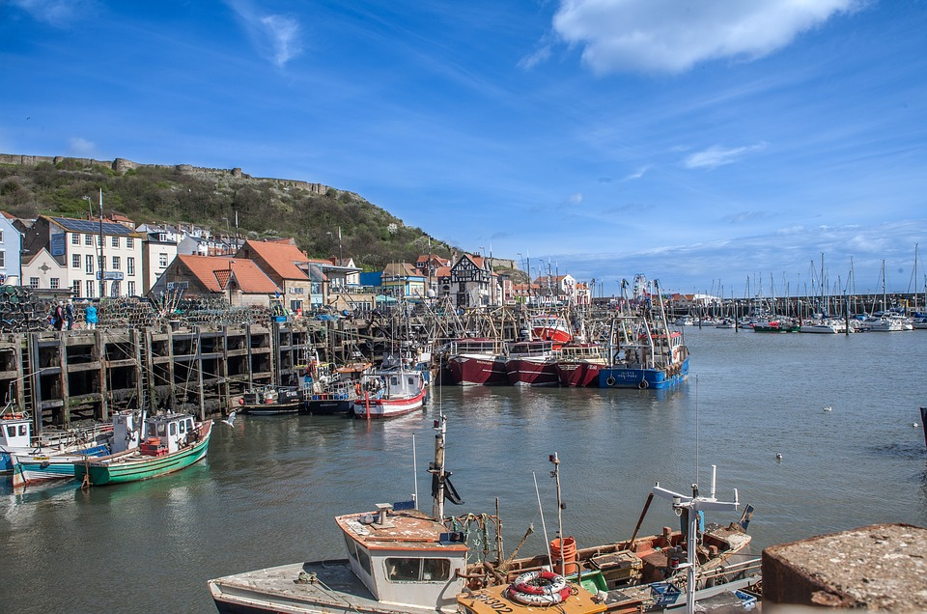
Scarborough

Slide 4
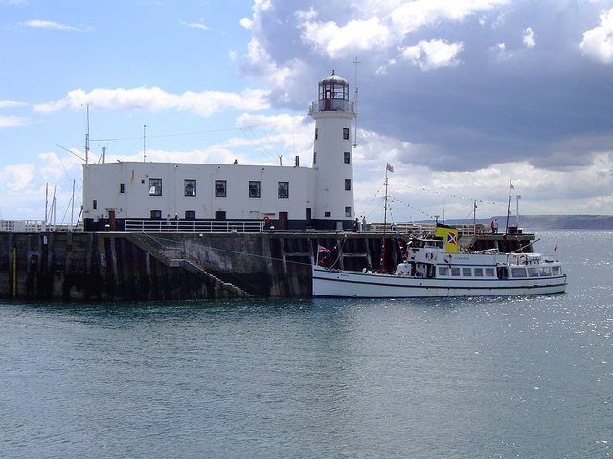
Scarborough

Slide 5
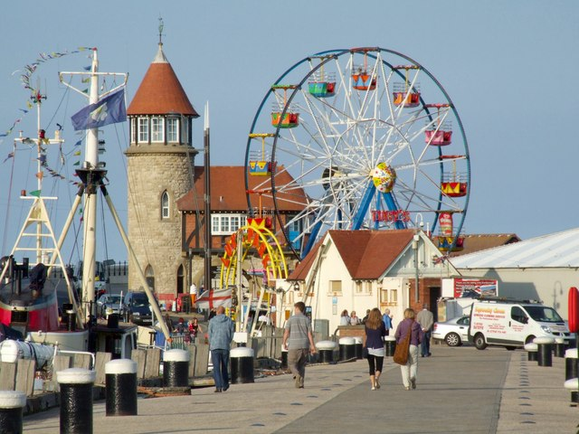
Scarborough

Slide 6
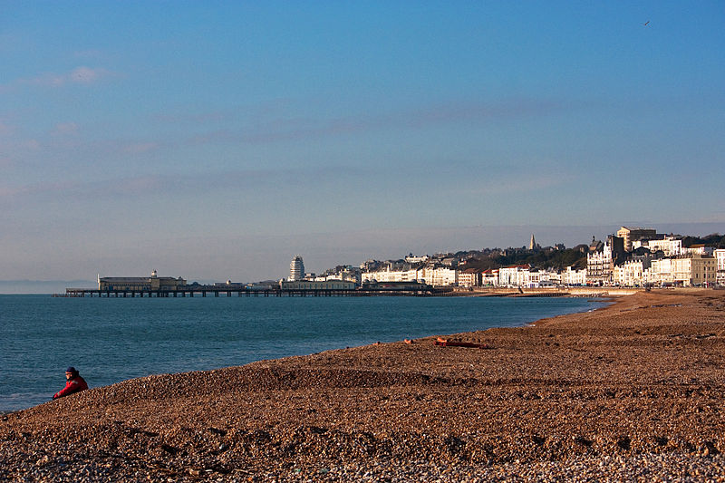
Hastings

Slide 7
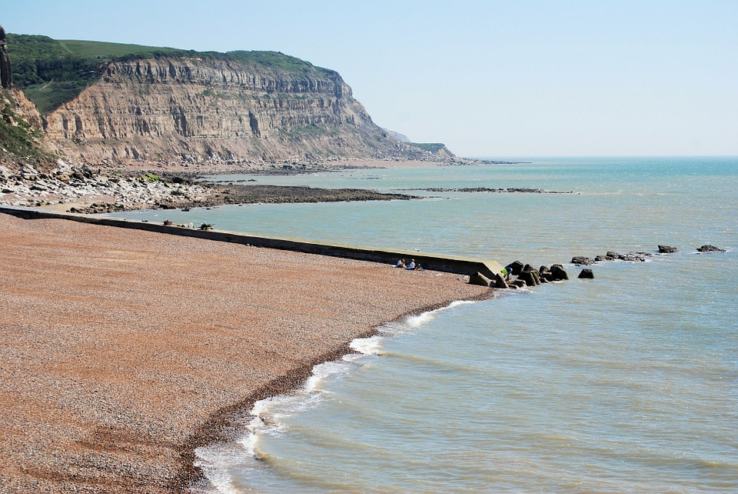
Hastings

Slide 8
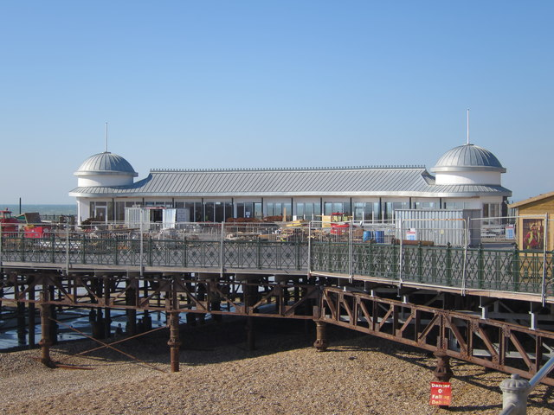
Hastings

Slide 9
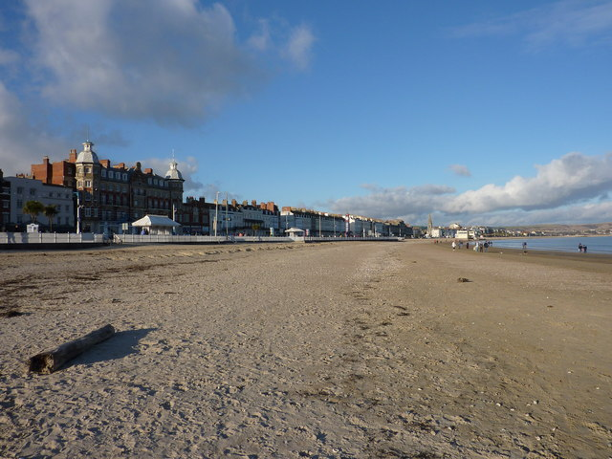
Weymouth

Slide 10
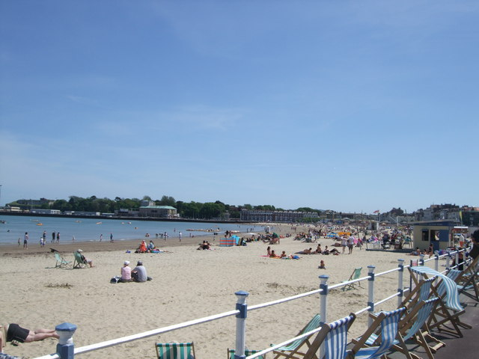
Weymouth

Slide 11
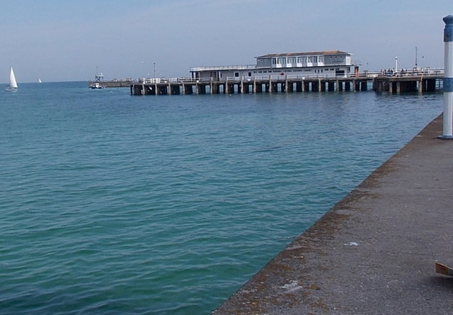
Weymouth

Slide 12
Image attributions
Appendix – Images in this resource
Scarborough South Bay from the Esplanade
Scarborough South Bay from the Esplanade http://www.geograph.org.uk/photo/384321
by Sheila Tarleton https://www.geograph.org.uk/profile/12900
Available under CC BY-SA 2.0 License. For more information see https://creativecommons.org/licenses/by-sa/2.0/
2. Scarborough
Scarborough Seaside Sea Resort England Yorkshire https://pixabay.com/p-2224173/?no_redirect
By funky-noodle https://pixabay.com/users/funky-noodle-4623189/
Available under Pixabay License. For more information see https://pixabay.com/service/license/
3. Scarborough Lighthouse
Scarborough Lighthouse http://www.geograph.org.uk/photo/191980
By Scott Robinson https://www.geograph.org.uk/profile/5892
Available under CC BY-SA 2.0 License. For more information see https://creativecommons.org/licenses/by-sa/2.0/
4. Old Pier, Scarborough
Old Pier, Scarborough. The piers are a pleasurable walk, but do make sure you have children under control as there are no railings and it's a long drop into the water. A view of the Amusement Park and former Toll House. http://www.geograph.org.uk/photo/2066383
By Dave Hitchborne https://www.geograph.org.uk/profile/4330
Available under CC BY-SA 2.0 License. For more information see https://creativecommons.org/licenses/by-sa/2.0/

Slide 13
Image attributions
Appendix – Images in this resource
5. Hastings, Sussex, England
Hastings, Sussex, England : https://commons.wikimedia.org/wiki/File:Hastings,_Sussex,_England-16Dec2009.jpg
By Mark Robinson https://www.flickr.com/photos/66176388@N00
Available under CC BY 2.0 License. For more information see: https://creativecommons.org/licenses/by/2.0/deed.en
6. New café, Hastings Pier
New café, Hastings Pier. Work continues on the pier restoration. The only remaining building before the fire has been restored and converted to a café. http://www.geograph.org.uk/photo/4681542
By Oast House Archive https://www.geograph.org.uk/profile/10354
Available under CC BY-SA 2.0 License. For more information see https://creativecommons.org/licenses/by-sa/2.0/
7. Weymouth Beach in Winter
Weymouth Beach in Winter Showing Gloucester Lodge prominently. https://commons.wikimedia.org/wiki/File:Weymouth_Beach_in_Winter_-_geograph.org.uk_-_1803394.jpg
By Ivan Hall https://www.geograph.org.uk/profile/38466
Available under CC BY-SA 2.0 License. For more information see https://creativecommons.org/licenses/by-sa/2.0/

Slide 14
Image attributions
Appendix – Images in this resource
8. Weymouth Beach
Weymouth Beach. Viewed from near the Royal Hotel looking south towards the pier and harbour http://www.geograph.org.uk/photo/2968961
By Paul Gillett https://www.geograph.org.uk/profile/36675
Available under CC BY-SA 2.0 License. For more information see https://creativecommons.org/licenses/by-sa/2.0/
9. Weymouth Pleasure Pier
Weymouth Pleasure Pier http://www.geograph.org.uk/photo/4607114
By Jaggery https://www.geograph.org.uk/profile/39302
Available under CC BY-SA 2.0 License. For more information see https://creativecommons.org/licenses/by-sa/2.0/

