Slide 1

EAL Nexus Resource
Local environment
Flashcards
Subject(s): | Geography
Key Stage: | KS1
Topic: | Local environment
© Bell Educational Trust 2020
This resource was originally developed by L. Webster and has been adapted for EAL Nexus.

Slide 2
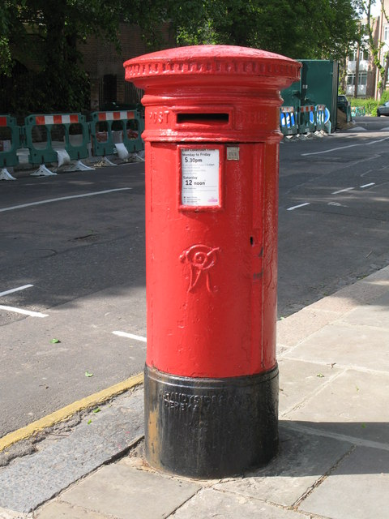
post box

Slide 3

traffic lights

Slide 4
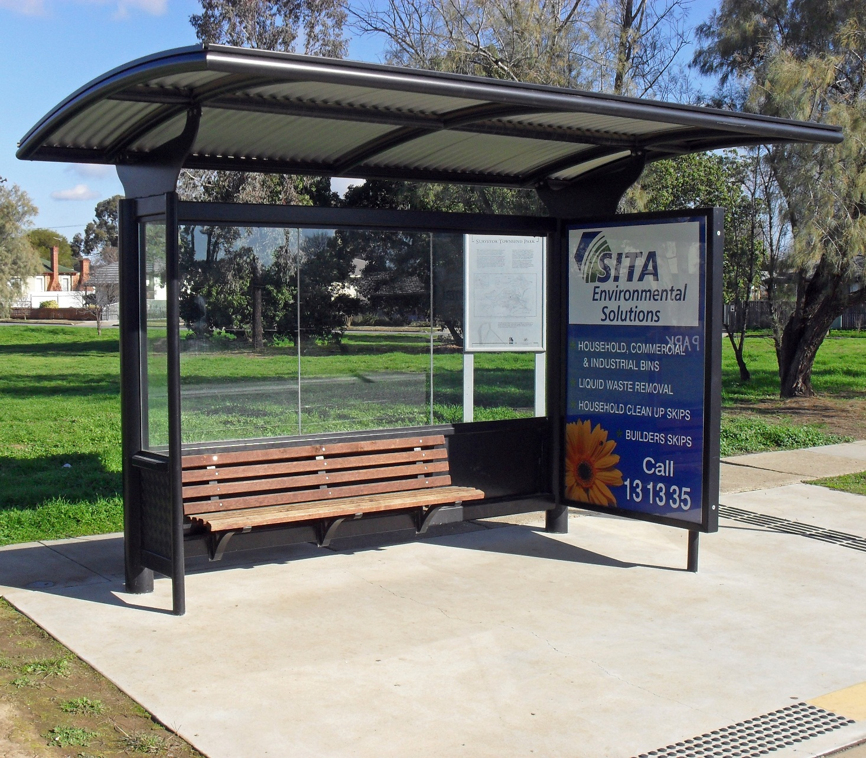
bus stop

Slide 5
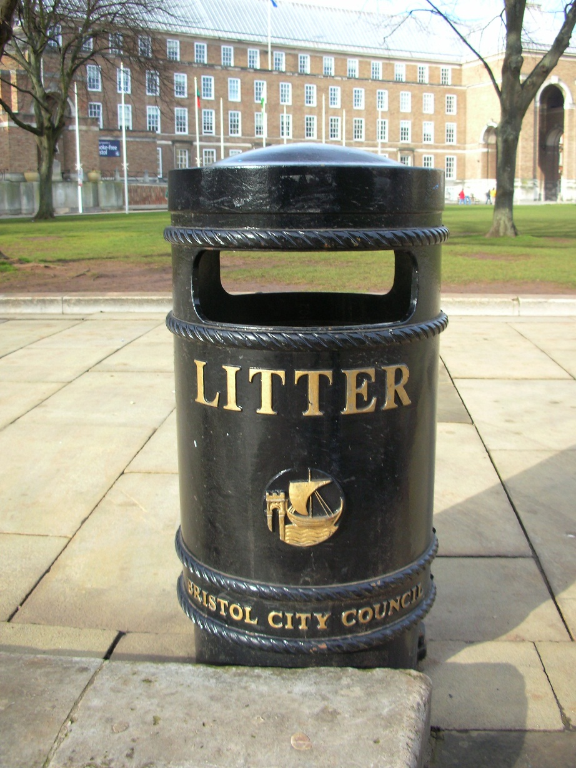
bin

Slide 6
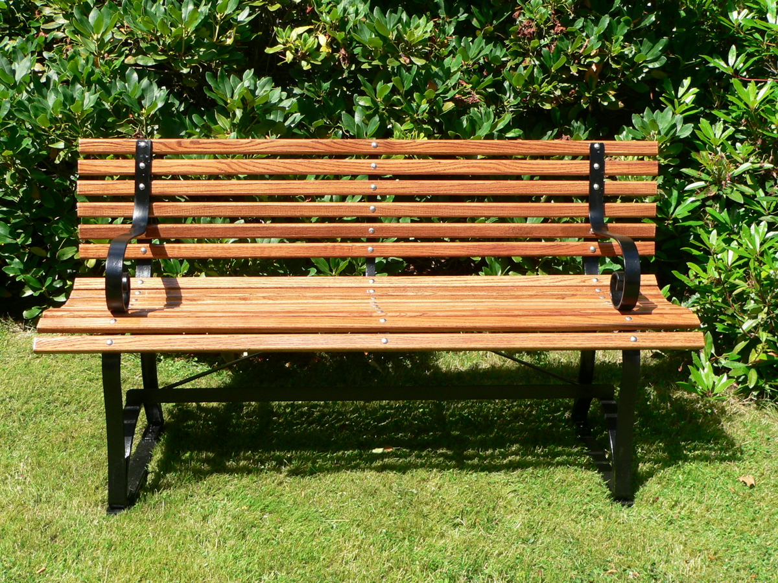
bench

Slide 7
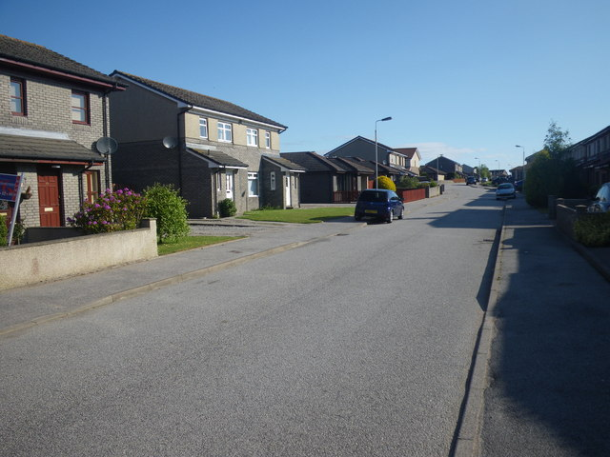
road

Slide 8
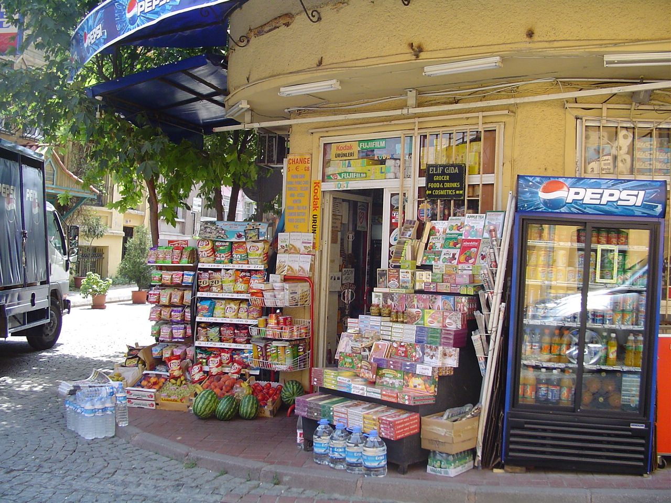
shop

Slide 9
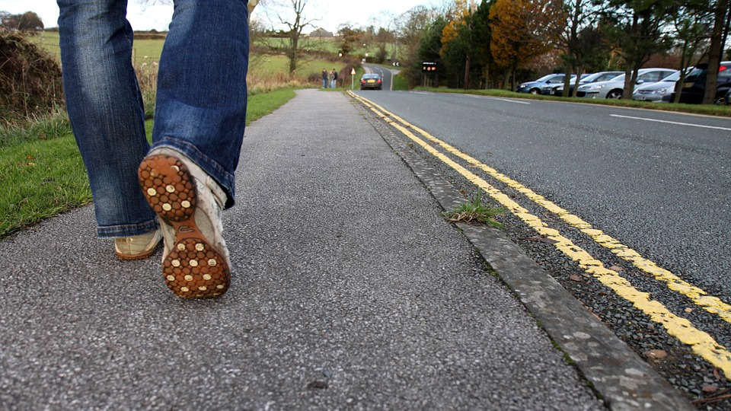
pavement

Slide 10
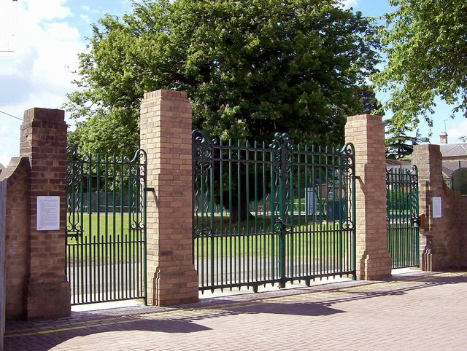
gate

Slide 11
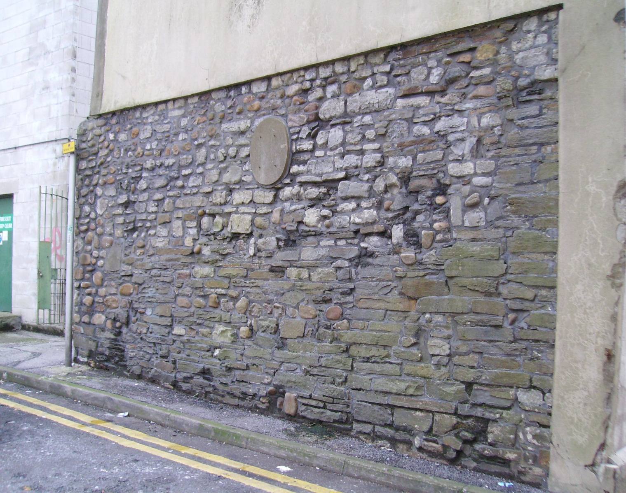
wall

Slide 12
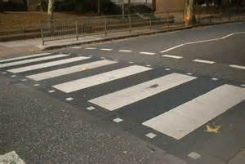
zebra crossing

Slide 13
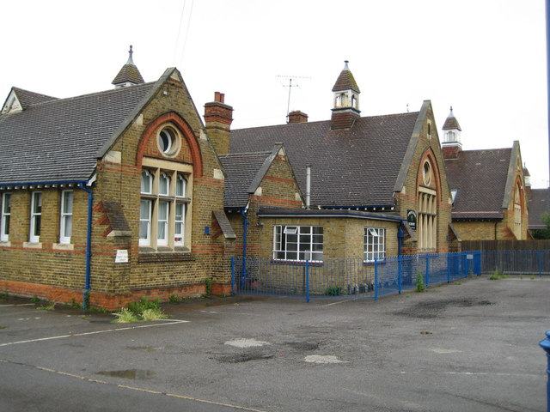
school

Slide 14
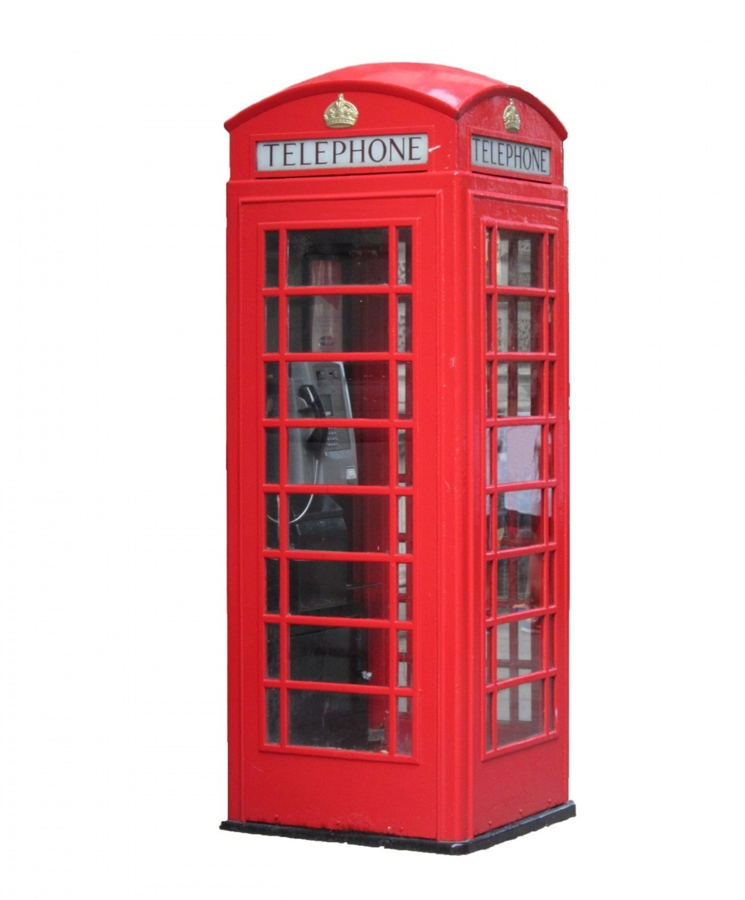
phone box

Slide 15
Image attributions
Post box: http://www.geograph.org.uk/photo/1404615 by Mike Quinn licenced for re-use via creative commons
Traffic lights: https://commons.wikimedia.org/wiki/File:Traffic_light_red.png By TheGoTeam (Own work) [Public domain], via Wikimedia Commons
Bus stop: https://commons.wikimedia.org/wiki/File:Bus_stop_shelter.jpg By Bidgee (Own work) [CC BY-SA 3.0 (http://creativecommons.org/licenses/by-sa/3.0)], via Wikimedia Commons.
Litter bin: https://commons.wikimedia.org/wiki/File:Litter_Bin_in_Bristol.jpg Author unknown but permission given [GFDL (http://www.gnu.org/copyleft/fdl.html) or CC-BY-SA-3.0 (http://creativecommons.org/licenses/by-sa/3.0/)], via Wikimedia Commons
Bench: https://en.wikipedia.org/wiki/Bench_(furniture) By James F Perry, creative commons
Road: http://www.geograph.org.uk/photo/2451038 C. Michael Hogan licensed for re-use via creative commons
Shop: https://commons.wikimedia.org/wiki/File:Street_corner_shop_Istanbul_(2831712575).jpg By mwanasimba from La Réunion (Street corner shop Istanbul) [CC BY-SA 2.0 (http://creativecommons.org/licenses/by-sa/2.0)], via Wikimedia Commons
Pavement: https://pixabay.com/en/walk-shoes-shoe-leg-pavement-2021/ public domain via Pixabay
Gate: http://www.geograph.org.uk/photo/4327269 By Rex Needle, licensed for reuse under creative commons
Wall: https://en.wikipedia.org/wiki/Cardiff_town_walls By Seth Whales (Own work) [Public domain], via Wikimedia Commons
Zebra crossing: https://commons.wikimedia.org/wiki/File:Zebra_crossing.jpg By The original uploader was Secretlondon at English Wikipedia (Transferred from en.wikipedia to Commons.) [CC BY-SA 1.0 (http://creativecommons.org/licenses/by-sa/1.0), GFDL (http://www.gnu.org/copyleft/fdl.html) or CC-BY-SA-3.0 (http://creativecommons.org/licenses/by-sa/3.0/)], via Wikimedia Commons
School: http://www.geograph.org.uk/photo/913225 By Nigel Cox, licensed for re-use via creative commons.
Phone box: http://www.publicdomainpictures.net/view-image.php?image=70128&picture=red-phone-box By Karen Arnold, public domain.

