Slide 1





Farmland Protection in Sullivan County
Credit: NYS Department of Agriculture & Markets

Slide 2
Community Preservation
How to protect and preserve critical lands in your County & Its Towns

Slide 3
Options for Community Preservation
General Taxation
Bonding
Home Rule Legislation for your Town
Federal, State, County, Land Trust ( all only offer partial funding )
Hudson Valley Community Preservation Act Inclusion By the County

Slide 4
General Taxation or Bonding
Your Town Boards can raise taxes as part of their budgets to acquire easements. The Town of Montgomery ( Orange Co.) did this early in 2000.
Bonding is also a method which generally is subject to a permissive referendum, however if the Town Board wants the residents to decide, especially if it is a large bond, they can always place the decision on the ballot.
Warwick (Orange Co.) got voter approval in 1998 to borrow $9.5 million for farmland preservation.

Slide 5
Home Rule Legislation for a Real Estate Transfer Tax
(for those not in the HVCPA)
Submit a home rule request to your Senator and Assemblyperson with accompanying board resolution
Stay attentive to how it is or isn’t moving through legislative committees.
Work with your State reps to get it to the floor and then to the governor, hope she signs it. Need support of your representatives
If the Governor signed, develop a Community Preservation Plan and place before their voters in a referendum. Best to do this at the November general election.
The Town of Chester, Orange County, was successful in 2025 after 4 years of trying. This route takes long term commitment and stamina from the municipal board.

Slide 6
Hudson Valley Community
Preservation Act
Enacted in 2006, amended in 2019
The County submits a home rule request to be included. Follows same process as you would do individually. Why do this? Once your County is included, any municipality in that county automatically has the right to prepare a Community Preservation Plan and place the issue to impose a Real Estate Transfer Tax on the ballot for a vote by your residents.
Ulster County was included in 2020 and since then four (4) Towns & the City of Kingston have implemented it with another working towards a referendum in 2026.
Having your County included in the HVCPA lets the Municipality focus on developing a thoughtful Community Preservation Plan and an effective campaign to pass a referendum

Slide 7
Why is it important to be included in the Community Preservation Act?
Having a dedicated source of funding makes a Town more likely to be successful in leveraging State and Federal grant funding. For Instance the NYS DAM or Federal NRCS grant rounds will provide 87.5%, 75% and 50% respectively to awardees.
  Example: An award from NYS for a conservation easement on a farm worth $1,000,000 would equal $750,000- $875,000 plus 75% of closing costs!
  Having a Community Preservation Plan and RETT ensures your community grows while respecting its environment, open space and working landscapes
  NYS DAM has just announced the next Farmland Protection Implementation Grant funding round

Slide 8
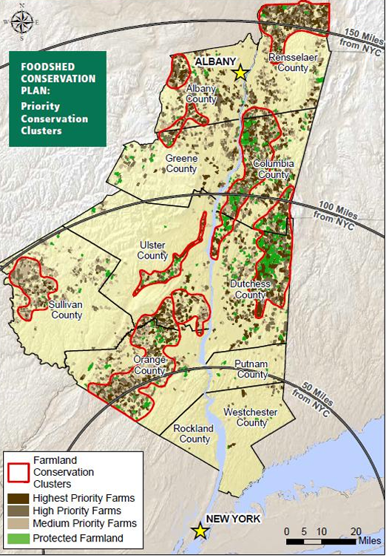
NYS Targets to Preserve Food Sources for its residents!

Slide 9
Issues for a successful Community Preservation Campaign
Opposition by Realtors & Developers who consider it an unnecessary burden diminishing their inventory
Prevents new home buyers from acquiring homes- In Warwick, Red Hook this has not been the case, the cost as with other closing costs fold into the mortgage and the value is maintained in the home
It’s a tax and legislators say they hate raising taxes– you are not imposing it, you are asking your municipalities' voters to vote on it, the essence of democracy
It hurts home values – just not true, in Warwick home values are consistently above the median sale price in Orange County, the preserved lands are a selling point used by realtors. Buyers value a community that has a great quality of life and preserves it for its residents

Slide 10
Next Steps
  The Sullivan County Legislature has passed a Home Rule Resolution requesting inclusion to the Hudson Valley Preservation Act. This will initiate a Bill in the 2026 NYS legislative session
  Sullivan County’s State Senator P. Oberacker and Assembly members P. Kay & B. Maher would need to sponsor and champion the bill in the 2026 session.
  Bills introduced: A09411 and S08938
  Political support will be needed to ensure the Governor signs the bill once passed by the Legislature
  No monetary cost to the County and no mandate to your municipalities to pursue enacting a RETT in their jurisdictions- the decisions are left to local government and the voters of that jurisdiction.

Slide 11
If Successfully passed in Albany
Each Town and its residents would need to prepare a Community Preservation Plan. If protecting farmland is your primary goal than your farmland parcels would be listed in the plan. These would then become eligible for use of the transfer tax receipts. Areas where you want to see development occur would not be listed in the plan and would not be eligible for these funds.
The Town and its residents set an amount of the tax up to 2% (most communities set it between 1 to 1 ½%) with an exemption of the Median Sale Price of a home in Sullivan County each year.
A town-wide referendum is held before the law can take effect.

Slide 12
What does successfully establishing a CPF mean for your Town
  Your Town creates a Community Preservation Plan which spells out the rational for imposing the RETT
    The Plan lists all parcels to potentially be preserved
    It documents your natural resources, viable farmland, potential recreational areas and other critical environmental resources
    The HVCPA allows up to a 2% tax on any land transfer within the town’s boundaries with specified exemptions- most towns have imposed between ¾ to 1 ½%
    Only the amount over the median sale price of a home in the County is subject to the tax
    The tax is paid by the buyer- someone coming to the beautiful community its residents have stewarded through generations

Slide 13
Example of a Hypothetical Example for
Sullivan County
Assume a 1 ½% Transfer tax by a SC community
2025 Median Sale price of a home in Sullivan County- $342,000
A home sells for $450,000
The HVCPA transfer tax would apply to the amount over the median price or $450,000-342,000 = $108,000
Transfer tax receipt would be $108,000 x .015 = $1,620
Not a burdensome sum to be asked of someone coming to live in the attractive community you have built with your tax dollars and hard work!

Slide 14
What Can be Protected with Proceeds from a Community Preservation Fund?
Only parcels identified in your Community Preservation Plan
  Viable agricultural lands
  Establishment of parks, nature preserves or recreational areas
  Preservation of open space
  Preservation of lands of exceptional scenic value
  Preservation of fresh or saltwater marshes or other wetlands
  Preservation of aquifer recharge areas
  Preservation of undeveloped beachlands or shorelines
  Establishment of wildlife refuges
  Preservation of rivers in a natural state
  Preservation of public access to lands for public use
  Historic properties on the NYS Registry of Historic Places

Slide 15
How is this Accomplished?
  Outright purchase of the property
  Purchasing the “Development Rights” via a Conservation Easement
  Creating a “Transfer of Development Rights” program
  Any expenditure of funds must first be recommended by an appointed Community Preservation Advisory Board ( no elected officials allowed)
  A public hearing must be held by the Town Board
  An affirmative vote of the Town Board for the acquisition is required
  Up to 10% of the fund can be used to maintain the acquisition

Slide 16
Communities with Community Preservation Funds
  Five Towns on East End of Long Island- Suffolk County
  Town of Warwick – Orange County
  Town of Red Hook – Dutchess County
  Town of Chatham – Columbia County
  Town of New Paltz – Ulster county
  Town of Gardiner – Ulster County
  Town of Marbletown – Ulster County
  City of Kingston – Ulster County
  Town of Rochester- Ulster County
  Westchester & Putnam County are in the HVCPA and several Towns are preparing for referendums

Slide 17
Future Goals!
Continually look for further refinements of your Zoning Code.
Work at all levels of government to make farming more profitable - that’s what keeps farmers farming.
Include Sullivan County in the HVCPA

Slide 18
Is This a Wise Investment?
Our farms remain as working farms, paying taxes and contributing to our economy.
Our community receives the added benefit of preserving open space, watershed resources, and habitat for wildlife.
Real estate values in Warwick rose 45% higher than anywhere else in Orange County.

Slide 19
Don’t Take My Word For It
See the results!
Warwick has had a CPF since 2006 and the results are impressive:
  5000 acres of 40 active farms preserved, all still farming & paying taxes
  $18 million raised to date, leveraged to gain another $18 million from grants
  Preserved a historic site, the only public access site to a 9 mile bi-state lake, 2 public parks in two Villages, 100 acre watershed protection area and a former summer camp for public enjoyment.
  Real Estate prices not hurt by having a RETT contrary to naysayers:
    2008 - $370,000 vs $189,920
    2023 - $450,000 vs $247,840

Slide 20
More Results
Using Smart Growth Zoning techniques 100% of new subdivisions are clustered on 40% or less of the parcel developed
Less roads & infrastructure = savings to the municipalities
Vibrant farm economy leads to a vibrant Town!

Slide 21

Contact Information
Michael P Sweeton, Community Liaison
(845) 534-3690 x 7
Michael@oclt.org

