Slide 1


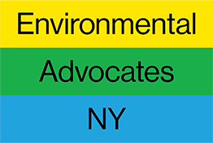
What’s Next for New York’s Climate Law
CLCPA Changes and Next Steps
August 13, 2026 Jon Binder, Executive Director
Model Climate Laws Initiative

Slide 2
Background – Key Provisions of OG CLCPA
Original law passed in 2019 during first Trump Administration
Included stringent greenhouse gas (GHG) emissions accounting methodology, focusing on methane emissions and natural gas, including:
  Twenty-year global warming potential (GWP20) rather than GWP 100, which emphasized short-term impacts of pollutants like methane
  Upstream out-of-state emissions from imported electricity and fossil fuels
  Direct carbon dioxide (CO₂) emissions from biogenic combustion
Established binding statewide emission reduction requirements
  40% reduction from 1990 levels by 2030
  85% reduction from 1990 levels by 2050

Slide 3
Selected Prior State Actions under OG CLCPA
Scoping Plan development over three years, including public process and finalization in December 2022
Adoption of various regulations to implement the law, including Statewide emission limits, mandatory GHG emissions reporting, and reductions of HFCs and SF6
Requirement to consider GHGs for individual permit decisions, including denial of permits for certain natural gas-fired power plants
Annual Statewide GHG Emissions Report (i.e., inventory)

Slide 4
Requirement to Regulate and Cap-and-Invest
Original CLCPA included obligation for DEC to promulgate regulations by Jan. 1, 2024 to ensure compliance with the Statewide GHG limits
Throughout 2023 and 2024, DEC and NYSERDA held extensive public stakeholder process and were developing a cap-and-invest program
In early 2025, Governor decided to not move forward with the program
A lawsuit led to a court decision that the delay violated the CLCPA
The court ordered DEC to issue overdue regulations, but instead, administration sought to change the law as part of the 2026 Budget

Slide 5
2026 Amendments – GHG Accounting
The 2026 amendments changed all 3 primary components of the CLCPA’s GHG accounting methodology:
GWP100 instead of GWP20 (i.e., methane shift)
Exclusion of upstream out-of-state emissions from imported fossil fuels from NY Statewide total
  *Retained upstream emissions from imported electricity*
Apparent treatment of biogenic combustion as zero CO₂ emissions
* Retained gross rather than net Statewide emission limits*

Slide 6
2026 Amendments – Limits and Regs
DEC implementing regulations are now not required until December 31, 2028 – a full five years after original deadline
40% by 2030 emission limit – while this remains in the law, DEC’s requirement to regulate is no longer explicitly tied to ensuring achievement with the 2030 target
Interim 60% by 2040 target – a new 2040 interim target is in the law, but with soft and flexible language re feasibility and cost-effectiveness, giving the administration a potential loophole

Slide 7
2026 Amendments – Other Changes
Increased disadvantaged community (DAC) clean energy investment requirement
  From previous 35% minimum/40% goal to 40% minimum/45% goal
Additional $1 billion to the Sustainable Future Fund (now $2 billion total)
Other relatively minor changes related to Scoping Plan update timing and considerations for DEC rulemaking

Slide 8
Impact of Changes – GHG Accounting
Significantly weakens overall ambition of CLCPA
Makes the State appear closer to targets on paper, without any reductions
Shrinks the emissions “pie” that the State is responsible for reducing
De-emphasizes methane and other short-lived pollutants
Makes natural gas appear less impactful in terms of GHG emissions
Depending on details of implementation, likely makes biogas appear less impactful in terms of GHG emissions
Notes:
According to State Energy Plan, under new accounting, State is already largely on target to achieve 60% reduction by 2040
→ Meaning the Act now calls for less emissions reductions
Potentially incentivizing and facilitating buildout of new gas infrastructure, such as pipelines and gas-fired power plants
→ Potentially incentivizing and facilitating increased use of renewable natural gas

Slide 9
OG CLCPA v. Conventional UNFCCC Accounting
Source: 2025 DEC Statewide GHG Emissions Report

Slide 10
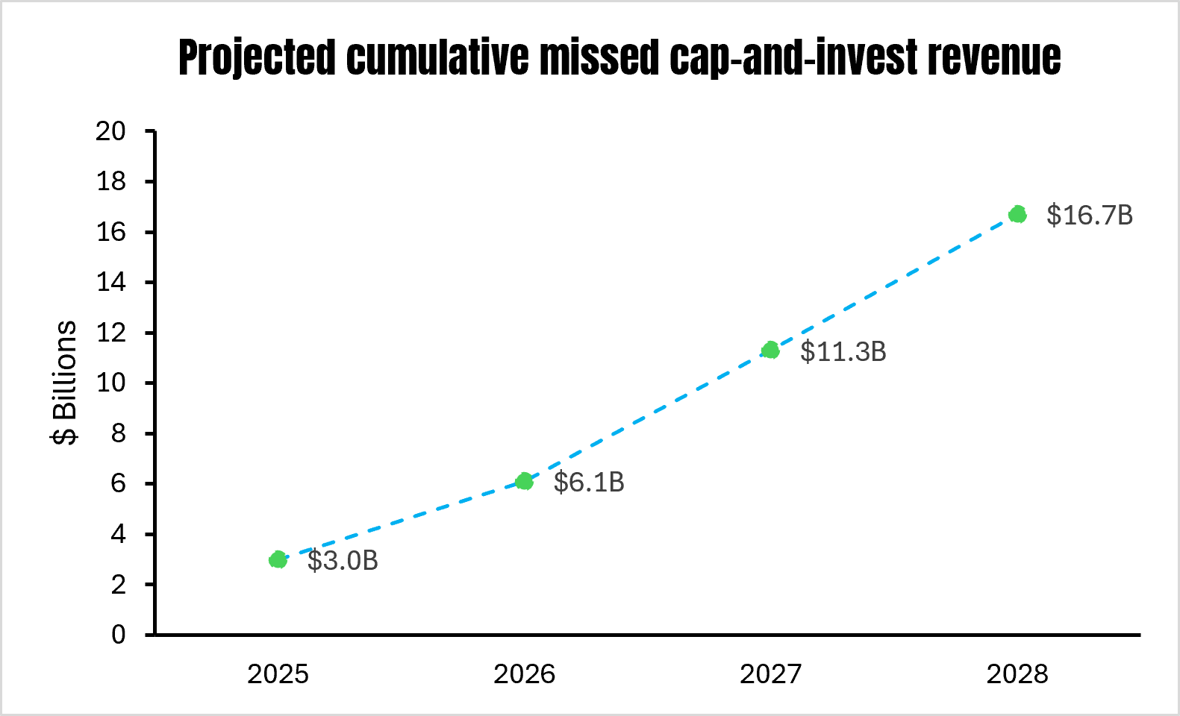
Impact of Changes – Limits and Regs
Delayed implementation of cap-and-invest until 2029 means missing out on public health, cost-savings, revenue, and other benefits
189,000 fewer drivers upgrade to EVs, missing out on up to $1,000 in saved annual fuel costs
145,000 homeowners don’t upgrade insulation, which would save $660 per year
73,000 less homes get heat pumps that could save $1,070 per year
Billions of dollars in lost clean energy investments, which would have supported 118,000 new jobs
Cap-and-invest would have provided $16.9 billion in public health benefits and over 1,500 avoided premature deaths
Source: Environmental Defense Fund

Slide 11
Summary of Emissions and Policy Impacts
Less GHG emission reductions
Reduced need for additional regulatory or policy action by the State
Less pressure to transition off natural gas; potential incentive for more biogenic fuel combustion
Further delay in implementation of cap-and-invest and other policies that will ensure emission reductions and generate necessary revenue
Rather than being a national leader in advancing climate policy, NYS is now a national leader in weakening a major state climate law and its binding emission limits
The changes do not do anything to address affordability – just the opposite

Slide 12
Next Steps and Opportunities
DEC and the State will need to reconsider or update certain regulations and policies that were based on the OG CLCPA
DEC and NYSERDA need to move quickly to develop and implement the Clean Air Initiative (i.e., Cap-and-Invest 2.0)
  Even with the pushed-out deadline, the State will need to take a variety of actions and receive public input before standing up a program
Unlike the budget negotiation process, these steps will need to be public, presenting myriad opportunities for stakeholder input and advocacy
Many questions and uncertainties remain, meaning that thoughtful implementation can still deliver meaningful progress

Slide 13
Anticipated Near-Term State Actions
NY’s GHG Inventory – the State will need to clarify exactly which emissions are included in the Statewide total, including re biogenic-related emissions
Statewide GHG Emission Limits – while the law sets the percentage reduction, DEC must translate that into tons of GHGs to set the limit (based an an updated estimate of 1990 emissions)
  This is done through a rulemaking process with public input
Mandatory GHG Emissions Reporting – DEC intends to update recently adopted regulations in response to legislative changes
Notes:
Inventory - Exactly how to count biogenic emissions?
The State could choose to continue reporting information under the OG methodology, alongside the updated methodology
Different fuel types will now have different apparent emissions intensities
Limit - This becomes the emissions target that cap-and-invest is seeking to achieve
Actually want more emissions included so amount of reductions is higher
Reporting - Delayed enforcement in the meantime
Ongoing litigation regarding the rules, although DEC has clear authority

Slide 14
Anticipated Near-Term State Actions (cont’d)
Permitting Considerations – Agencies are still required to consider whether individual projects are consistent with the CLCPA, but new accounting may weaken the process and increase need for advocacy
Kick-off of Cap-and-Invest 2.0 – If the State wants to meet the new deadline, DEC and NYSERDA need to re-start development process very quickly:
  Obtain stakeholder input
  Undertake updated modeling analyses and draft updated rules
  Go through formal public notice and comment process
Notes:
Permitting - Changed accounting may require updated implementation guidance
Stakeholders must continue to ensure GHGs are part of permit decisions
May make more difficult with changed accounting and limits

