Slide 1

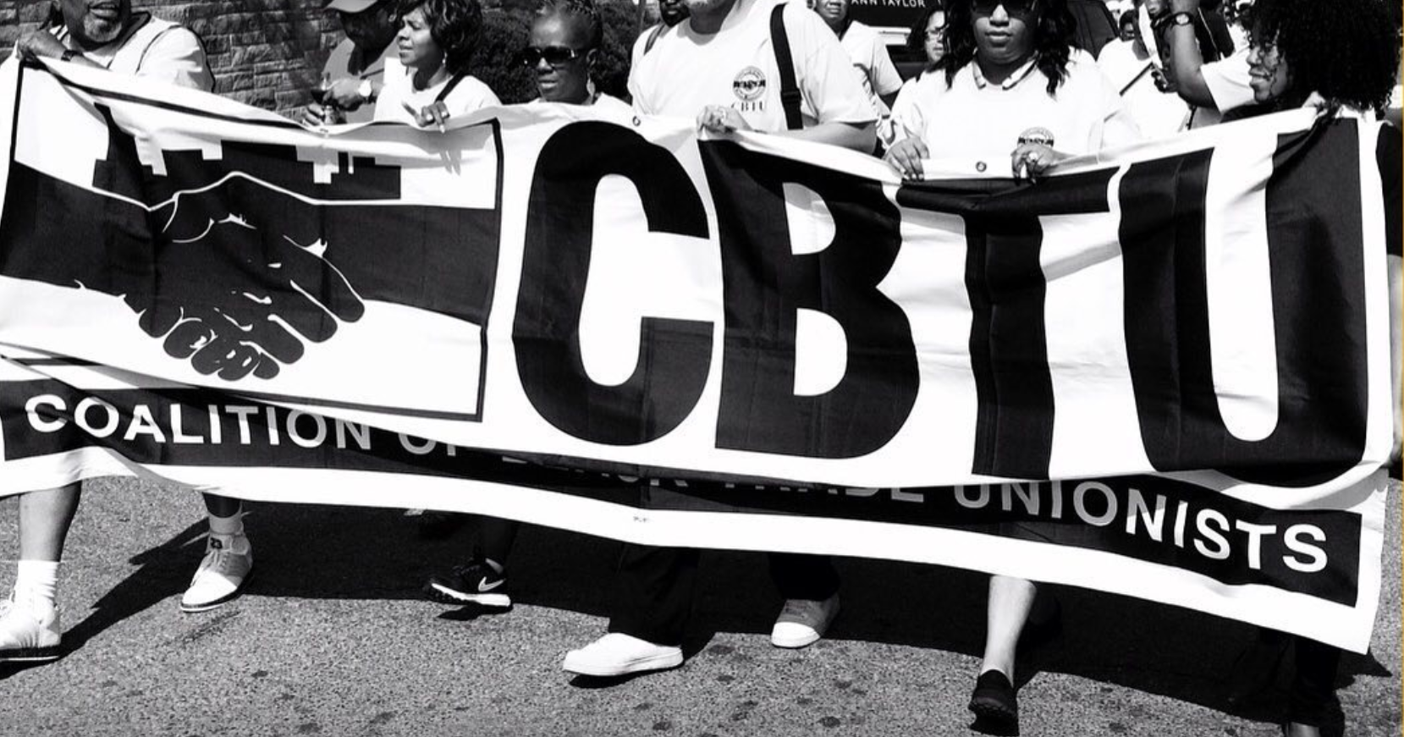
THE COALITION OF BLACK TRADE UNIONISTS (CBTU) INTERNATIONAL
MEMBER RECRUITMENT PRESENTATION
-
01
"The fiercly independent voice of black workers within the trade union movement."
02

Slide 2


About Us
Founded in 1972 in Chicago, IL
Challenges organized labor to be more relevant to the needs and aspirations of Black and poor workers.
Potent economic and political force within the African American community
Leverage resources of unions to mobilize black voters to influence elections and public policy at every level of government.
Catalyst for actions against human rights violators.
More than 77 different international and national unions are represented in CBTU. With 50 chapters nationwide and in Canada.
01
02
03

Slide 3



Mission
CBTU seeks to fulfill the dream of those Black trade unionists, both living and deceased, who throughout this century have courageously and unremittingly struggled to build a national movement that would bring all our strengths and varied talents to bear to achieve economic, political, environmental and social justice for every American.
02
03
04

Slide 4
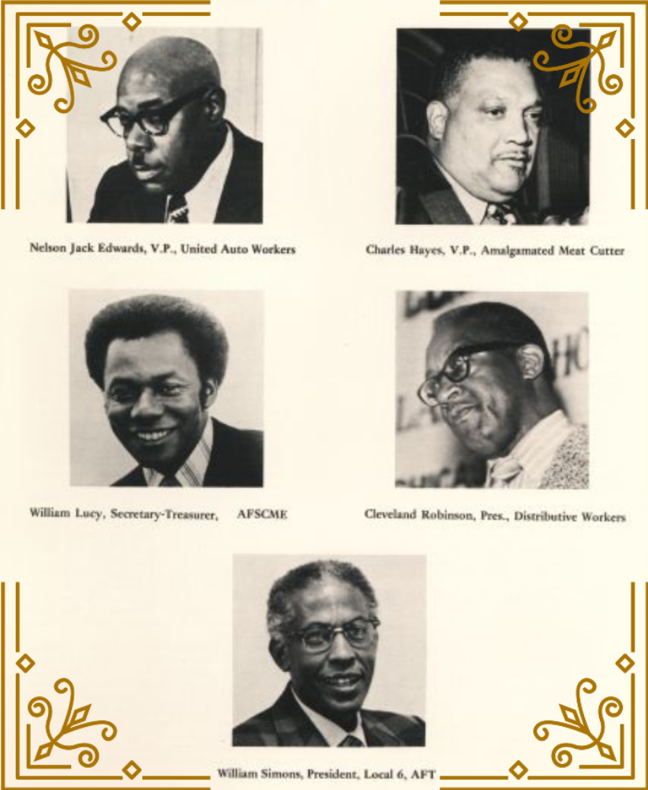
CBTU's Founders
03
04
05

Slide 5
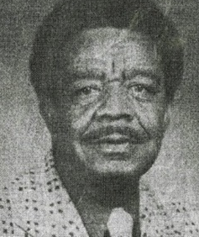
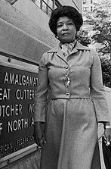
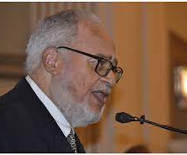
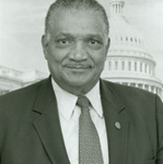
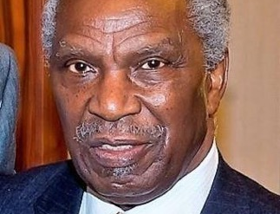
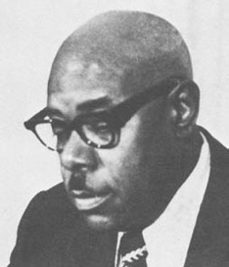
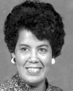
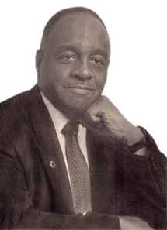
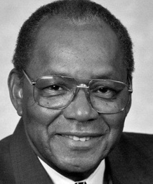
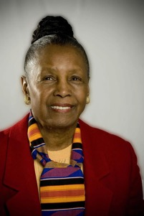
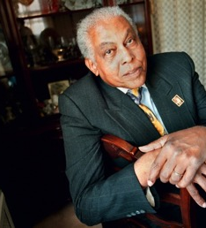
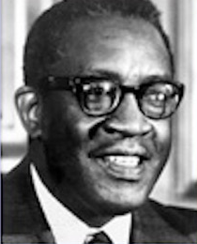
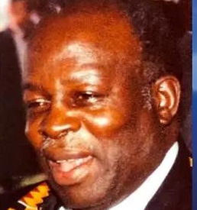
CBTU's Founding Members
WILLIAM LUCY, AFSCME*
CHARLES HAYES, UFCW*
NELSON "JACK" EDWARDS, UAW*
CLEVELAND ROBINSON, UAW*
WILLIAM SIMONS, AFT*
ALZADA CLARK, UFW*
ISOM CLEMONS, ILA*
LEVI DANIEL, UMWA*
OLA KENNEDY, USW*
GIDEON PARHAM, TEAMSTERS *
LILLIAN ROBERTS, AFSCME
DENNIS SERRETTE, CWA*
HORACE SHEFFIELD, UAW*
ED TODD, TEXTILE WORKERS*
AGNES WILLIS, IUEW*
ROBERT WILSON, UFCW*
CONSTANCE WOODRUFF, ILGWU*
ADDIE WYATT, UFCW*
ROBERT SIMPSON, TEAMSTERS*
LEONARD BALL, AFSCME*
JIM BELL, UAW*
JAMES DAVIS, USW*
OLIVER MONTGOMERY, USW*
Deceased*
04
05
06

Slide 6
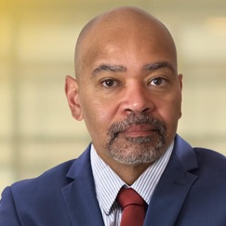
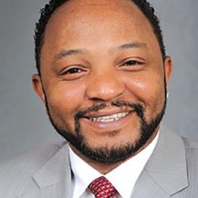
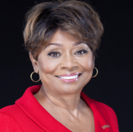
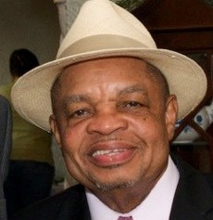
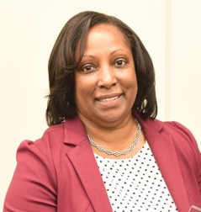
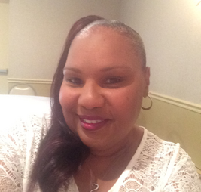
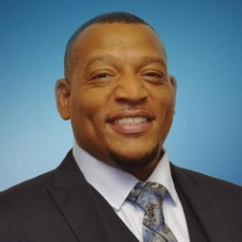
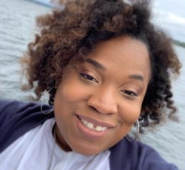
CBTU's Executive Council
The International Leadership of The Coalition of Black Trade Unionist
Rev. Terrence L. Melvin
Anthony Harmon
Clayola Brown
Lew Moye
President, AFSCME
1st Vice President
Workers United/SEIU
2nd Vice President
UAW
Exec. Vice President, AFT
05
Cherika Carter
06
Yolanda McClean
Faith Morris
Wayne Blanchard
3rd Vice President, CUPE
Treasurer, AFSCME
Recording Secretary, UAW
Corresponding
Secretary, OPEIU
07

Slide 7
CBTU's Executive Council
The International Leadership of The Coalition of Black Trade Unionist cont.
WILLIAM "BILL" LUCY
PRESIDENT EMERITUS
AFSCME
WILLIE L. BAKER JR.
EXEC. VICE PRESIDENT EMERITUS
UFCW
GWEND JOHNSON
TREASURER EMERITUS
CWA
Trustees:
CLAUDE CUMMINGS JR., CWA
ELIZABETH "LIZ" POWELL, APWU
GEORGE GRESHAM, SEIU
BECKY PRINGLE, NEA
KENNETH RILEY, ILA
DR. LORRETTA JOHNSON, AFT
FRED REDMOND, USW
SHANNA PEEKS, UMWA
06
07
08

Slide 8
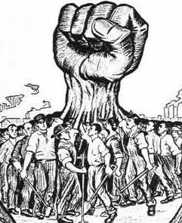

Union Solidarity & Greetings
from the CBTU ______ Chapter!
We are honored for your time and willingness to listen.
Spread the word to your members.
Sign up to become a CBTU Member TODAY!
Show soldarity and support.
08
08
09

Slide 9
CBTU _____ Chapter Executive Board
The Local Chapter Leadership of The Coalition of Black Trade Unionists
INSERT NAME HERE
TRUSTEE
INSERT UNION LOCAL HERE
INSERT NAME HERE
TRUSTEE
INSERT UNION LOCAL HERE
INSERT NAME HERE
TRUSTEE
INSERT UNION LOCAL HERE
INSERT NAME HERE
SERGEANT-AT-ARMS
INSERT UNION LOCAL HERE
INSERT NAME HERE
PRESIDENT EMERITUS
INSERT UNION LOCAL HERE
INSERT NAME HERE
PRESIDENT
INSERT UNION LOCAL HERE
INSERT NAME HERE
VICE PRESIDENT
INSERT UNION LOCAL HERE
INSERT NAME HERE
TREASURER
INSERT UNION LOCAL HERE
INSERT NAME HERE
SECRETARY
INSERT UNION LOCAL HERE
INSERT NAME HERE
ASSISTANT SECRETARY
INSERT UNION LOCAL HERE
08
09
10

Slide 10

CBTU's Core Committees
Women's
Under 40 Leaders
Youth
Men's
Retirees
C.A.R.A.T. Team
Scholarship
International
CBTU is an AFL-CIO Constituency Group that provides a voice for all Workers within the framework of a Trade Union while improving Members’ economic development and employment opportunities.
09
10
11

Slide 11
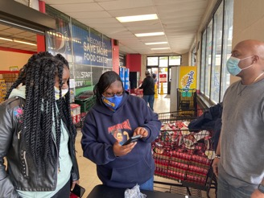

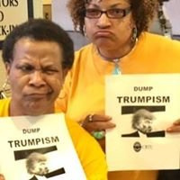
CBTU's Civic Engagement Initiative
It is Through CBTU’s chapter network in key states, our community partnerships, and the personal commitment of “each one, reach one,” will we harness our power to be a decisive force in local, state & national elections.
Voter Registration
Education
Mobilization
01
02
03
10
11
Boosting number of registered voters
Increased Voter Turnout
One-On-One grassroots relational organizing
12

Slide 12
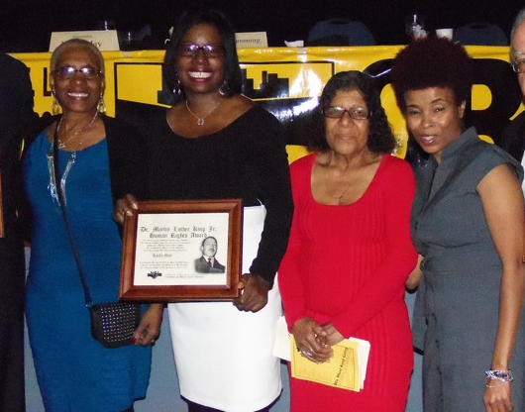
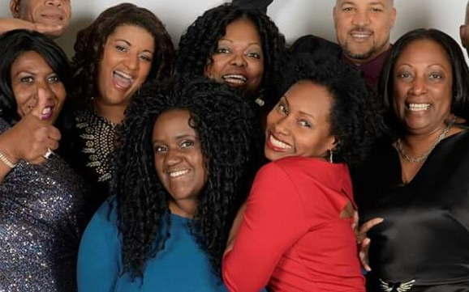
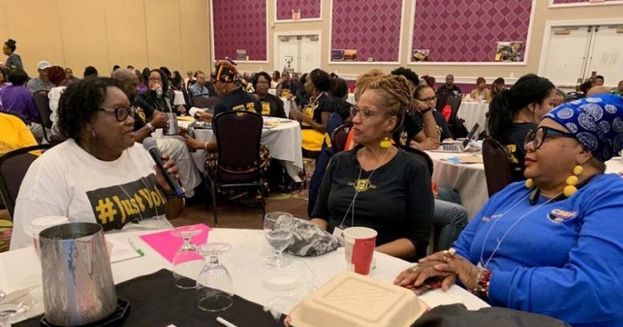
CBTU Women's Commitee
The CBTU National Women's Committee conducts conferences and workshops that focus on the needs of African American women in the trade union movement.
The CBTU Women's Conference is an uplifting, healing and empowering experience.
CBTU Women's Committee pays tribute to women who have made a difference in their chapters, unions or communities.
More information is available from any committee representative or from Mamei Pratt (UFCW), the CBTU National Women's Committee Chair or Co-chair Natashia Pickens (CWA)
11
12
13

Slide 13
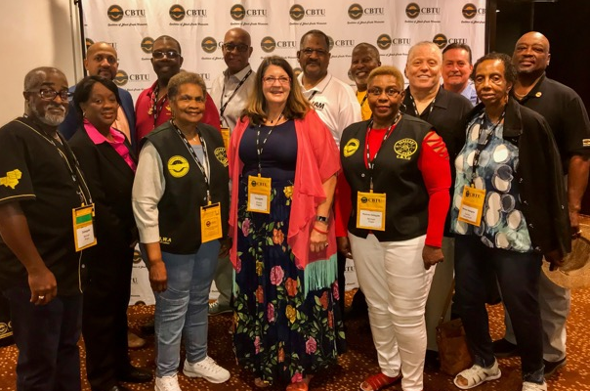
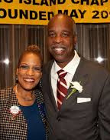
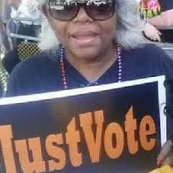
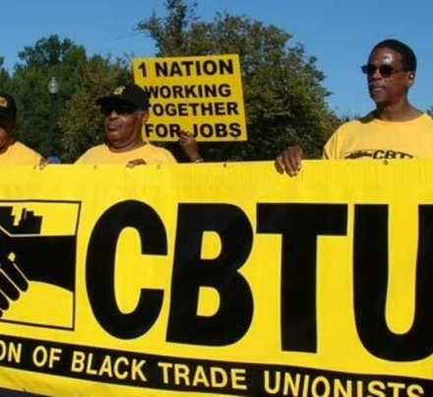
CBTU Retiree's Commitee
The CBTU Retiree Committee is a group of senior advocates who act as the conscience of the senior movement from a black and minority perspective.
CBTU Retiree Committee members serve as officers, board members, directors and advisors to many local, national and international organizations
Guarantee the integrity of the Social Security program
Fight against culturally biased age decisions regarding social security, Medicare, managed care, retirement and pension benefits.
12
13
14

Slide 14
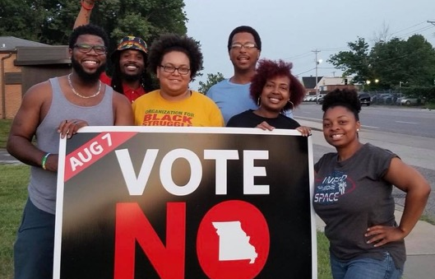
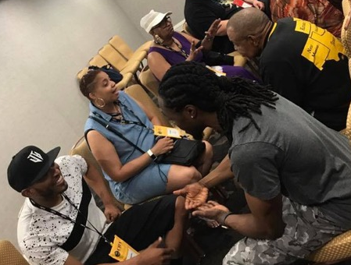
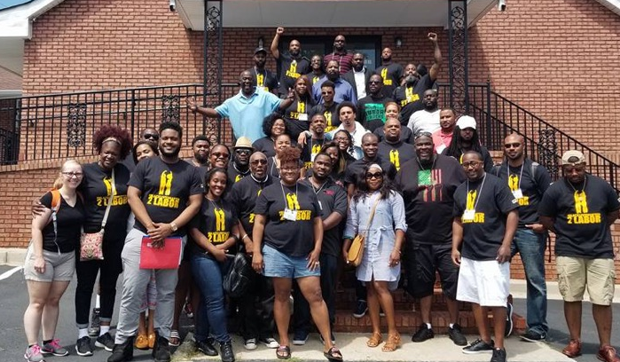
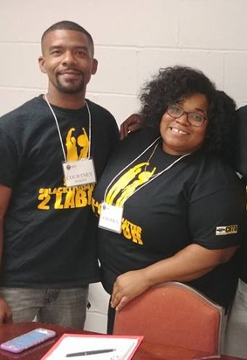
CBTU Under 40 Leaders Committee
CBTU Under 40 Leaders consists of young union members within CBTU who are fighting for social, environmental and economic justice in our communities.
Political Education
01
Union and Electoral politics are used to create change.
Community Service
02
We give back and serve our communties that need it most.
Fundraising
03
Host innovative events to raise funds to sustain our movement work
04
Recruitment
13
Educate new and young union members on the legacy, impact, and essential role of CBTU.
14
15

Slide 15
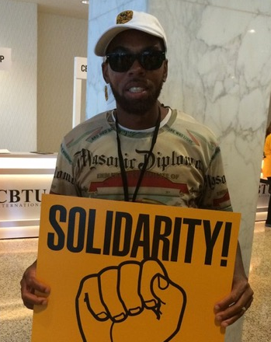
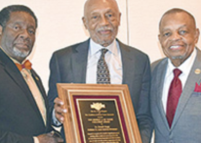
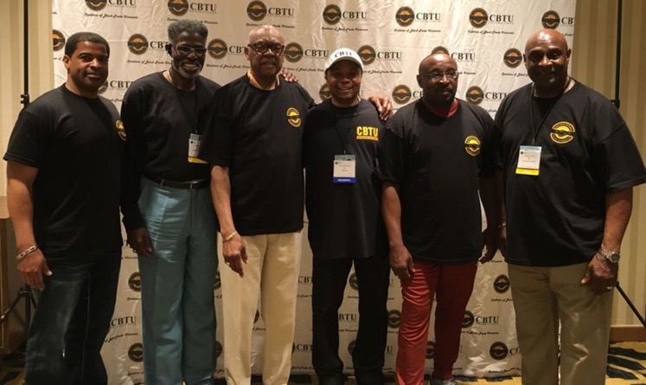
CBTU Men's Committee
The CBTU Men's Committee was established for the sole purpose of educating, advocating, and advancing the Black Man.
Black Men are the highest incarcerated and largest unemployed demographic of this country.
CBTU Men's Committee fights against generational oppression and disenfranchisement
CBTU Men's Committee helps build Black Men up to be the leaders their families, unions, and communities need.
14
15
16

Slide 16
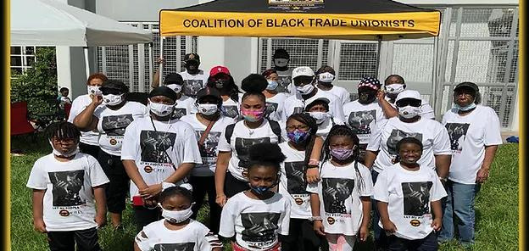
CBTU's Youth Committee
The CBTU National Youth Committee was established to educate and empower youth to use their energy and talents to create meaningful change in their schools and communities.
Youth ages 14-21 can be on the youth committee.
01
An annual youth conference is implemented into the CBTU Convention
02
15
Well-designed and well-run youth development programs promote youth leadership by involving youth in needs assessment, planning, implementation, and evaluation.
16
17

Slide 17
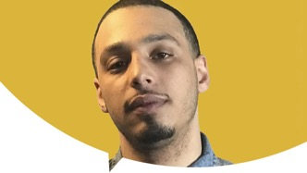
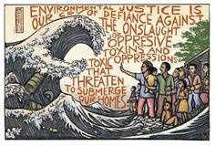
Community Action and Response Against Toxics (CARAT) Team
National Director: Payton M. Wilkins
CBTU is part of the growing Environmental Justice movement that empowers community-based organizations to identify harmful or discriminatory conditions, mobilize their constituencies, and resolve local environmental health problems.
Several CBTU chapters have formed (CARAT) teams, to help educate and monitor issues such as illegal waste dumping and hauling in poor communities.
16
17
18

Slide 18
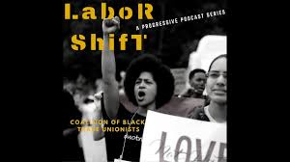
CBTU’s Labor & Community Impact
Greater participation of black trade unionists at every level of labor and electoral decisions.
CBTU helps ALL workers benefit from the goals achieved by the trade union movement
Increased economic status of black workers. (Higher wages, improved working conditions, better benefits)
17
CBTU help make the labor movement relevant to the needs and aspirations of black workers and our communities.
CBTU help create new openings for women and members of racial minority groups in leadership
18
19

Slide 19
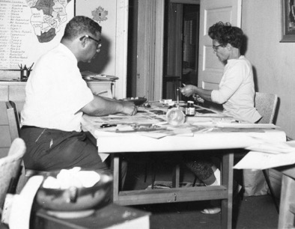
Local CBTU Chapter Events
Ernest & DeVerne Calloway Awards Banquet
The Awards are given in honor and memory of Ernest and De Verne Calloway. Ernest was the former Director of Education for Teamster's Local 688 and President of the St. Louis NAACP. His wife De Verne was a political, civil & human rights activist leader and was the first female African American State Representative elected to the Missouri Legislature.
Dr. Martin Luther King Jr. Awards Banquet
Juneteenth Community Clean Up
Awards are presented to the following individuals for their contributions for Social Justice, Human and Labor Rights in the tradition of Dr. King in the St Louis Metro Area Communities.
Union members come together on Juneteenth to clean the most neglected areas of the city.
18
19
20

Slide 20



Other AFL-CIO Constituency Groups
APRI is an alliance between labor and the civil rights movement. Today, it fights for racial equality and economic justice.
CLUW unifies union women to face shared concerns. The coalition focuses on action on issues important to women workers.
LCLAA represents 2 million Latino workers. The council organizes working people to protect the rights and expand the influence of Latinos.
19
20
21

Slide 21



Other AFL-CIO Constituency Groups
The council brings together workers who are veterans and speaks out on issues that affect them the most.
Pride@Work brings together the labor movement and the LGBTQ community in pursuit of social and economic justice.
APALA is the nation’s first national organization of AAPI workers. It focuses on advancing worker, immigrant and civil rights.
20
21
22

Slide 22
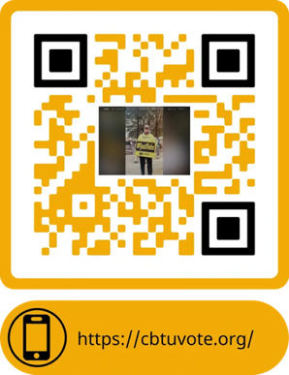
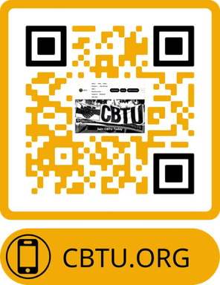
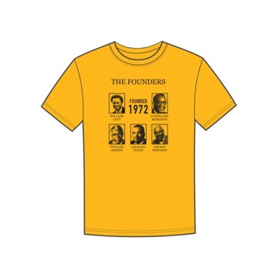
Join Us & Get Involved Today!
Become A Member!
Support
https://myunionstore.com/pages/cbtu
21
Volunteer
22
23

Slide 23
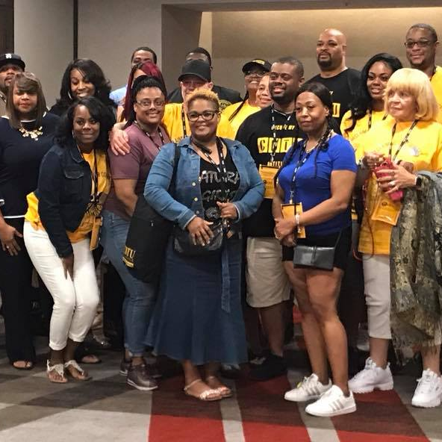
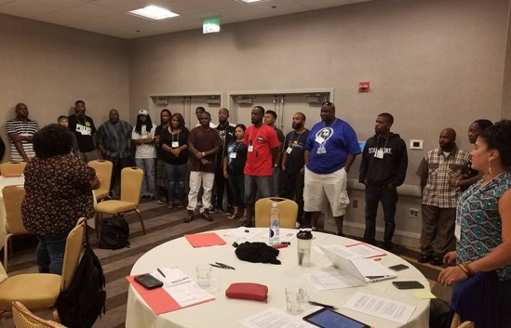




Gallery
22
CBTU Members in Action
23
24

Slide 24

Applications Available Online & In-person
Scan QR Code, Apply online or via paper application.
See CBTU website for International & Chapter Dues information.
Membership Application: https://action.cbtu.org/forms
23
24
25

Slide 25

Contact Information
CBTU _____ Chapter / INSERT NAME HERE - President
ADDRESS
Website: / Facebook / Twitter: @
PHONE NUMBER
EMAIL
24
25
-

