Slide 1
CEIU ON Health, Safety and Security
2025 Report

Slide 2
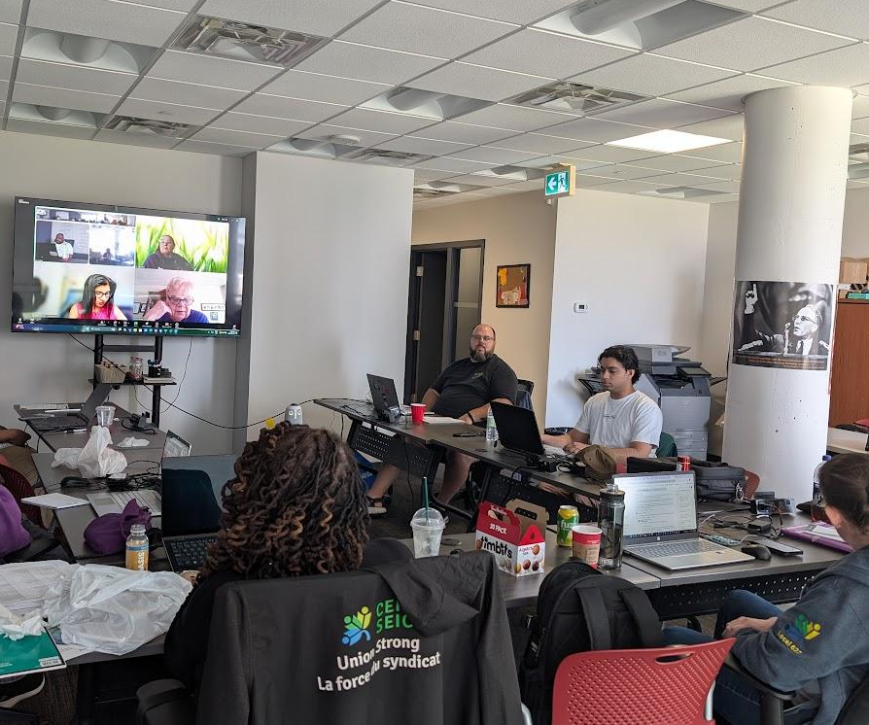
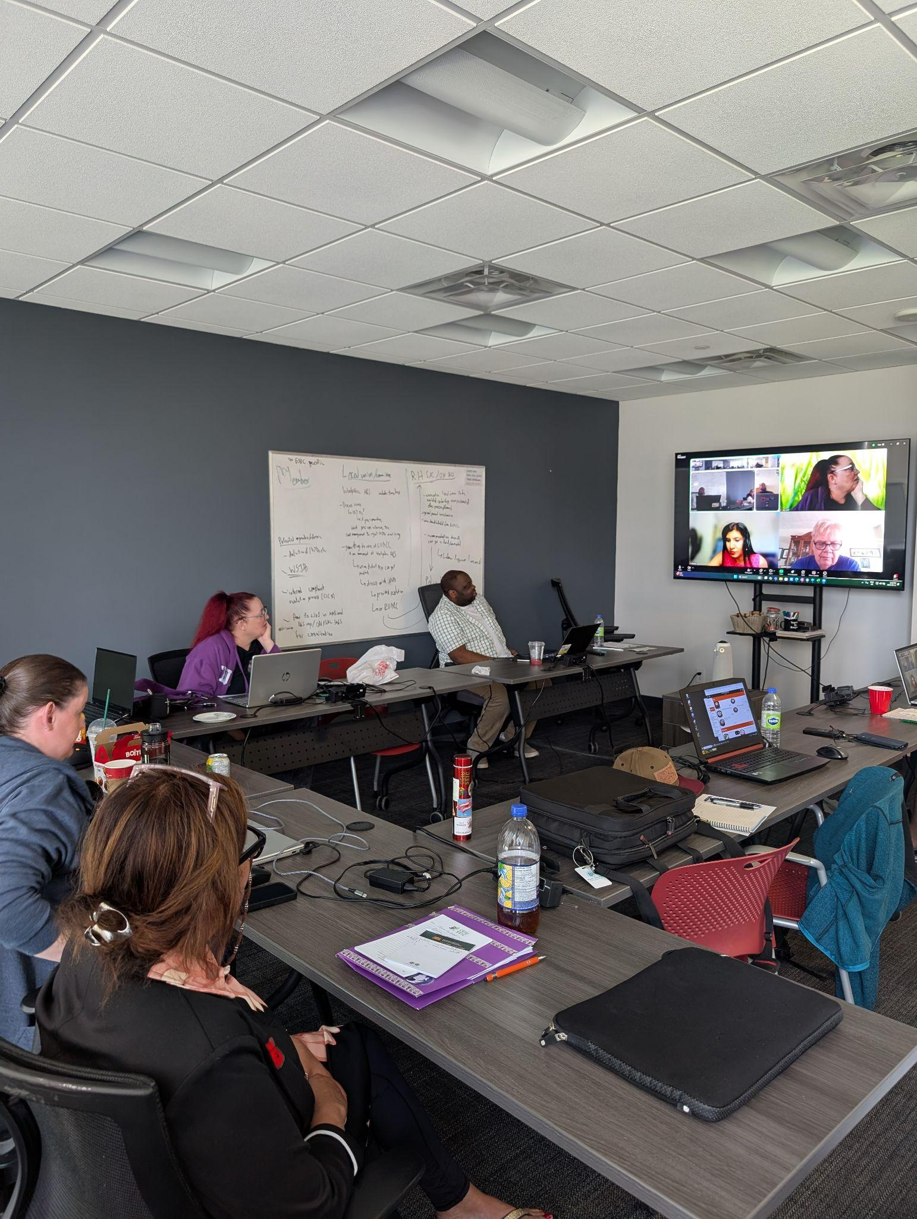
Accomplishments
2 in-person, 4 virtual meetings
Bought in special guests from IRB, IRB, and ESDC
Submitted 10 Health and Safety resolutions
AED, First-Aid Kits, Updated Procedures, etc.
Drafted Health and Safety related ATIP requests
Workplace inspection reports, Lab 1070s, harassment incidents, etc.
Notes:
ATIP Request is across departments and nationwide.
We have also submitted a number of proposals to ORC regarding how conferences can be run, included a health and safety briefing at the beginning of each conference, a Health and Safety focused conference briefing sheet to be sent as as part of any conference package

Slide 3


Slide 4

PSAC Ontario Health and Safety Conference
Pitfalls and limitations of WSIB
Migrant workers falling through the cracks
Teaser of Climate Change & Environmental Racism course

Slide 5
CEIU National Mental Health and Wellness Committee
Meets twice a year
Working on resolutions for triennial
Formalize national health and safety conference to be occurring every 3 years
Updates on what is happening in each region
Notes:
Committee helped ensure that CEIU had a National Health and Safety Conference in Dec 2024 at St Johns

Slide 6
Asbesto Town hall
Online for Fall/Winter 2025
Still searching for an asbesto expert to provide background info
Will invite an union Health and Safety Officer about the Employer’s Responsibilities
CCOHS material

Slide 7
Committee Challenges & Recommendations
Lack of representation from IRB and IRCC
Time commitment both within and outside the Employer’s working hours
Lack of outreach from Locals and members to Committee about H&S issues
Notes:
ESDC has RHSAC (3 hour long meetings + prep meetings before hand)
Point 1:
Encourage IRB and IRCC delegates to apply to this committee. The current committee is 100% comprised of ESDC members and risk siloing itself.
Point 3:
Everyone here is a representative of a committee or a Local, if you have H&S issues, please contact the Health and Safety Committee.

Slide 8

Thank you everyone!

