Slide 1
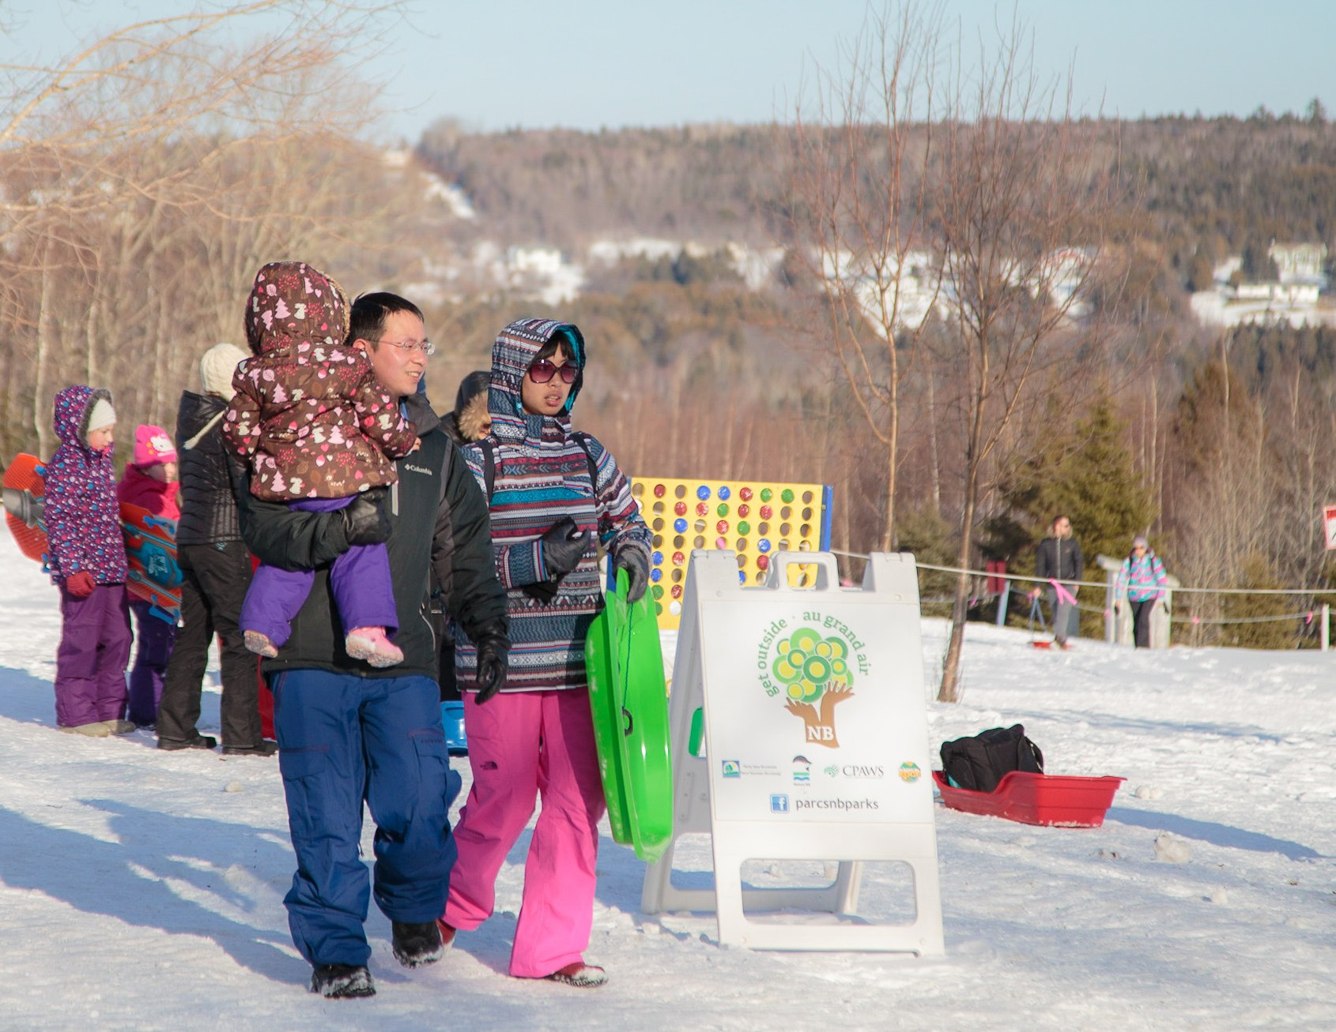
Canadian Parks and Recreation Association
Sport for Life Canadian Summit
January 2018

Slide 2
Who is CPRA?
The Canadian Parks and Recreation Association (CPRA) is a national organization dedicated to realizing the full potential of parks and recreation
CPRA advocates and educates that parks and recreation is essential to individual, family and community health and well-being
CPRA partners with national organizations on sport, physical activity and health

Slide 3
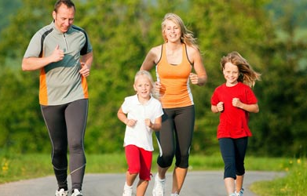
Today’s Presentation
Framework For Recreation - Implementation
  How is it being implemented?
  What are the next steps?
  How can you support Implementation?

Slide 4

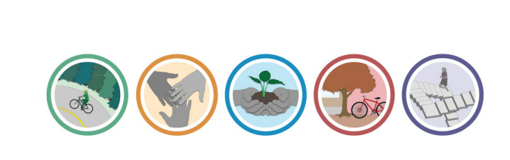
Framework for Recreation in Canada
www.cpra.ca

Slide 5
Framework for Recreation in Canada
The Framework for Recreation in Canada:
  A new vision for recreation in Canada;
  Invites collaboration in pursuit of common priorities;
  Aims to improve wellbeing of individuals, communities and environments
Definition: Recreation is the experience that results from freely chosen participation in physical, social, intellectual, creative and spiritual pursuits that enhance individual and community wellbeing

Slide 6
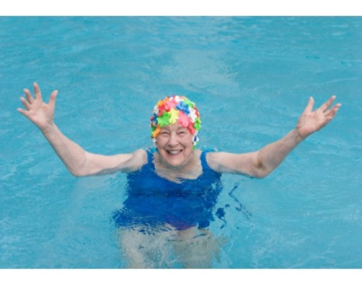
Framework for Recreation in Canada
How we got here
Three National Summits and extensive consultations in provinces and territories
Sector endorsed the Framework
November 2014
CPRA Board endorsed the Framework
November 2014
PT Ministers endorsed and federal government stated support for the Framework in February 2015

Slide 7
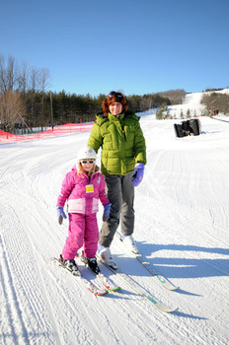
How will the Framework be used?
Guide decision-making, planning and
resource allocation for recreation leaders;
Municipal and Community planning;
Foster positive relationships between the
sector and all orders of government;
Guide document for the field of recreation;
Inform consistent and coordinated actions to address emerging trends and challenges; and
To contribute to active and healthy communities and citizens.

Slide 8





The Framework
Vision
Everyone engaged in meaningful, accessible recreation experiences that foster:
Individual Wellbeing Wellbeing of Natural and Built Environments Community Wellbeing
Values
Public Good Inclusion and Equity Sustainability
Principles
Lifelong Participation Outcome-Driven Quality and Relevance Evidence Based Partnerships Innovation
Goals
Priorities
Active Living
Inclusion & Access
Connecting
People & Nature
Supportive Environments
Recreation
Capacity
Participation throughout the lifecourse
Physical literacy
Play
Reduce sedentary behaviours
Equitable participation for all, regardless of socioeconomic status, age, culture, race, Aboriginal status, gender, ability, sexual orientation or geographic location.
Natural spaces and places
Comprehensive system of parks
Public awareness and education
Minimize negative impacts
Provide essential spaces and places
Use existing structures for multiple purposes
Renew infrastructure
Active transportation
Partnerships in social environment
Recreation education
Assessment tools
Align community initiatives
Collaborative system
Career development
Advanced education
Capacity development
Community leadership
Volunteers
Knowledge development

Slide 9
Implementation & Monitoring
Awareness
Alignment
Implementation
Evaluation

Slide 10
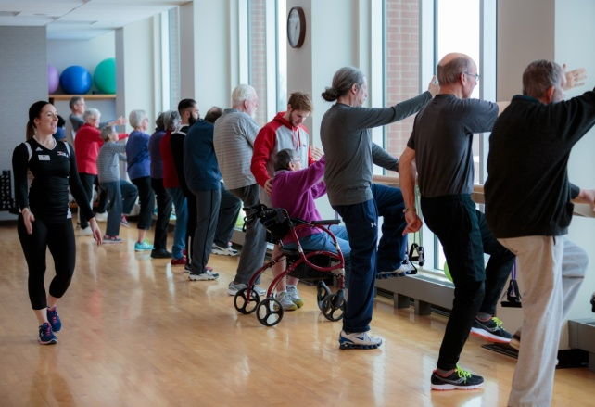
Framework for Recreation
Goal #1: Active Living
Foster active living through physical recreation

Slide 11
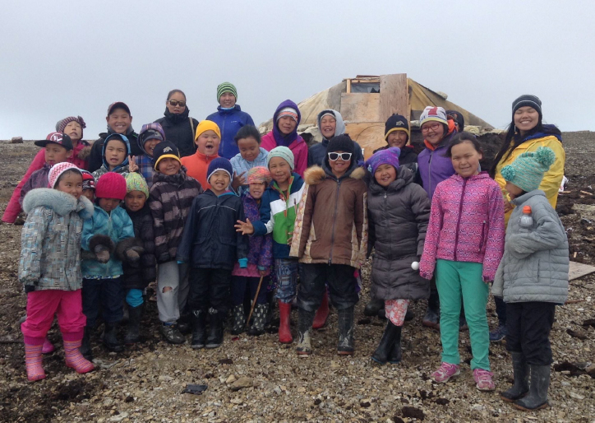
Framework for Recreation
Goal #2: Inclusion and Access
Increase inclusion and access to recreation for populations that face constraints to participation

Slide 12
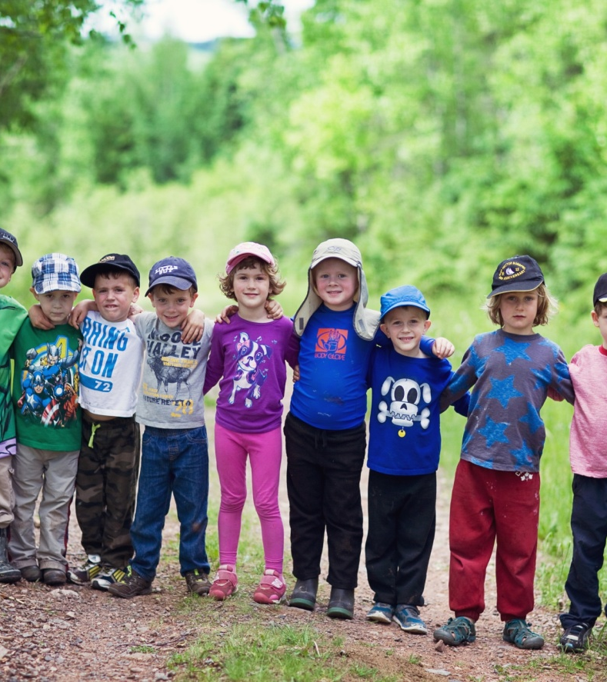
Framework for Recreation
Goal #3: Connecting People and Nature
Help people connect to nature through recreation

Slide 13
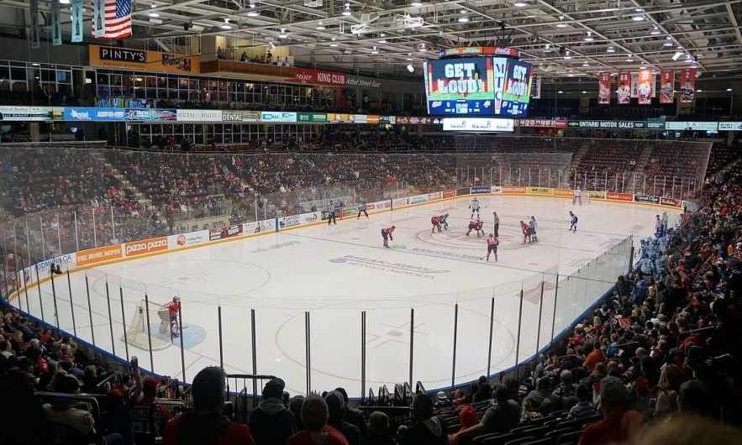
Framework for Recreation
Goal #4: Supportive Environments
Ensure the provision of supportive physical and social environments that encourage participation in recreation and help build strong, caring communities

Slide 14

Framework for Recreation
Goal #5: Recreation Capacity
Ensure the continued growth and sustainability of the recreation field

Slide 15
National Framework Implementation
CPRA & PT Members
PT and Federal Government
Communities
Aligned Sector
IMWG
Notes:
Names of Atlantic members of WG

Slide 16
Implementation and Monitoring
Working Group
Priorities:
Measuring and reporting implementation
Organizational Audit Tool
Framework Implementation Portal
Implementation Tools
Academic Community Engagement
Implementation in Indigenous Communities
Knowledge Management
Supporting 2018 National Framework Forum

Slide 17
National Implementation Survey
Targeting local organizations by region to explore the current state of implementation efforts
Deliverables of the survey include:
  Identification of barriers or challenges in implementation efforts.
  Tools and resources for Provincial and Territorial Recreation and Parks Associations
  National and regional specific data
Results presented at May National Framework Forum

Slide 18
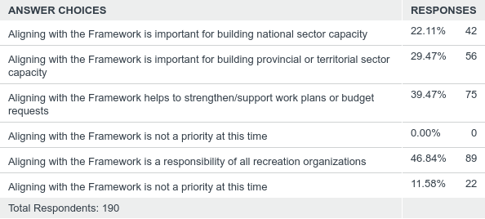
Q6: Which of the following statement(s) reflects your organization’s motivation for aligning with the Framework?
Answered: 190 Skipped: 27

Slide 19
Organizational Audit Tool
Created to allow organizations to assess current situation with respect to Framework goals
Enables better alignment with the Framework, coordination of efforts and measurement
Intent is to support communities but also provide system-level data on progress on the Framework
Supported by annual surveys

Slide 20

What’s in the Tool?
How-to guide for facilitators & staff
Plain language questions related to each of the Framework priorities
Simple assessment form

Slide 21
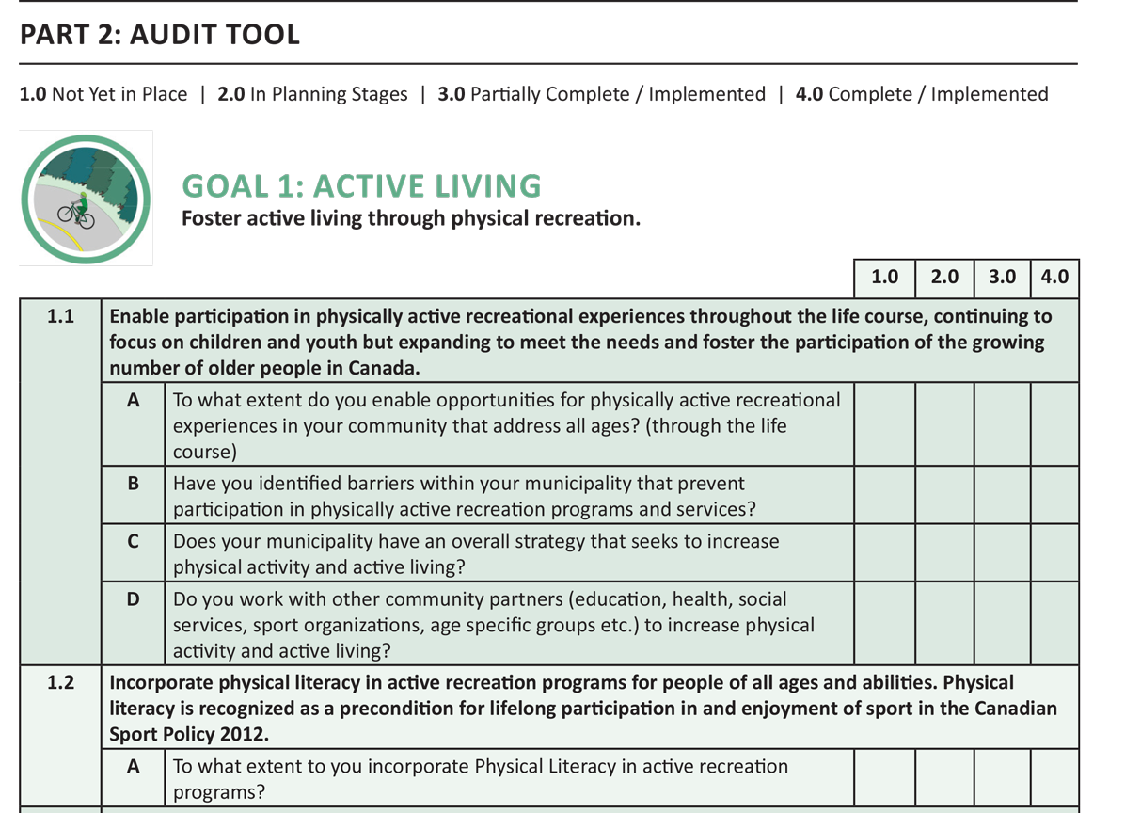

Slide 22

Next Steps
Application to Ontario Trillium Foundation
Ontario and national pilots
Supported by survey

Slide 23

Leading by Example
Communities
Endorsement
Master Plans
Educate, Profile, Train
Build new activities or change priority activities
Linkages to aligned community sectors
Provinces and Territories
Joint implementation efforts by provincial/territorial governments and sector
Fundi initiatives that support goals
Implementation translates into something different to each province and territory
CPRA
Federal advocacy
National profile and education
Linkages to National Partners
Funding opportunities
Support for May National Forum

Slide 24

What’s Next?
National Forum – May 2018 - Regina
National Survey Results
Launch of Organizational
Audit Tool
Ongoing Population of
Framework Portal
Framework Project in Indigenous Communities
Academic Progress
Knowledge Management Strategy

Slide 25
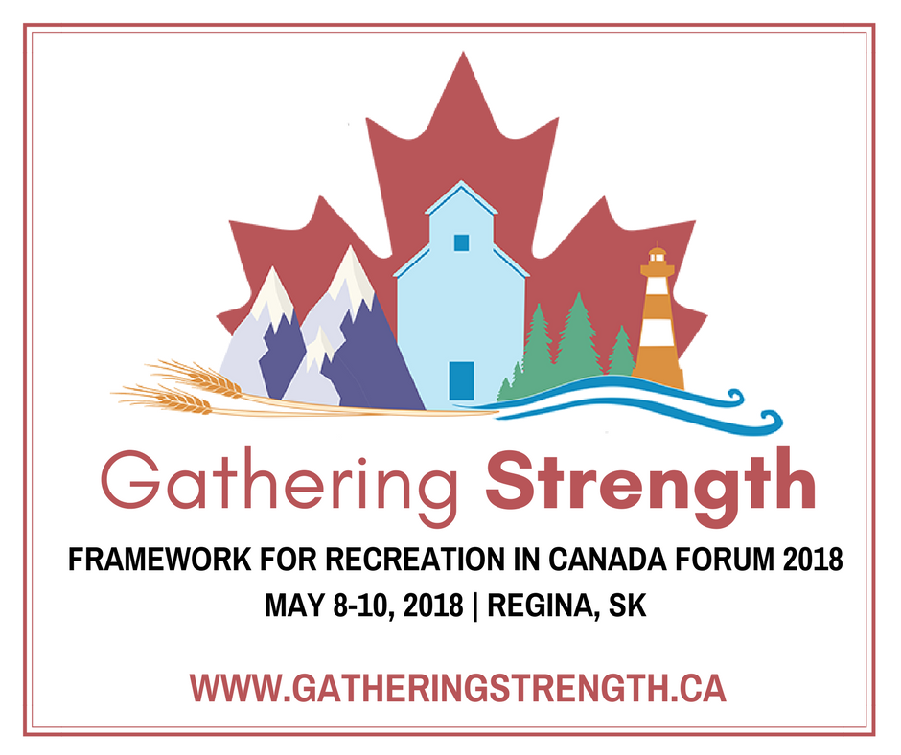

Slide 26

Thank You
CONTACT:
CJ Noble, Executive Director, CPRA
info@cpra.ca www.cpra.ca

