Slide 1
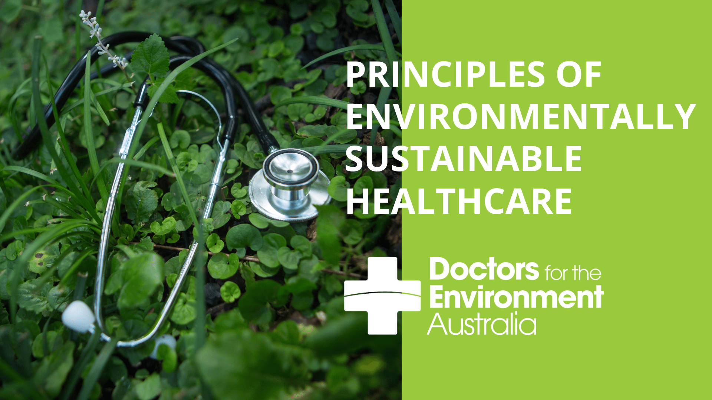


Slide 2

Use the prompts from these slides for your next education presentation
Are there any appropriate Choosing Wisely principles/recommendations that you could incorporate into your presentation?
Are there ways to avoid over-investigation or over-treatment?
Are there non-invasive or ambulatory care pathways that could be utilised?
https://www.choosingwisely.org.au/
How could you incorporate the principles of environmentally sustainable healthcare into your presentation?
Reduce, Reuse, Recycle, Rethink, Research
https://dea.org.au/publications/healthprofessionaleducationresources/
https://sustainablehealthcare.org.uk/what-we-do/sustainable-specialties
How is your dept/health service working toward sustainability goals?

Slide 3

Indigenous Australians’ stewardship of country and protection of resources stands as a useful example of how we must transition to a more thoughtful approach to healthcare resource utilization, waste management and environmental stewardship
Brand, Gabrielle, et al. "Embedding Indigenous knowledges and voices in planetary health education."
The Lancet Planetary Health 7.1 (2023): e97-e102

Slide 4
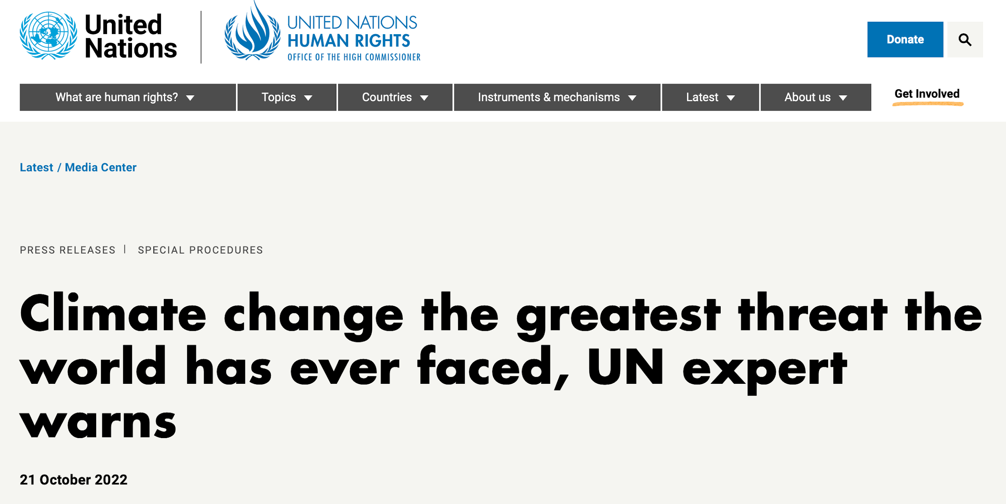
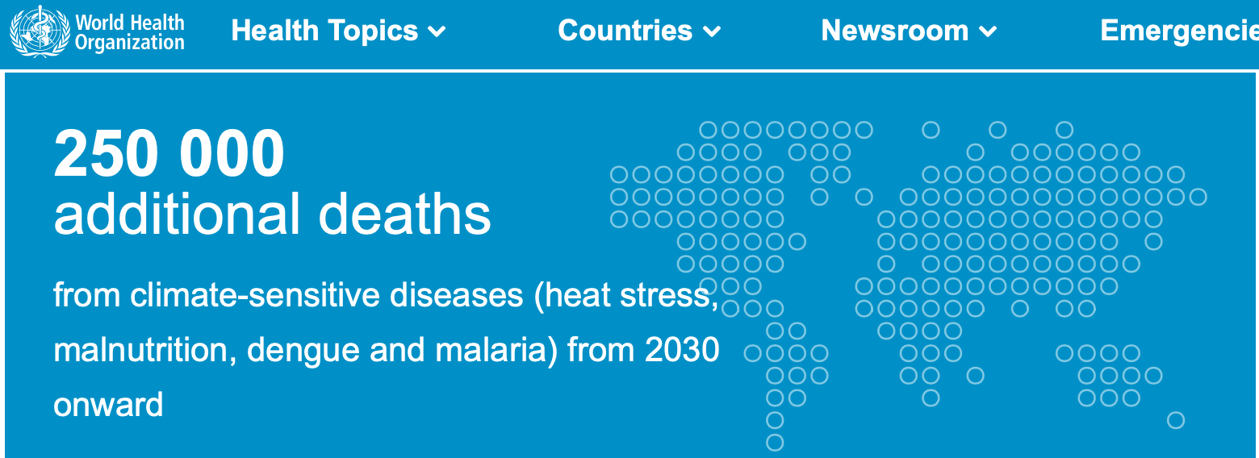
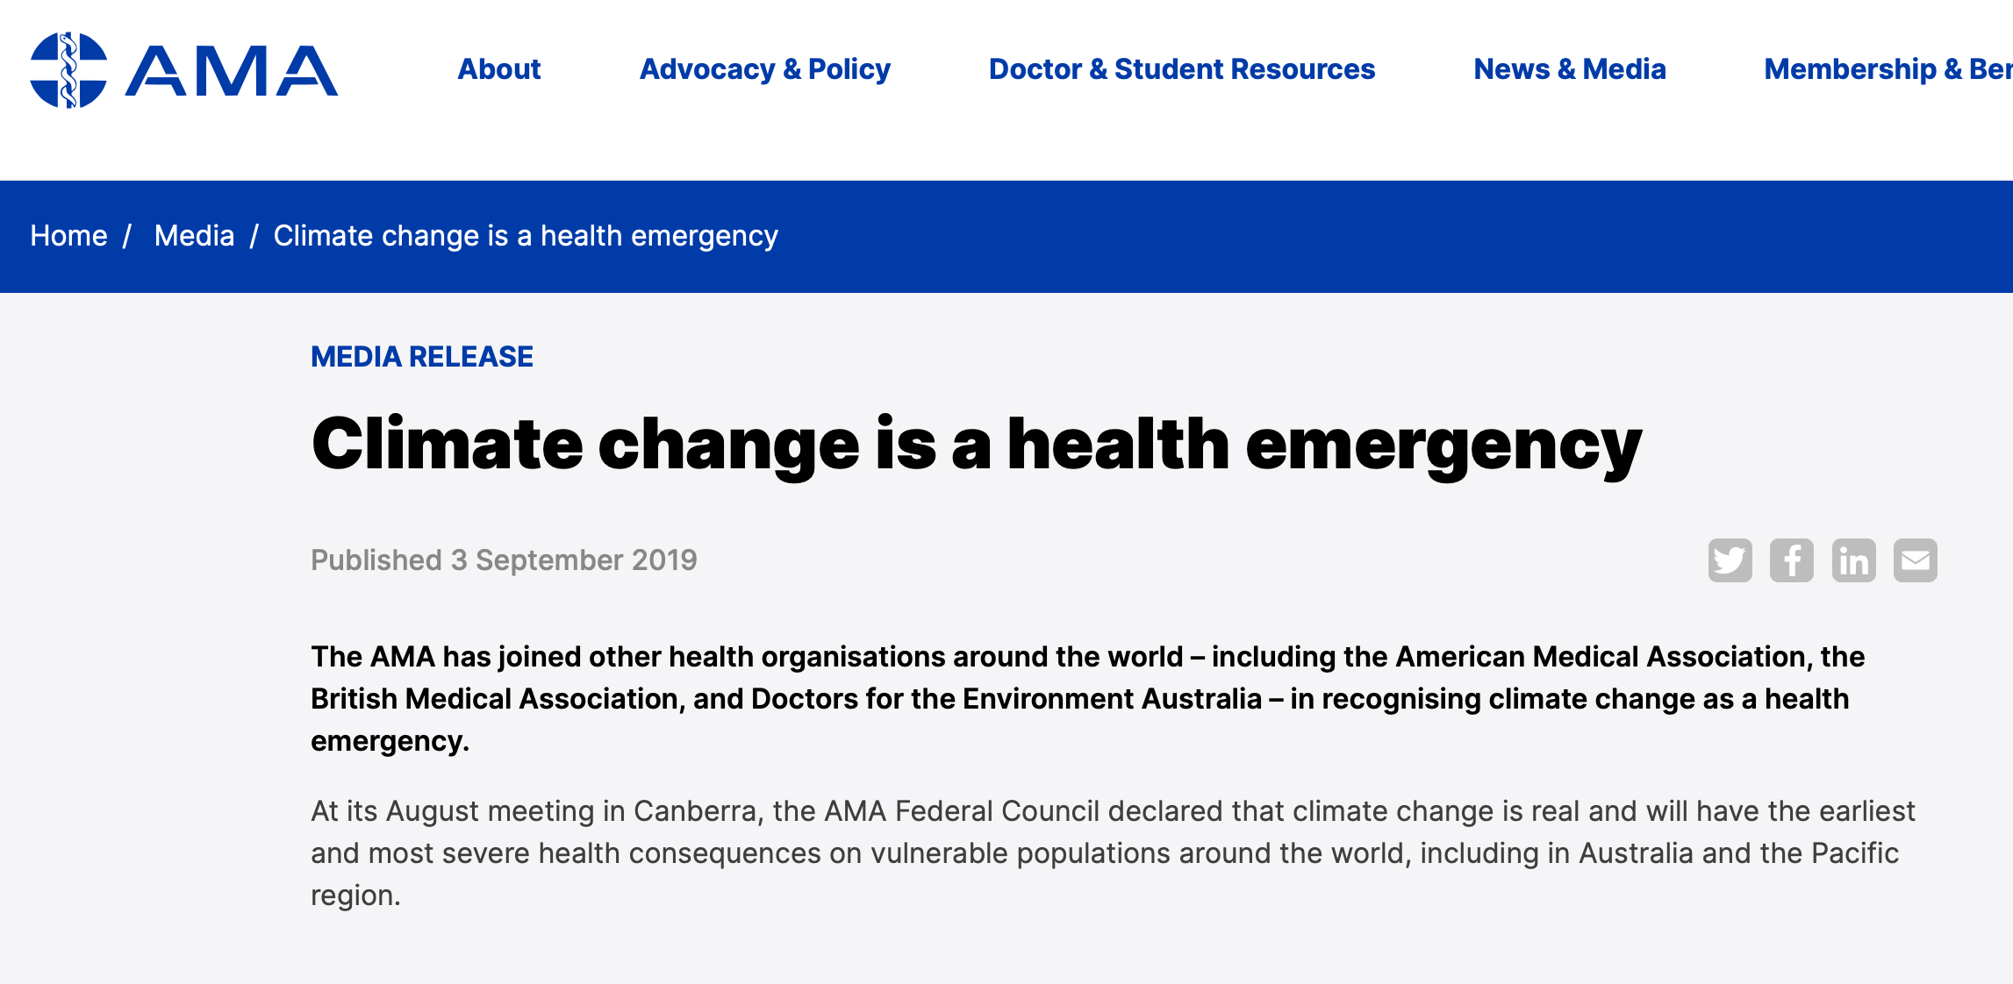
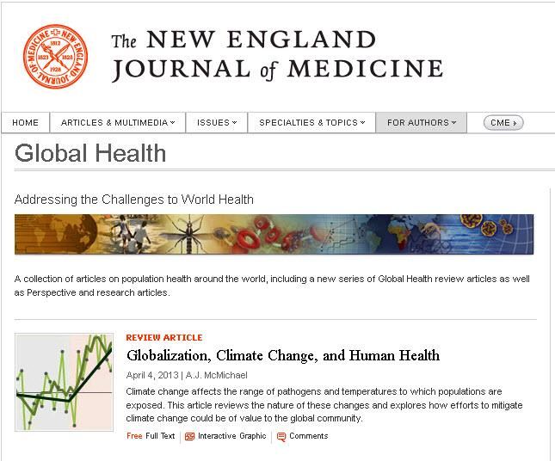
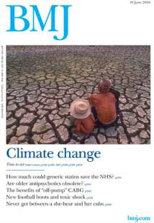
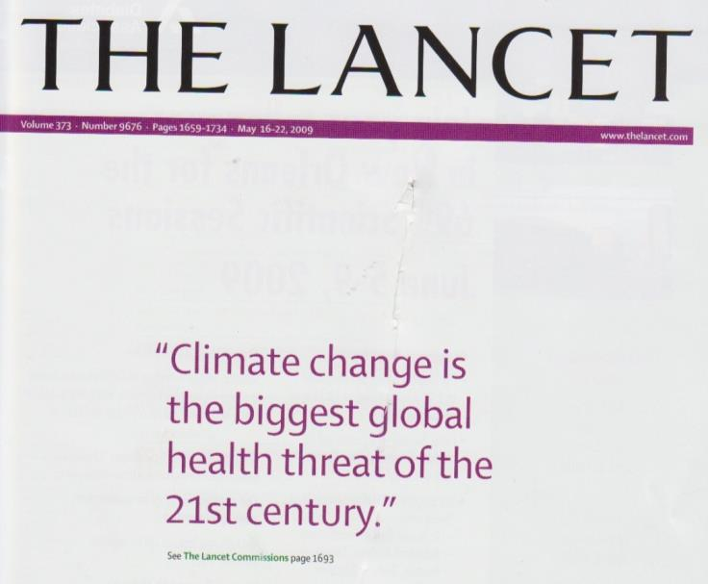
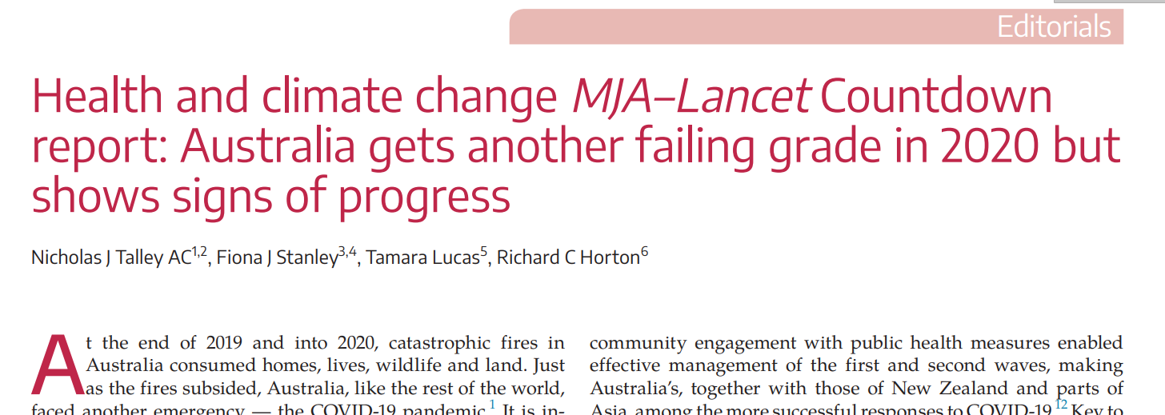

Slide 5

Our environment is changing — and it’s not just our climate.
We’ve cleared nearly half of temperate & tropical forests
Biodiversity is rapidly disappearing: ~150 species lost daily
Our oceans have become 30% more acidic since the Industrial Revolution
Land is desertifying: we use over two-thirds of the world’s ice-free surface for agriculture
Soil, air, and water ecosystems are being polluted
Biogeochemical cycles are being altered: CO2 levels increased 25% since the 1950s and we’ve exceeded the planetary boundaries for nitrogen and phosphorus
We’ve dammed over 60% of our rivers
Extreme weather events wreak havoc on communities
Temperatures are increasing
Sea levels are rising
Almada, A. A., C. D. Golden, S. A. Osofsky and S. S. Myers (2017), A case for Planetary Health/GeoHealth,GeoHealth,1,75–78, doi:10.1002/2017GH000084.

Slide 6
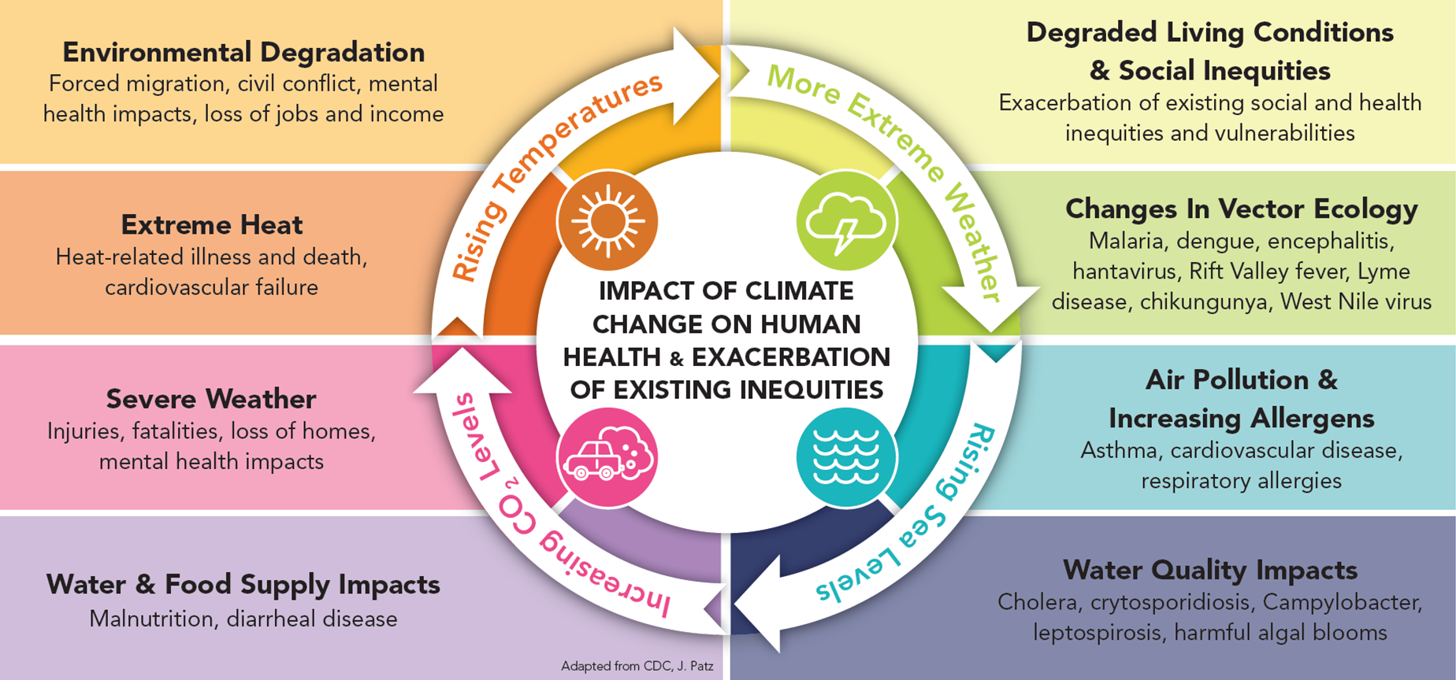
These changes in our environment severely affect our health and jeopardise decades of public health gains

Slide 7
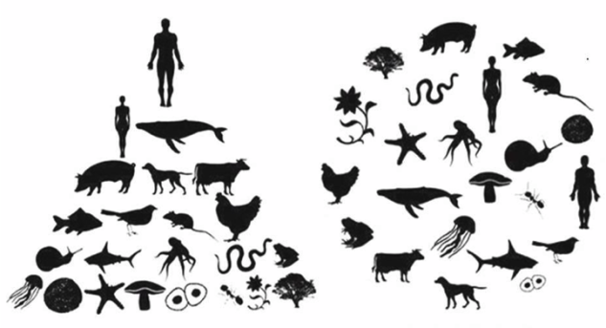

Planetary health maintains a sharp focus on human health, while blurring the boundaries between humans and all life with which we share this planet.
By harming our natural systems, we harm ourselves and future generations.
Planetary Health Alliance ‘Planetary Health Education’ 12 Feb 2023 https://www.planetaryhealthalliance.org/ph-education-materials

Slide 8
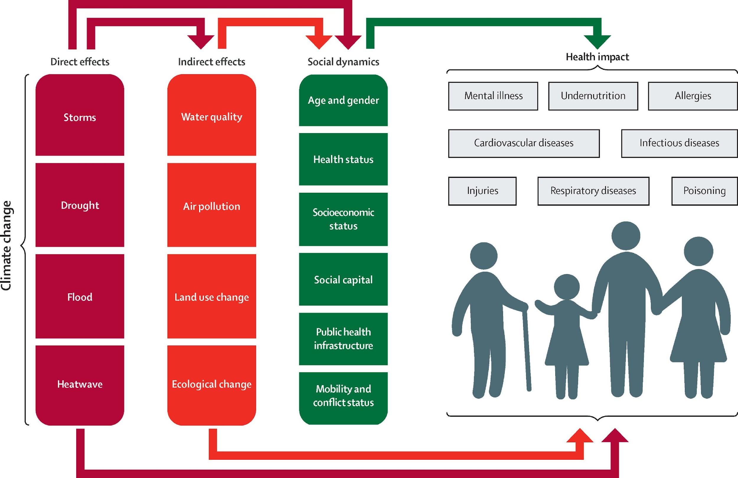
Developing a more environmentally sustainable health system supports improvements in the social determinants of health, improves health equity, and brings health and care back into the community.

Slide 9
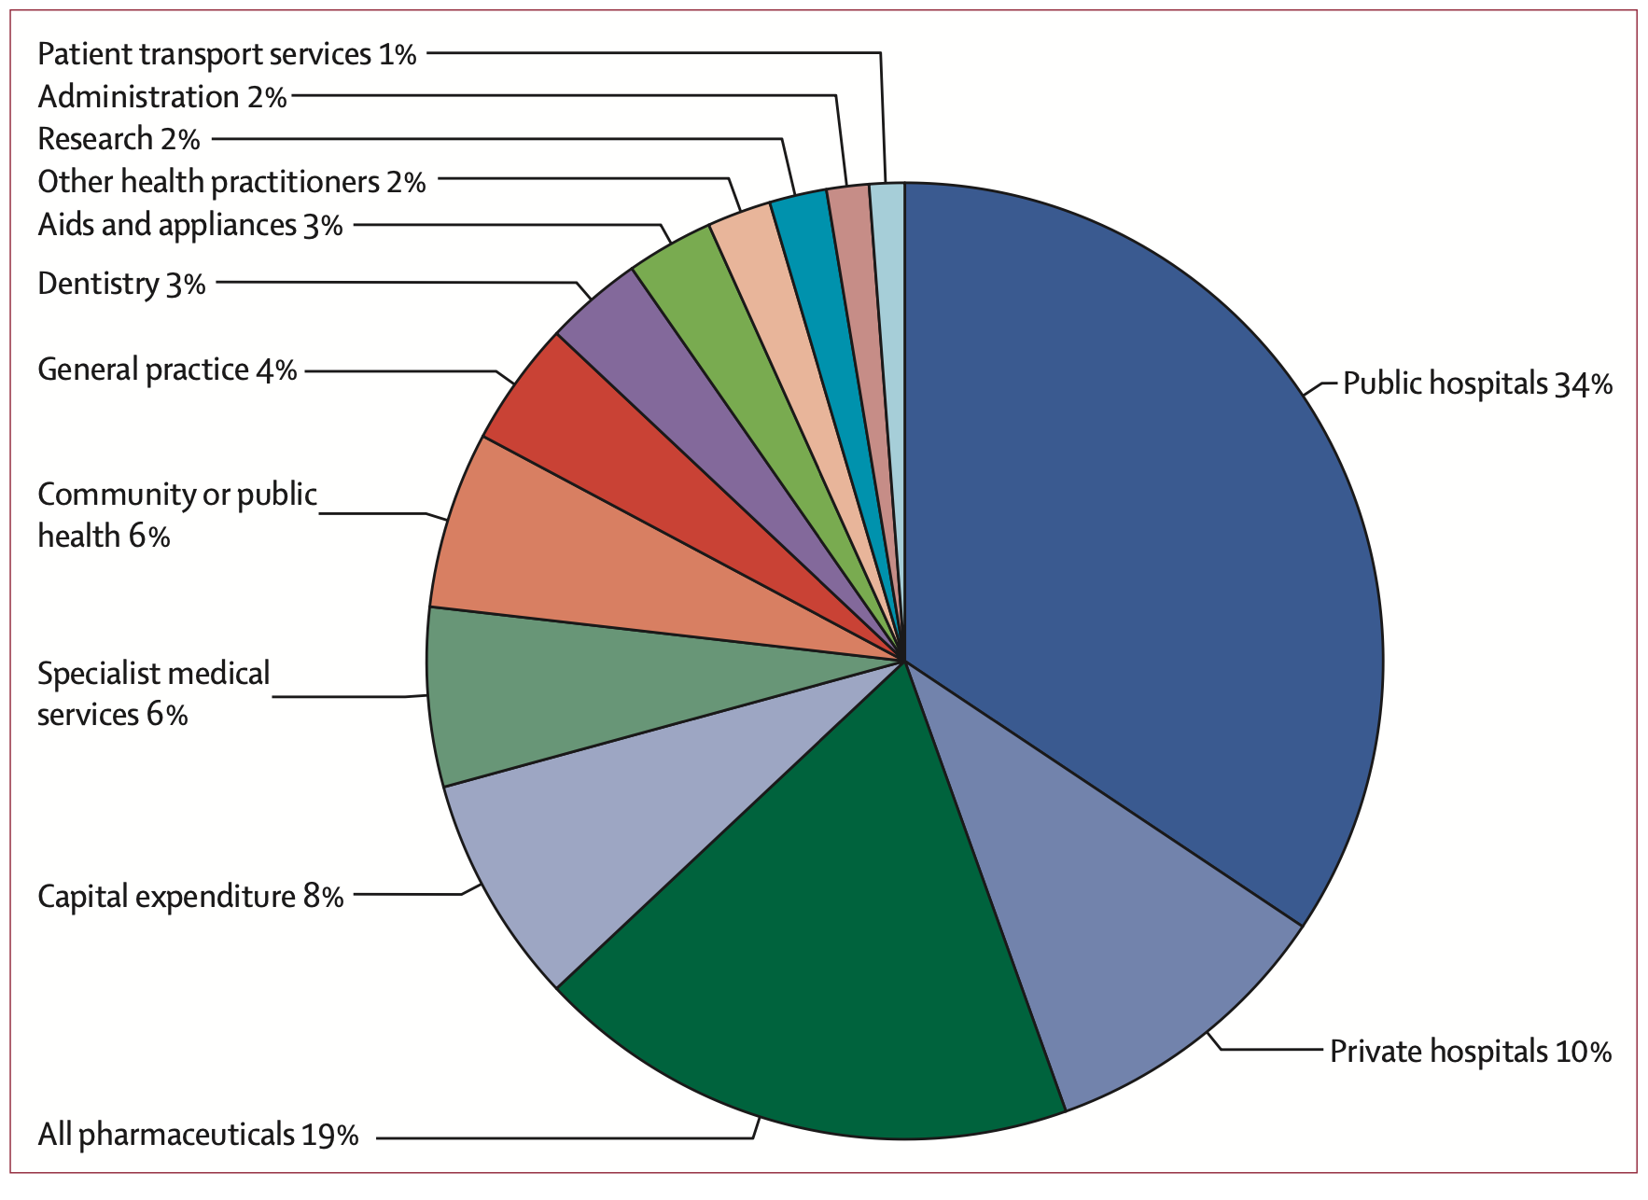
The problem
The carbon footprint of Australian healthcare is 7% of Australia’s entire emissions¹
This is more than the carbon emissions produced by all South Australians²
All vehicles on the road in Australia produce 10% of our emissions³
Worldwide 4% of global emissions come from healthcare… compared to only 2% from all aviation⁴
[1] Malik A., Lenzen M., McAlister S., McGain F. The carbon footprint of Australian health care Lancet Planetary Health 2;1;27-35
[2] South Australia Dept of Environment and Water ‘Climate Change’ 12 Feb 2023 https://www.environment.sa.gov.au/topics/climate-change/south-australias-greenhouse-gas-emissions
[3] Federal Dept of Climate Change, Energy, Environment and Water ‘Transport’ 12 Feb 2023 https://www.energy.gov.au/households/transport
[4] International Energy Agency ‘Aviation’ 12 Feb 2023 https://www.iea.org/reports/aviation

Slide 10
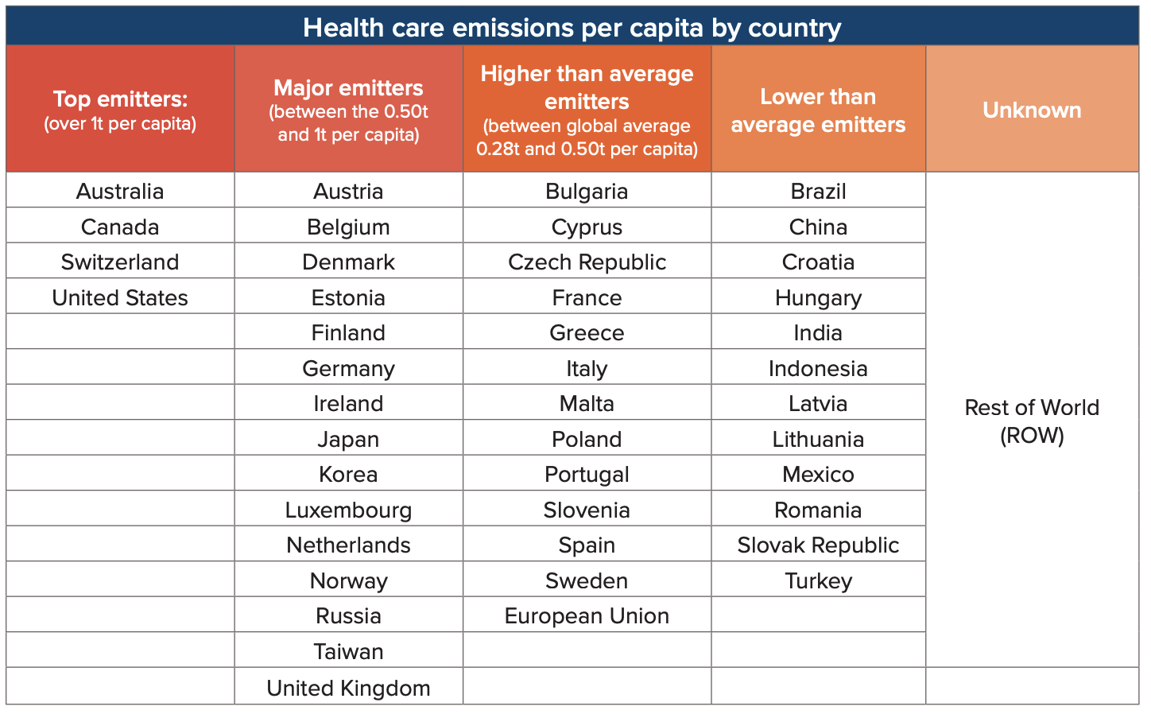
How does Australia compare worldwide?
Healthcare Without Harm ‘Health Care’s Climate Footprint’ 12 Feb 2023 https://noharm-global.org/sites/default/files/documents-files/5961/HealthCaresClimateFootprint_092319.pdf

Slide 11
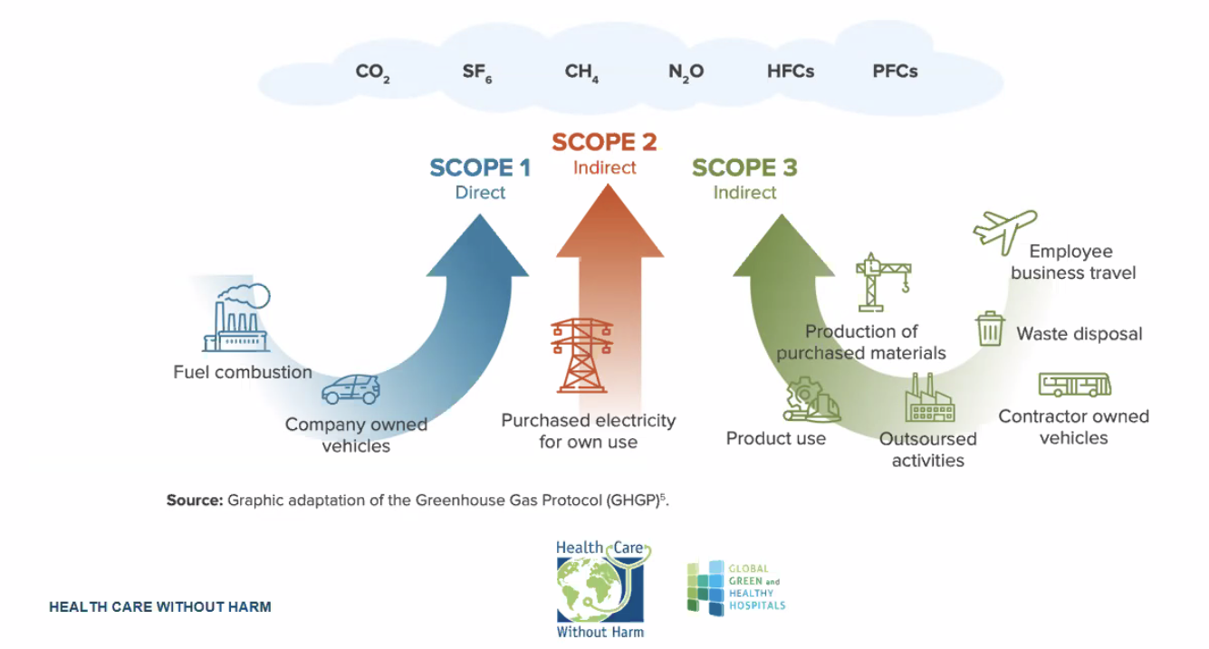
Our environment is changing — and it’s not just our climate.
Carbon footprint – Organisation by scope
Healthcare Without Harm ‘Health Care’s Climate Footprint’ 12 Feb 2023 https://noharm-global.org/sites/default/files/documents-files/5961/HealthCaresClimateFootprint_092319.pdf

Slide 12
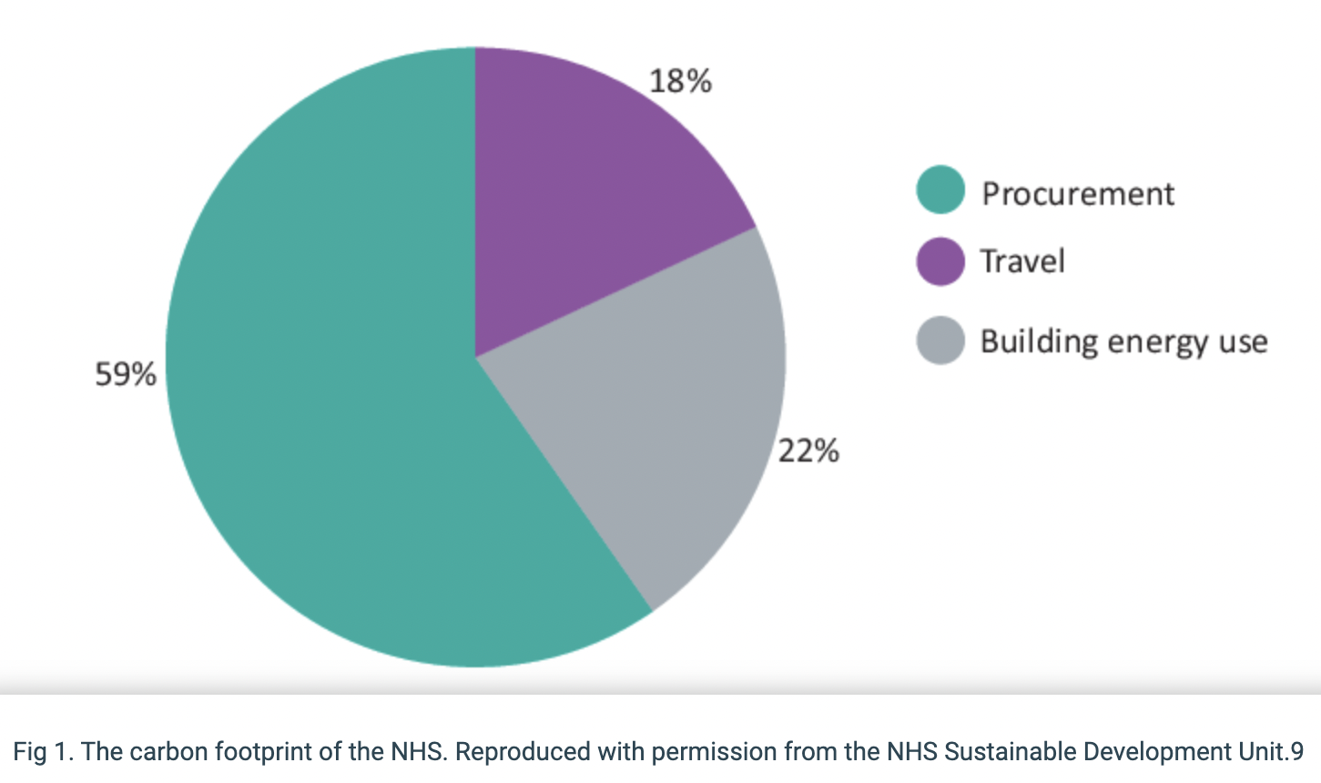
Healthcare Emissions Sources
National Health Service ‘Delivering a Nero Zero National Health Service’ 12 Feb 2023 https://www.england.nhs.uk/greenernhs/wp-content/uploads/sites/51/2020/10/delivering-a-net-zero-national-health-service.pdf

Slide 13
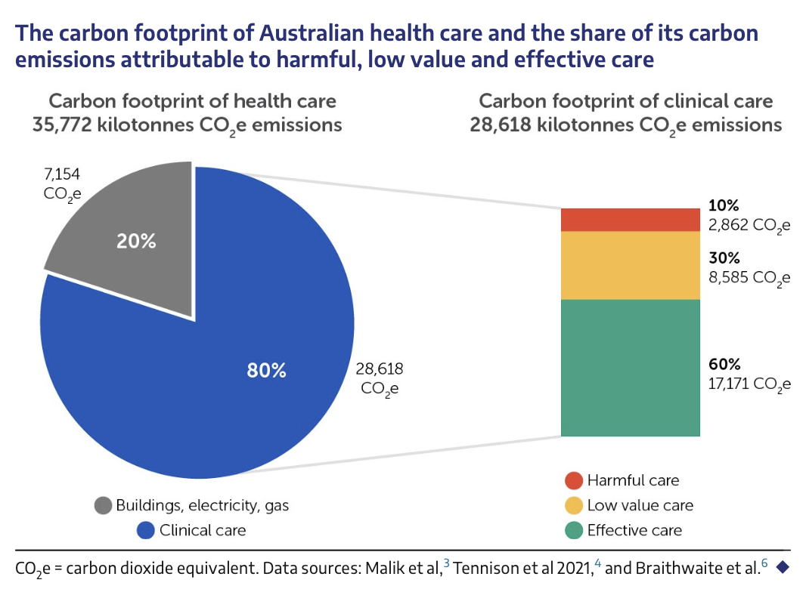
Safer healthcare is sustainable healthcare
Environmentally sustainable care reduces harm and uses our resources as wisely as we can
Better care for our patients is better care for our planet
Barrat A., Bell K., Charlesworth K., McGain F. High value health care is low carbon health care Med J Aust 2022; 216 (2): 67-68

Slide 14
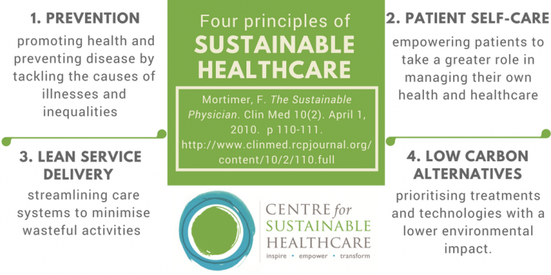
Principles of environmentally sustainable healthcare

Slide 15






Pathways to low carbon healthcare
Reduce
Reuse
Recycle
Rethink
Research
Advocate

Slide 16
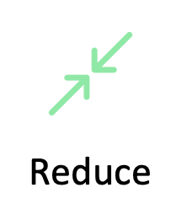
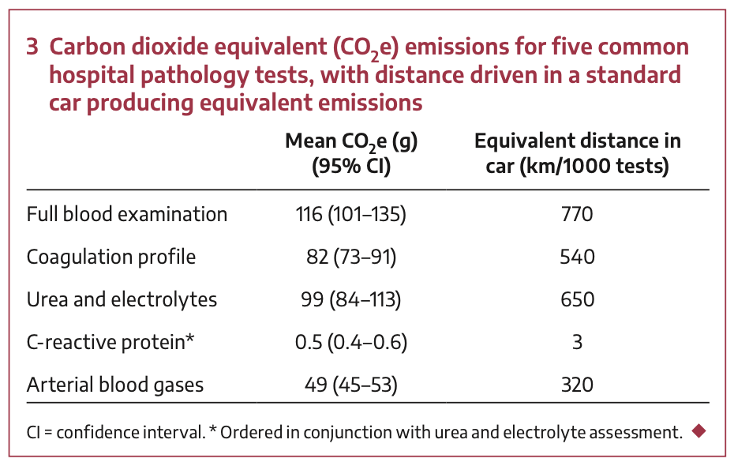
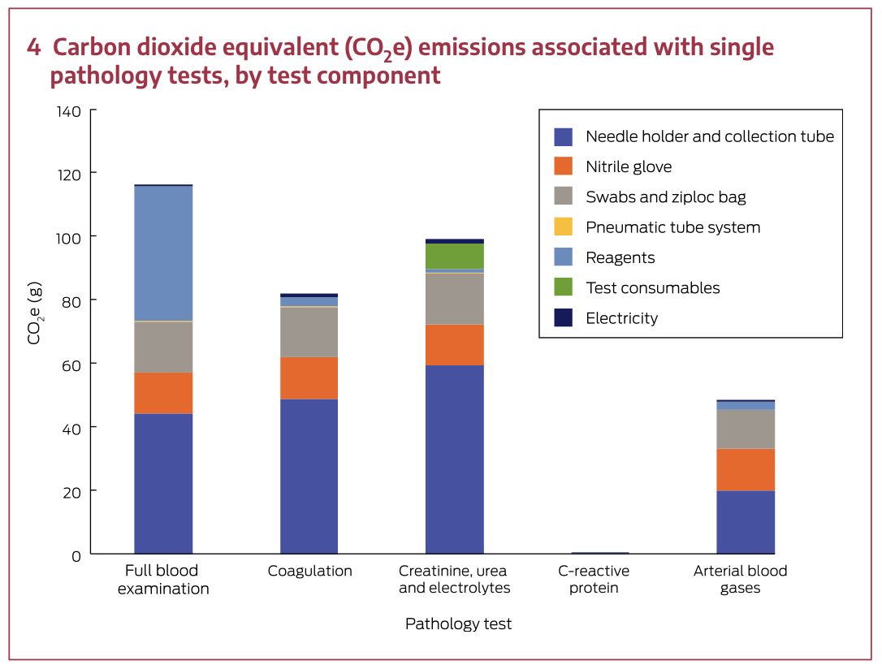
Investigations
Why are we ordering this test?
Reducing low value care means reducing unnecessary investigations
Carbon footprint of pathology testing
Ordering just one extra FBC each shift over a year generates as much carbon as driving from Melbourne to Traralgon (170km)!
Mc Alister S., Barrat A., Bell K., McGain F. The Carbon Footprint of Pathology Testing Med J Aust 2020; 212 (8): 377-382
National Transport Commission ‘Carbon Dioxide Emissions Intensity for New Australian Light Vehicles 2020’ 21 Feb 2023
https://cdn-nrspp-s3-aus.s3.ap-southeast-2.amazonaws.com/wp-content/uploads/sites/4/2021/11/30061913/Carbon-dioxide-emissions-intensity-for-new-Australian-light-vehicles-2020.pdf

Slide 17
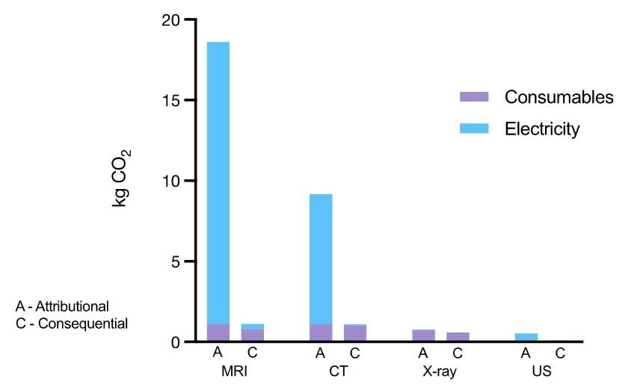
Investigations
Unnecessary imaging investigations have a significant CO2 footprint¹
One MRI scan (18kg CO2) is the equivalent of driving 122km in an average car^{1,2}
If your patient requires imaging, is there a lower carbon imaging investigation that can be requested?
[1] McAlister S., McGain F., Petersen M et al The carbon footprint of hospital diagnostic imaging in Australia Lancet Reg Health West Pac. 2022 Jul; 24: 100459
[2] National Transport Commission ‘Carbon Dioxide Emissions Intensity for New Australian Light Vehicles 2020’ 21 Feb 2023
https://cdn-nrspp-s3-aus.s3.ap-southeast-2.amazonaws.com/wp-content/uploads/sites/4/2021/11/30061913/Carbon-dioxide-emissions-intensity-for-new-Australian-light-vehicles-2020.pdf

Slide 18

Equipment
Reusable face shields
Reusable goggles
Reusable isolation gowns
Case Study
NHS ‘Gloves Are Off’ campaign at GOSH¹
35,000 less gloves used per WEEK!
Targeted education on appropriate glove use
No change in infection rates
[1] National Health Service ‘The Gloves Are Off Campaign’ Atlas of Shared Learning 12 Feb 2023 https://www.england.nhs.uk/atlas_case_study/the-gloves-are-off-campaign/

Slide 19
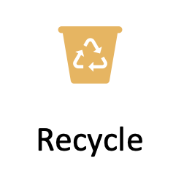
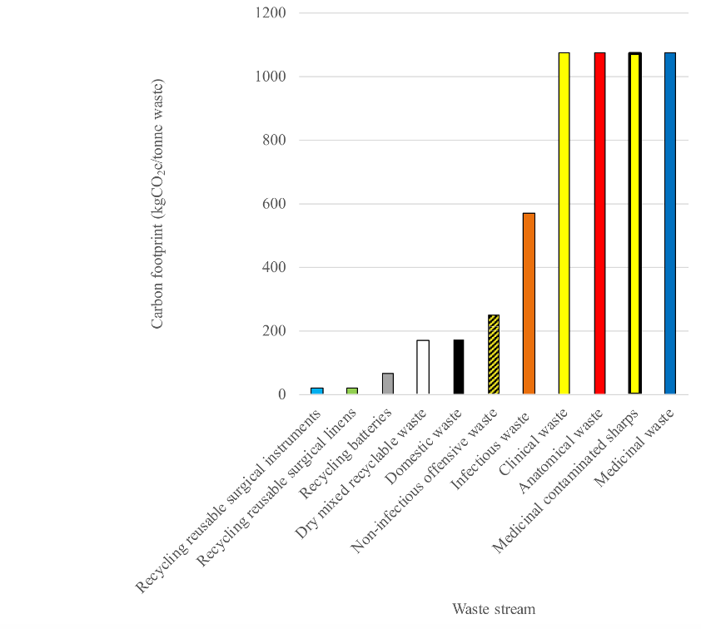
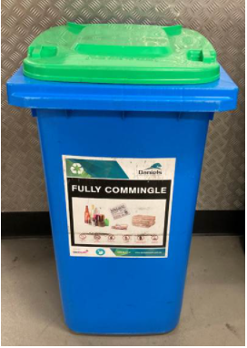
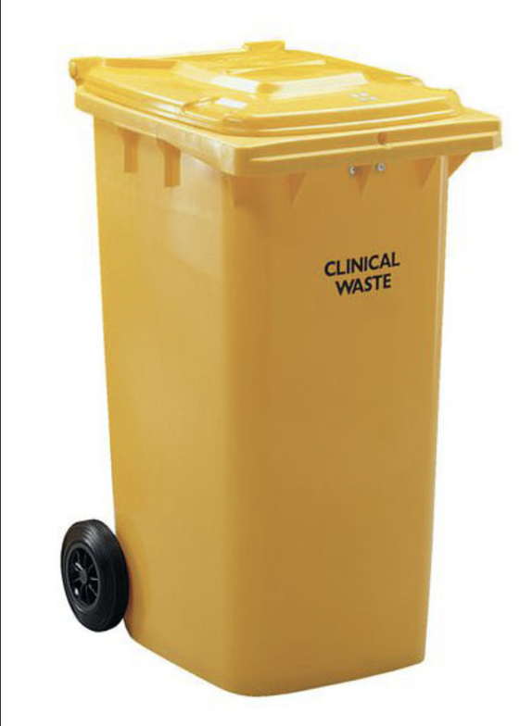
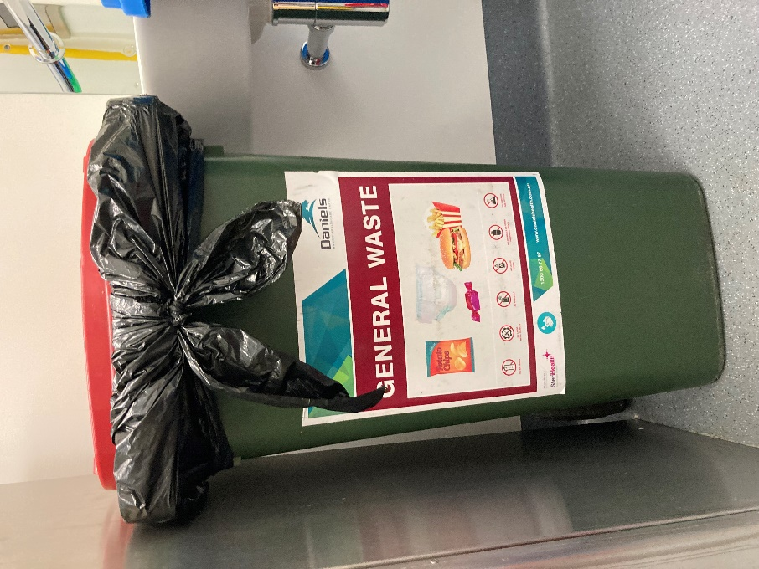
Waste Streams
Appropriate waste streaming saves money and ensures that waste is managed safely and in the most environmentally sustainable manner^{1,2}
1] World Health Organisation ‘Health-Care Waste’ 12 Feb 2023 https://www.who.int/news-room/fact-sheets/detail/health-care-waste
2] Chantelle Rizan, Mahmood F. Bhutta, Malcom Reed, Rob Lillywhite. The carbon footprint of waste streams in a UK hospital Journal of Cleaner Production 286 (2021) 125446

Slide 20

Prescribing
Choosing wisely¹
Lifestyle interventions over pharmacotherapy when appropriate²
Switching IV medications to oral options as soon as possible
Low carbon alternatives
Inhalers³
Anaesthesia⁴
Antimicrobial resistance and responsible antimicrobial prescribing⁵
[1] Choosing Wisely 12 Feb 2023 https://www.choosingwisely.org.au/
[2] National Heart Lung and Blood Institute Lifestyle Interventions to Reduce Cardiovascular Risk: Systematic Evidence Review from the Lifestyle Work Group 12 Feb 2023 https://www.nhlbi.nih.gov/health-topics/lifestyle-interventions-reduce-cardiovascular-risk
[3] Green Inhaler 12 Feb 2023 https://greeninhaler.org/
[4] Shelton C., Knagg R., Sondekoppan R., McGain F. Towards Zero Carbon Anaesthesia BMJ 2022;379:e069030
[5] Australian Commission on Safety and Quality in Healthcare ‘AntimicrobialStewardship Clinical Care Standard’ 12 Feb 2023 https://www.safetyandquality.gov.au/our-work/clinical-care-standards/antimicrobial-stewardship-clinical-care-standard

Slide 21
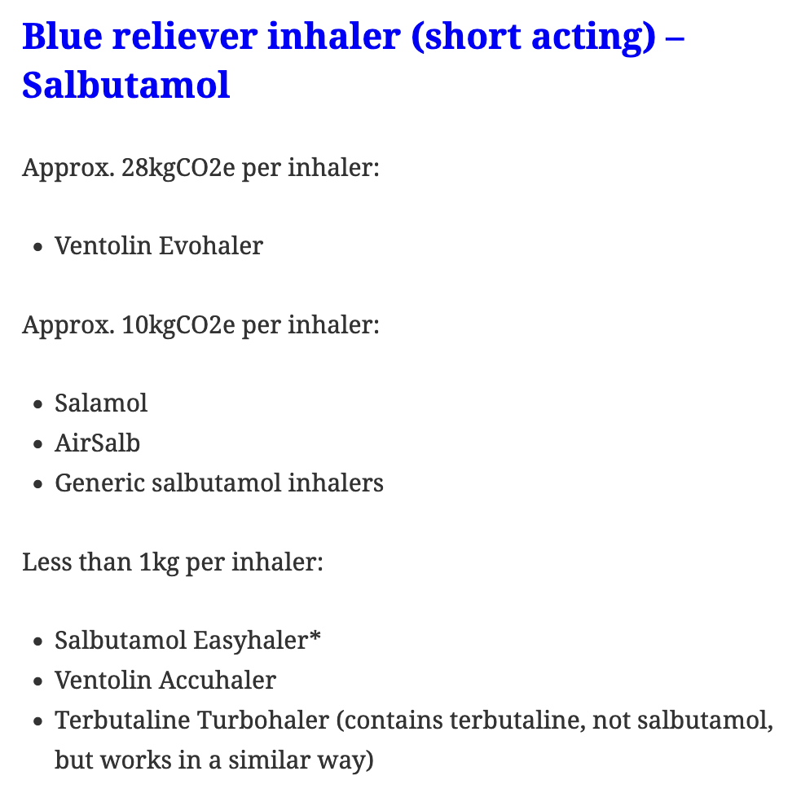
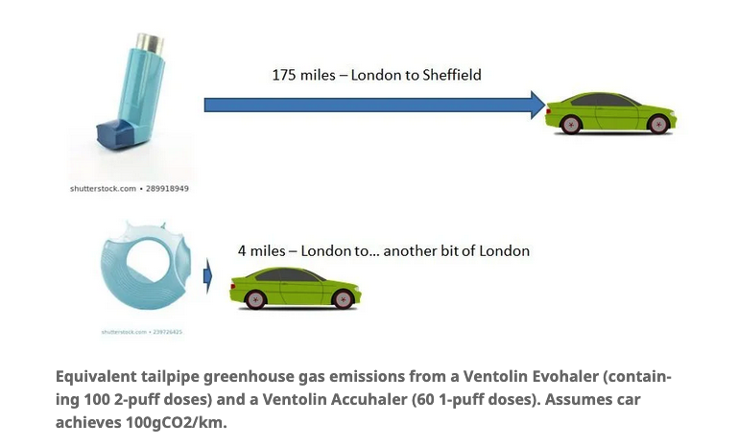
Inhalers
Equivalent tailpipe greenhouse gas emissions from a Ventolin Evohaler (containing 100 2-puff doses and a Ventolin Accuhaler (60 1-puff doses). Assumes car achieves 100gCO2/km.
Blue reliever inhaler (short acting) – Salbutamol
280km - Melbourne to Horsham
6km - Melbourne to… another bit of Melbourne
Green Inhaler 12 Feb 2023 https://greeninhaler.org/

Slide 22
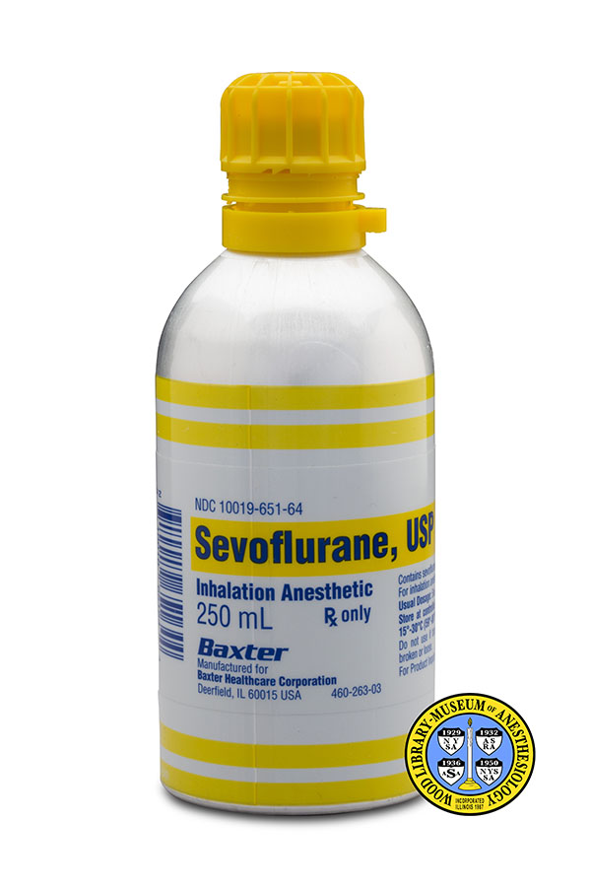
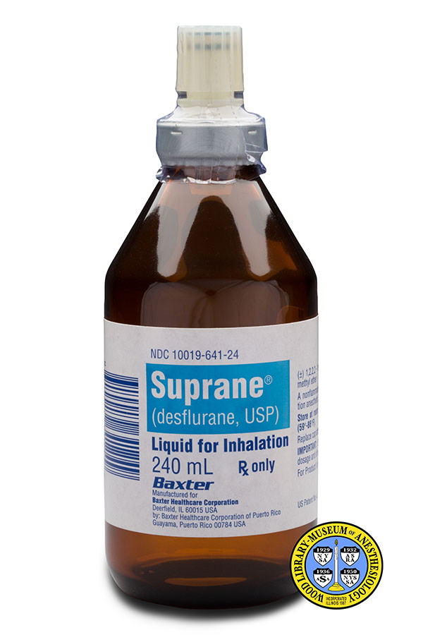
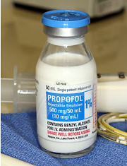
All anaesthetic agents are not equal
GWP₁₀₀ 130
1 bottle = 41 KgCO₂e
Driving 297 Km in a car
GWP₁₀₀ 2580
1 bottle = 893 KgCO₂e
Driving 6471 Km in a car
Not a greenhouse gas
1 bottle = 0.011 KgCO₂e
Like cycling not driving!
Shelton C., Knagg R., Sondekoppan R., McGain F. Towards Zero Carbon Anaesthesia BMJ 2022;379:e069030

Slide 23
Rethink – Treatment Pathways¹
Evidence based
Shared decision making
More is not better
Consider:
Increased focus on preventive health/primary care
Reduce complications
Targeted use of resources
Non-surgical/interventional alternatives
Care at home
Telehealth where appropriate
[1] Salas R., Maibach E., Pencheon D. A pathway to net zero emissions for healthcare BMJ 2020;371:m3785

Slide 24

Research – QI Resources
Are you interested in being involved in improving the environmental sustainability of your ward/department/hospital?
Sustainable quality improvement projects
Reduce waste/improve waste management
Reduce unnecessary testing
Generate evidence to develop sustainable models of care
Sustainable Quality Improvement ‘SusQI’ 12 Feb 2023 https://www.susqi.org/

Slide 25


Advocate – get involved
Your Hospital Sustainability Working Group
Doctors for the Environment Australia
Royal Colleges/Societies
JOIN US

Slide 26
Good news stories at our health service

Slide 27
Thank You
Reduce
Reuse
Recycle
Rethink
Research
Advocate

Slide 28
