Slide 1
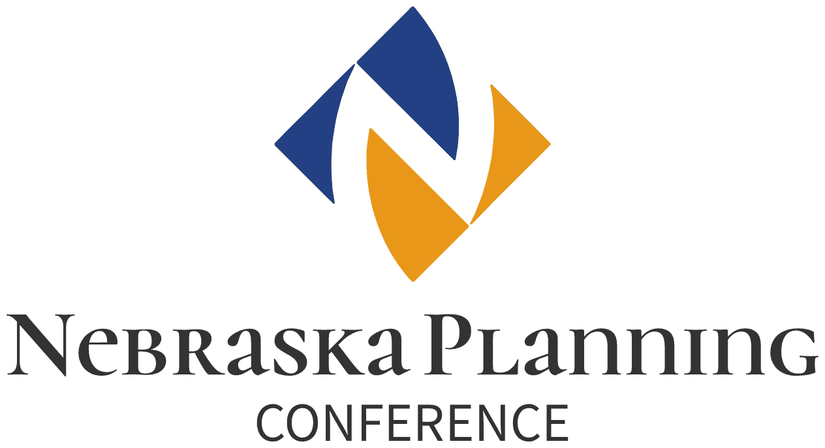
The Benefits and Perils of Anaerobic Digester/Biogas Technology:
Waste Management & Energy Generation Systems for Concentrated Animal Feeding Operations (CAFOs)

Slide 2
The Benefits and Perils of Anaerobic Digester/Biogas Technology as a Waste Management & Energy Generation System for Concentrated Animal Feeding Operations (CAFOs)

Slide 3
Add AgStar Danny Kluthe Farm Biogas Digester 1-page picture with text
This will describe NE’s first permitted CAFO biogas digester from 2024
ONE RED Update—August 1, 2024. Nebraska has been awarded $307 million to implement the measures listed below over a five-year period. Participation in all incentive programs will be strictly voluntary and will not rely on new rulemaking or requirements. The distribution of funds between measures is being discussed with EPA, and grant funds will not be available to NDEE until mid-October 2024. The program designs and timeframes for implementation will be worked out over the coming months.
One of 8 ONE RED (“Opportunity for Nebraska: Reducing Emissions and Decarbonization”) measures :
Establish Hub-and-Spoke Anaerobic Digester/Biogas Hubs for Agricultural Waste: Establish three [recently downsized to one by NDEE] regional biogas cleaning facilities near existing natural gas pipelines, with biogas supplied by digesters at nearby animal feeding operations to benefit multiple producers.
Metric Tons GHG reduction by 2030: 689,256
Metric Tons GHG reduction by 2050: 5,927,405
(see: https://dee.nebraska.gov/sites/default/files/publications/ONE%20RED%20Fact%20Sheet%202024-11-12.pdf)

