Slide 1
LIFE PRESERVING SERVICES (LPS) Whiringa-ā-nuku/ October 2025

Slide 2
Schedule 1B Code of good faith for the public health sector
Schedule 1B was inserted on 1 December 2004 by section 69 of the Employment Relations Amendment Act
The Code was further Amended in June 2024
The Code applies to the parties to an employment relationship in the public health sector which includes Health New Zealand and New Zealand Blood and Organ Services
And unions whose members are employees of HNZ or other providers of services to HNZ or NZ Blood and Organ Services
It also applies to other employers where they provide services to HNZ
And employees of other employers to the extent that they provide services to HNZ or NZ Blood and Organ Services
Notes:
The Code of good faith for the public health sector was introduced as a compromise for a call in the early 2000’s for the right to strike for nurses working in the public health sector being deemed to be an essential service, to be restricted. This is in a similar way to the situation of the Police where they cannot strike and their collective bargaining outcomes are arbitrated. The 2024 Amendments were made following the dissolution of the Māori Health Authority and the reverting back to the use of Health New Zealand, rather than Te Whatu Ora. It was also made clearer that there was a broadening out of the definition of the “public health sector” to include any provider providing health services to HNZ, by extension covering employees pretty much across the health sector.

Slide 3
Life Preserving Services – As defined in the code
Crisis intervention for the preservation of life:
Care required for therapeutic services without which life would be jeopardised:
Urgent diagnostic procedures required to obtain information on potentially life- threatening conditions
Crisis intervention for the prevention of permanent disability:
Care required for therapeutic services without which permanent disability would occur:
Urgent diagnostic procedures required to obtain information on conditions that could potentially lead to permanent disability
Notes:
Life preserving services include patient safety and as in this slide diagnostic and therapeutic services without which permanent disability would occur. This broadens out what is normally thought of as LPS. On the day of the strike / during the period thereof, members need to think about the patient safety aspects and who the industrial action is focussed on, i.e. the employer. We would hope that in the lead up to and the preparation for the action the employer has been massively inconvenienced, and services are disrupted. On the day of the strike we should have achieved that and can continue to provide safe nursing care using our professional judgement and assessment skills of what is required. Describing “tasks” that should or should not be done is not appropriate as the full context of the situation is only known to those present.

Slide 4
Life Preserving Services (Sec.12) Contingency planning
As soon as notice of industrial action is received or given an employer must develop a contingency plan; and take all reasonable and practicable steps to ensure that it can provide life preserving services
If the employer believes it cannot arrange to deliver any life preserving services during industrial action without the assistance of members of the union, the employer must make a request to the union seeking the union and its members’ agreement to maintain or to assist in maintaining life preserving services.
The request must include details about the assistance it is seeking
Notes:
The union is required only to use best endeavours and all reasonable effort to assist. It is the employer's responsibility to provide for patient safety during industrial action and can only “seek the assistance” of striking members.

Slide 5
For clarity, every LPS request made by Te Whatu Ora to the union must include the following specific information:
The particular area / ward that is seeking assistance from NZNO members
The efforts already made to reduce patient volume
The efforts already made to exhaust the filling of any staffing gaps with non-NZNO workers
What the ‘normal’ staffing levels are in this area
NOTE: LPS cannot be used as a mechanism to fill pre-existing gaps in staffing levels. The existing levels on the day the strike notice is issued shall define the ‘normal’ level.
Notes:
As a guideline, normal staffing levels refer to there being no more staff than was rostered on the same day of the week, the week before the strike. In fact, there should be less staff given the reductions and consolidation of services and the availability of non-NZNO member.

Slide 6
The parties must make every reasonable effort to agree on:
the extent of the LPS necessary for patient safety
the number of staff necessary to provide LPS
an emergency protocol should additional LPS be required

Slide 7
Member-Led Life Preserving Services
In keeping with NZNO’s ongoing commitment to make this campaign genuinely member-led,
NZNO delegates and NZNO member leaders will be negotiating as equals, in good faith, with the relevant Te Whatu Ora District representatives as to the appropriate LPS staffing levels during the industrial action, including agreeing the strike (day) rosters.
Notes:
Good faith – General requirements are – engage constructively, participate fully and effectively. Behave openly and with courtesy and respect toward each other; and create and maintain open, effective, and clear lines of communication, including the provision of information in a timely manner; and recognise the role of health professionals as advocates for patients

Slide 8
LPS timeline
Notice of industrial action is issued to Te Whatu Ora.
By 5pm the following day Te Whatu Ora must make any specific requests to NZNO for LPS assistance.
It is from this point, for a period of three days, the detailed LPS discussions / negotiations will take place across all Districts.

Slide 9
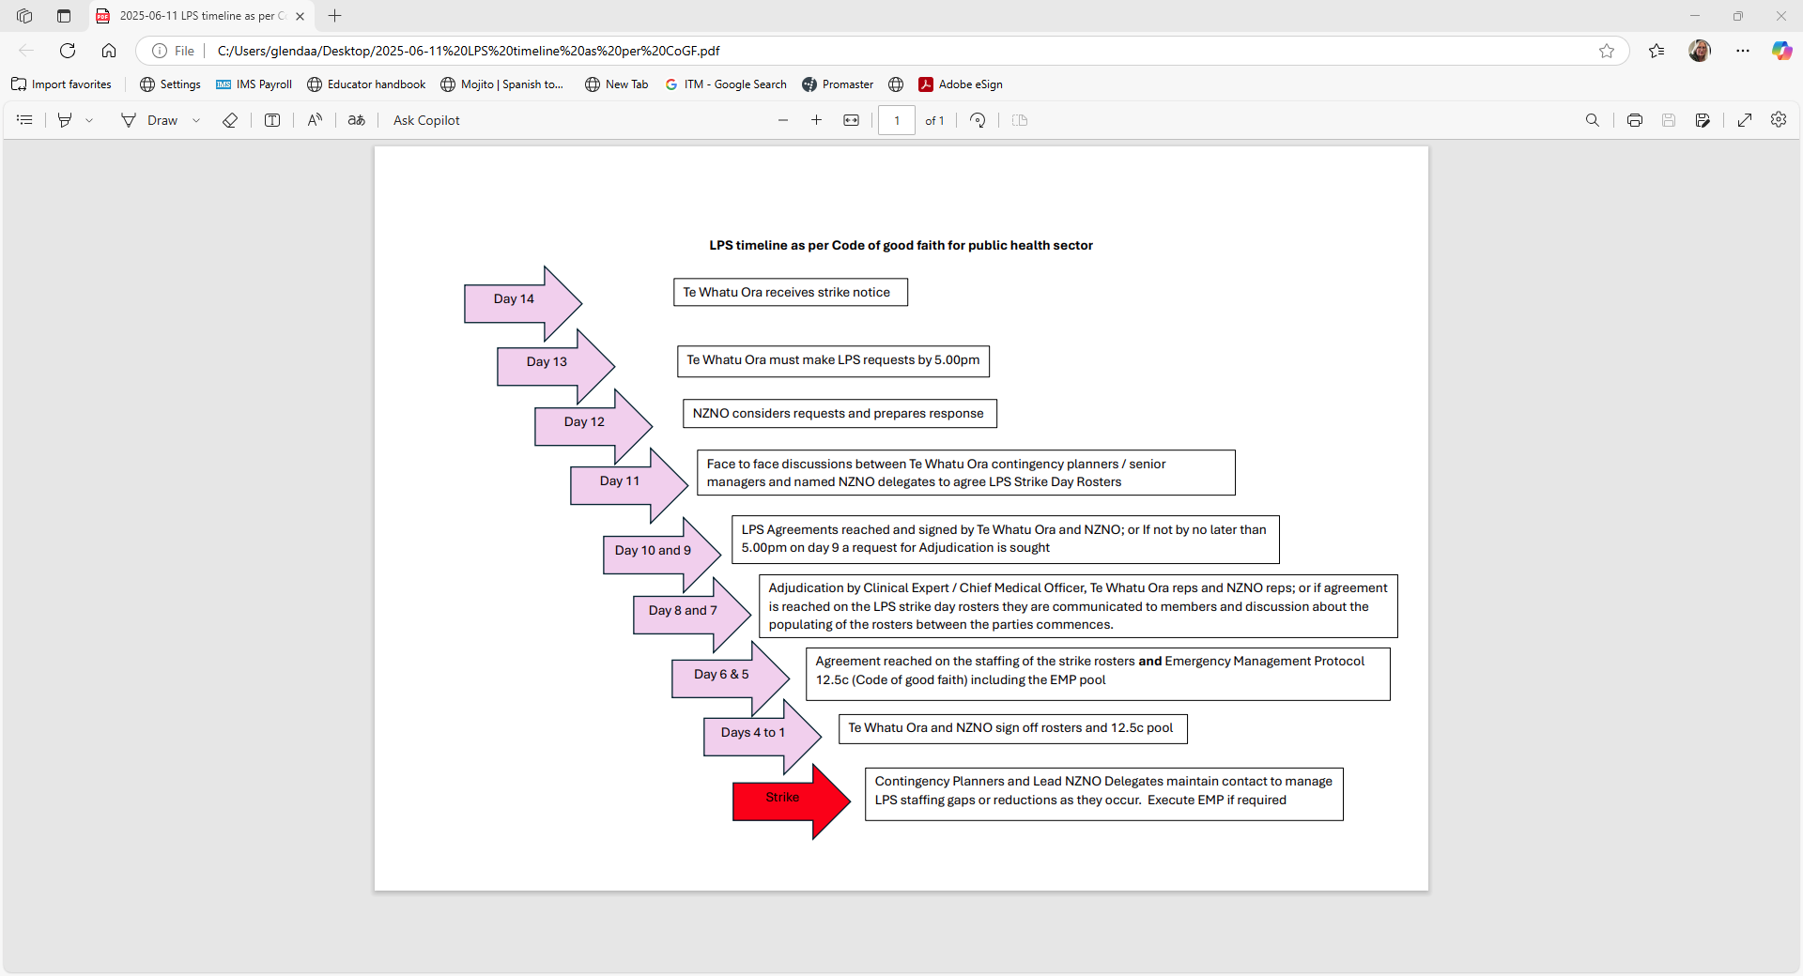

Slide 10
NZNO LPS representatives
Why should delegates / member lead this process?
NZNO delegates and members know better than anyone else what ‘life preserving services’* mean in their work area, that’s why they need to step up and lead this crucial process.
Members should urgently identify and support official NZNO LPS representatives across all the Districts who will lead these discussions from the floor. The number of reps required to effectively cover each District should be decided by members, in consultation with your local NZNO staff.
Notes:
In considering what LPS means in each clinical area, delegates need to refer to the full definition LPS as per the Code of good faith (slide 3)

Slide 11
NZNO LPS representatives
are identified by name as the official NZNO LPS representatives for their District
will be NZNO members who understand the basics of LPS provisions
have the confidence and mana to conduct these discussions as equals with District representatives, whoever they may be
have the full support of the members they are representing
have the confidence to say “no” and seek support from NZNO staff when necessary
Notes:
It is better not to agree on a strike day roster if NZNO reps think the requests are inflated or have not taken proper account of other resources available. It agreement is not reached the roster / strike arrangement will be referred to adjudication.

Slide 12
NZNO LPS representatives
To reiterate, LPS reps
are the NZNO delegates / NZNO member leaders (not NZNO staff) who will be the front-line LPS negotiators, on an equal footing with the District representatives in all LPS negotiations across all Districts.
will be provided with to support during the negotiations, each rep will have an NZNO staff contact who will be available to speak at all times.

Slide 13
Failure to reach LPS agreement?
Within 5 days from when the strike notice is issued, should the NZNO LPS rep(s) and the District rep(s) fail to reach an agreement on LPS / strike day rosters, and the support of NZNO staff has failed to break the deadlock, the matter must be referred for adjudication by a mutually agreed clinical expert – in this case, the Chief Medical Officer of each District.
If the adjudicator cannot resolve the differences between the parties, they must make a determination not later than seven days after the date of the issuing of strike notice.
Notes:
The role of the Adjudicator is to receive and consider representations from the parties; and in consultation with the parties, seek expert advice if the adjudicator considers it necessary to do so; and attempt to resolve any differences between the parties to enable them to reach agreement and, if that is not possible, make a determination binding on the parties; and provide the determination to the parties as soon as possible but not later than 7 days after the date of notice of industrial action. The parties must use their “best endeavours” to give effect to the determination.

Slide 14
Although every reasonable effort must and will be made by both parties to reach LPS agreement, it is important that our NZNO LPS reps do not feel compelled to agree to LPS provisions that they cannot in good conscience accept.
Remember, if agreement can’t be reached, it is better to seek adjudication rather than accept a District request that does not seem reasonable.

Slide 15
The lead up to strike day
In the lead up to the strike day , all LPS agreements / strike day rosters (or adjudications) between the union and Te Whatu Ora will be put into writing and signed by representatives of both parties.
These signed documents will not be ‘secret’ and will be available to all for full transparency.
Should there be any changes in staff availability In the period between the LPS agreements being signed and the strike day, NZNO national contacts must be advised and changes to relevant agreements made.
Notes:
Discussion – by reaching agreement to a “strike day” roster, the usual roster should be null and void. This needs to be communicated to members so that they do not turn up for work during the period of the action where a “strike roster” has been agreed.

Slide 16
During the strike
Our delegates will play a critical role on strike day:
encouraging fellow members to participate
Reassure members that there is a robust LPS process in place - no individual member should need to make a difficult ‘personal decision’ about participation in the action. This is not personal. This is a process.
The employer is required to continue to reduce volumes and take other actions to avoid requiring the assistance of NZNO members leading up to and on the day of the strike. If due to reductions in the need for assistance or other appropriate non-striking personnel become available, above what has been agreed on the strike day roster, NZNO LPS responders will be released to participate in the strike action.
Notes:
Discussion regarding payment. That is if the NZNO member is released due to reductions in the need for members assistance, they will be paid for the period they worked, but not the full shift if they are stood down earlier.

Slide 17
Key points and principles
Remember, striking is not an end in itself – it is a way to exert pressure on an employer to get the parties back to the negotiating table or to resolve the impasse.
Being an LPS responder is actually supporting the strike.
As soon as LPS numbers are agreed/adjudicated, it’s critical that enough NZNO members put their name forward in good time to fully populate the strike day roster. Members need to do this directly with the District representatives
Strike day rosters should be confirmed no later than 72 hours (three days) before the strike commences

Slide 18
Key points continued:
All NZNO members covered by the Te Whatu Ora Collective Agreement are expected to support any industrial action regardless of how they voted (or didn’t vote!). This means:—
All members are expected to support and physically attend any pickets unless providing official Life Preserving Services.
All members need to remember the principles of collective responsibility. Participation and full support of the majority decision, regardless of your personal opinion.
Notes:
By ensuring the strike day rosters are populated, this should lessen the likelihood of the employer encouraging other non-LPS responders to work. NZNO members who are not on the strike day rosters should not turn up to work even if they were rostered on that day previously. The NZNO Constitution requires all members to support collective decision making of the union. This means even if an individual member did not vote for the strike they are bound by the strike notice to collectively support the strike. The strike notice will state that the strike covers all NZNO members and it is a complete withdrawal of labour.

Slide 19
Strike day is not:
A holiday. All members need to participate in the actions and support one another.
A day to suddenly feel guilty or pressured to go in to work to ‘help out’ (unless a legitimate LPS responder).
The life preserving service process is robust, transparent and member-led.
We must have the confidence to pursue our goals knowing we have done all we can do in the circumstances to assist in keeping patients safe.

Slide 20
Maranga mai!
Kia kaha- stand strong!

