Slide 1
Tenant Education and Outreach Program: A Webinar
September 4, 2025
Presenters: Michael Kane, Mass Alliance of HUD Tenants
Susie Shannon, AIDS Healthcare Foundation
Elizabeth Fernandez, HUD
Notes:
Removed full middle name & middle initial , will add LOGOS

Slide 2
Tenant Education and Outreach Program
HUD has awarded a $10 million Tenant Education and Outreach (TEO) grant to the AIDS Healthcare Foundation (AHF) and its partner, the Mass Alliance of HUD Tenants (MAHT), to sub-award up to $300,000 over 3 years to local groups to organize Project Based Section 8 tenants in their communities
HUD award is from Section 514 of the Multifamily Affordable Housing Reform and Affordability Act (MAHRAA) of 1997. HUD advertised TEO grant in 2023
AHF role: HUD’s Intermediary to sub-award TEO funding
MAHT role: Co-applicant to market program; screen and recommend sub-award applicants to AHF; provide training and support to sub-awardees
MAHT and AHF are responsible for negotiating and approving sub-award proposals
Notes:
TEO applications opened in July 2023 and closed October 2023 but the funding was allocated in Fiscal Year 2024 and contracted in Fiscal Year 2025 for Sub-Award competition to start in Fall of Calendar Year 2025

Slide 3
Goals of TEO Program
TEO Goal: Build capacity of Project-Based Section 8 tenants
  Work productively with property management and owners
  Hold management accountable for property conditions
  Improve management and oversight of Section 8 properties
  Advocate for preservation of at-risk housing
Notes:
Minor term suggestions like management refers to property management but edits not required, you could make it part of the speech if you wish.

Slide 4
Who Can Apply for TEO Funds
Eligible organizations that propose to serve at least 25 units of one or more HUD Multifamily housing developments where at least 75% of apartments receive Project Based Section 8 funding
Eligible organizations that can apply for TEO include:
  Tenant-affiliated nonprofit Community Based Organizations at the community, city, metropolitan, neighboring rural community, or state levels
  Established or newly-formed “legitimate tenant organizations” at the building level: a group that meets regularly, operates democratically, represents all tenants in the development, and is completely independent of owners/managers (24 CFR Part 245.110)
Notes:
Check the line spacing

Slide 5
Who Can Apply for TEO Funds (continued)
To receive TEO funds, a subawardee must have an organizational bank account at a licensed financial institution
Applicants may submit an application before they have a bank account, but cannot receive funds until account is set up
Newly-formed tenant organizations may apply on their own or submit a joint application with another more experienced organization or CBO in their area
Current or prospective owners or property managers are NOT eligible to apply, including resident-owned cooperatives, resident-controlled nonprofit owners, and housing authorities
Notes:
Minor order suggestions like 2-1-4-3 but edits not required

Slide 6
What buildings are eligible for TEO assistance?
Privately-owned, HUD Multifamily housing developments of at least 25 units with Project Based Section 8 contracts that serve at least 75% of the residents
Buildings receiving Project-Based Section 8 (PBRA) from one or more of these HUD programs:
  New Construction; Substantial Rehabilitation; Loan Management Set-aside (LMSA); Property Disposition Set-Aside (PDSA); Section 202/811 Elderly/Handicapped Housing; Section 202/8
Former Public Housing developments converted to private ownership through the Rental Assistance Demonstration (RAD) program that receive Section 8 through PBRA (but not Project-Based Vouchers (PBVs)) are eligible for TEO assistance
Notes:
We think it's too confusing to list out but for the RAD notes, conversions must have completed closing and if we include a list, it must have all the potential eligibles on it.

Slide 7
Federally-assisted buildings NOT eligible for TEO
Public Housing Developments owned by Local Housing Authorities
Properties receiving only mobile Section 8 Tenant Protection or Enhanced Vouchers (TPV or EHV)
Properties receiving only Project-Based Vouchers (PBVs), including properties converted to private ownership through HUD’s Rental Assistance Demonstration (RAD)
Properties whose federal assistance is only through the Low-Income Housing Tax Credit (LIHTC) program administered by the Internal Revenue Service
Notes:
Minor additions (TPV or EHV)

Slide 8
What are eligible uses for TEO funds?
Tenant and organizer training costs including travel to training events
Staff Resident Outreach Coordinators (salary plus fringe)
Resident service stipends for tenant group members who work on TEO activities
Limited direct overhead costs such as office or meeting space rental, flyers, printing, translation and interpretation
Reasonable food and daycare costs for tenant meetings
Cellphone, camera, laptop or tablet, internet service for tenant organization activities
Notes:
This is an eligible use of grant funds as a private business (translation and interpretation)

Slide 9
Eligible activities for TEO subawards
Publicizing and conducting tenant meetings
Documenting persistent unresolved physical condition concerns and owner responses
Addressing basic questions about tenant rights and responsibilities
Developing effective working relationships with owner/managers
Developing effective working relationships with HUD, Real Estate Assessment Center (REAC), Performance Based Contract Administrators (PBCAs), and state and local oversight agencies

Slide 10
Activities that are NOT eligible uses for TEO funding
Lobbying activities are strictly prohibited!
TEO funds must not be used for direct or indirect lobbying activities, including ‘grassroots’ lobbying, for or against legislation or referenda at the local, state or federal levels
TEO funds must not be used to contribute to a political party, campaign, political action committees, or similar organization
Administrative advocacy on policy or enforcement matters is not prohibited legislative lobbying, and is allowable
TEO funds must not be used for recreational activities, landlord/tenant legal services for individual households, activities funded from other sources such as resident participation funds in RAD converted properties, or pre-award activities prior to receiving a sub-award (such as collecting grant approval signatures from tenants)
Notes:
No back to school events with TEO funding, for example, you would need another source of funds to do that

Slide 11
How to Apply for TEO Funds
MAHT and AHF will open the application portal for TEO sub-applicants to apply for funds this fall, after HUD provides an approved application form
The online application portal will be fully compatible with Section 508 accessibility requirements
Required application components will include:
  List of proposed PBRA Section 8 properties to be served
  Documentation that the applicant has received the endorsement of 50% of the households in each property they propose to serve
  Description of organization structure and operating procedures
  Goals and Draft Plan of proposed activities, budget and timeline
Notes:
504 is physical accessibility
508 is digital and was changed to this

Slide 12
50% endorsement signature requirement
Sub-applicants must provide documentation that they have received the endorsement of 50% of the households in each property they propose to serve at the time of application
Sign in signatures for previous tenant meetings may count toward the 50% endorsement requirement
No more than one person per household may endorse an application
Each household can endorse the application of only one organization or CBO at a time
If a household endorses an application that is subsequently denied, that household may endorse another application

Slide 13
Joint applicants
Joint applicants must submit a Memorandum of Understanding (MOU) or Letter of Agreement that:
  Demonstrates a commitment to work collaboratively during the three year period of performance
  Identifies which party is the Lead Applicant
  Describes the respective roles of each co-applicant.
If a co-applicant is providing an MOU or Letter for more than one application, they must indicate this in each application and provide a list of all TEO applications on which they are co-applicants
Notes:
Minor adds, (MOU)

Slide 14
Applicant review process
AHF and MAHT are responsible for negotiating and approving sub-awardee proposals
AHF/MAHT will review applications and make subaward decisions on a first come, first serve basis for eligible applicants
AHF/MAHT will communicate with sub-applicants to refine their goals, draft plans, and proposed budgets, as well as notify sub-applicants of any technical deficiencies with deadlines for correction within 30 days
Notes:
Minor adds

Slide 15
Reasons for denying an application
AHF/MAHT may deny applications if:
  Applicant is ineligible
  The application is incomplete or does not propose eligible activities
  The proposed activities do not fall within the period of performance of AHF/MAHT’s agreement with HUD
  Proposed budget includes ineligible or unreasonable costs or activities, if not promptly revised when notified by AHF/MAHT
  Sub-applicant and AHF/MAHT are unable to agree on a final budget, plan, and timeline after reasonable efforts to assist with revisions
  The sub-applicant’s proposed budget exceeds the amount of remaining available funds

Slide 16
Appeal process to HUD
Notification that the application has been denied will be accompanied by a denial of award letter explaining in writing AHF/MAHT’s reasons for denial.
The Sub-applicant has the right to appeal that denial to HUD if:
  The sub-applicant has been rejected based on a requirement that they believe they meet; or
  The sub-applicant was not provided an opportunity to correct technical deficiencies in their application, other than failure to get written endorsement of a majority of households in properties served
  Appeal must be made within 45 days of rejection
  HUD will make binding determination within 45 days after the date of the appeal
Notes:
Minor adds

Slide 17
Successful Sub-Applicants
Selected organizations will execute a Cooperative Agreement with AHF/MAHT for execution of proposed activities
Sub-awardees must notify the residents of properties they propose to serve of the sub-award within 30 days of acceptance
AHF/MAHT will work with sub-awardees to refine their plans, budget and timeline, and amend these documents during the sub-award period of performance
Sub-awardees will submit monthly invoices to AHF including advanced payment requests, if applicable, and meet at least once quarterly with MAHT regarding performance progress on issues raised and resolved
Notes:
It was confusing as worded
Add that 1 month at a time (not 4 months) PARKING LOT ISSUE regarding quarterly or monthly advances
“ Subawards will submit invoices and supporting documentation “

Slide 18
Training and Support for TEO Subawardees
With 40 years HUD tenant organizing experience, MAHT will spearhead training and support for sub-awardees, including:
  Interactive Conference Calls and Webinars for issues and skills
  At least one on-site field training in your city each year
  Three national in-person training conferences with 12+ peer-led workshops and meetings with HUD
  Applicants have the option to include travel and registration for conferences in their budget requests
  MAHT/AHF anticipates offering annual conferences estimated at up to $1,500 per person
  On-call technical assistance by phone and email
Notes:
Variety of training available, please research and identify which training best suits the needs of your individual organization. You don’t have to use it all. This would be additional to the MAHT/AHF Conferences/Trainings

Slide 19
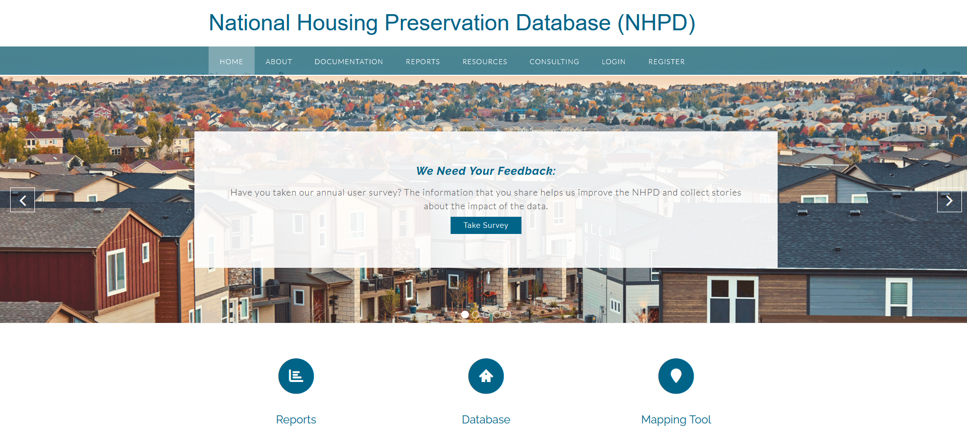
www.preservationdatabase.org
How to use the Preservation Database to look up eligible Section 8 properties
Notes:
Is this a live demonstration of the resources.hud.gov tool? Or the MF Database https://www.hud.gov/hud-partners/multifamily-assist-section8-database

Slide 20
Q&A
Notes:
Highlights are a parking lot issue we will get back to you on.

