Slide 1
Urban Forestry Commission
October 10, 2023

Slide 2
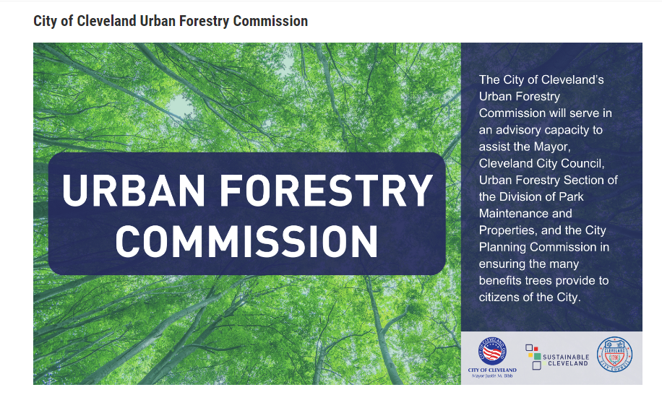

Slide 3
Agenda
01
Call to Order
02
Roll Call
03
Chair’s Welcome / Remarks – Reminder to sign up for Public Comment at entrance to room
04
Approval of Minutes
05
Unfinished Business – Members appointed to Sub-Committees
06
New Business
Complete and Green Streets Report Out
UFC Committee Chair Report Outs
Tree Academy Report Out
Urban and Community Forestry (IRA) Grant application result
07
Public Comment – 3 minutes, at Chair's discretion, will be recorded in Minutes; commenters are reminded that impugning character or reputation of any individuals will not be allowed
08
Closing Remarks
09
Adjourn
Notes:
Sam

Slide 4
UFC Members Appointed to Sub-Committees
01
Policy: Schreiber (Chair); Bay, Hernandez, Kipp, Spencer, Sridhar, Swiatalski
02
Maintenance: Leamon (Chair); Jackson, Jean-Baptiste, Kipp, Olesky, Sridhar, Tokars
03
Budget: Spencer (Chair); Kipp, Hernandez, Malone, O'Keeffe, Sridhar
04
UFC sub-committee meetings are internal to the Urban Forestry Commission, with reports at quarterly mtgs
05
Who Does the Work – sub-committee members are commission members; committee charter, initial work and discussion on non-commission non-voting members being invited to supplement knowledge, ad hoc
Notes:
Sarah
that there is not a quorum of commission members (8)

Slide 5
Agenda
01
Call to Order
02
Roll Call
03
Chair’s Welcome / Remarks – Reminder to sign up for Public Comment at entrance to room
04
Approval of Minutes
05
Unfinished Business – Members appointed to Sub-Committees
06
New Business
Complete and Green Streets Report Out
UFC Committee Chair Report Outs
Tree Academy Report Out
Urban and Community Forestry (IRA) Grant application result
07
Public Comment – 3 minutes, at Chair's discretion, will be recorded in Minutes; commenters are reminded that impugning character or reputation of any individuals will not be allowed
08
Closing Remarks
09
Adjourn
Notes:
Sam

Slide 6
Complete and Green Streets Report Out
Phil Kidd
Notes:
Sam introduce Phil?

Slide 8
Depaving Cleveland
Green Infrastructure Opportunities for Complete & Green Streets Projects in Cleveland

Slide 9
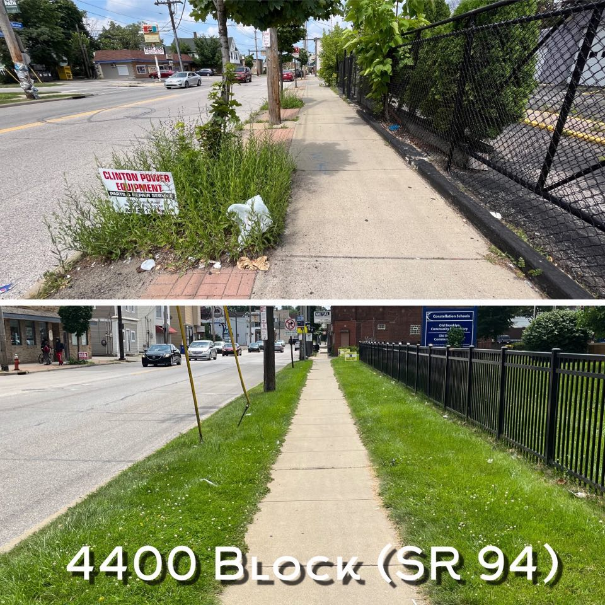
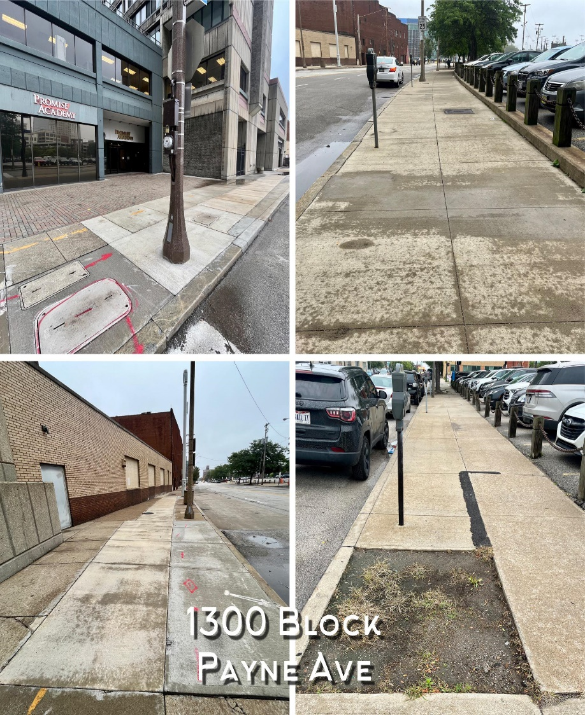
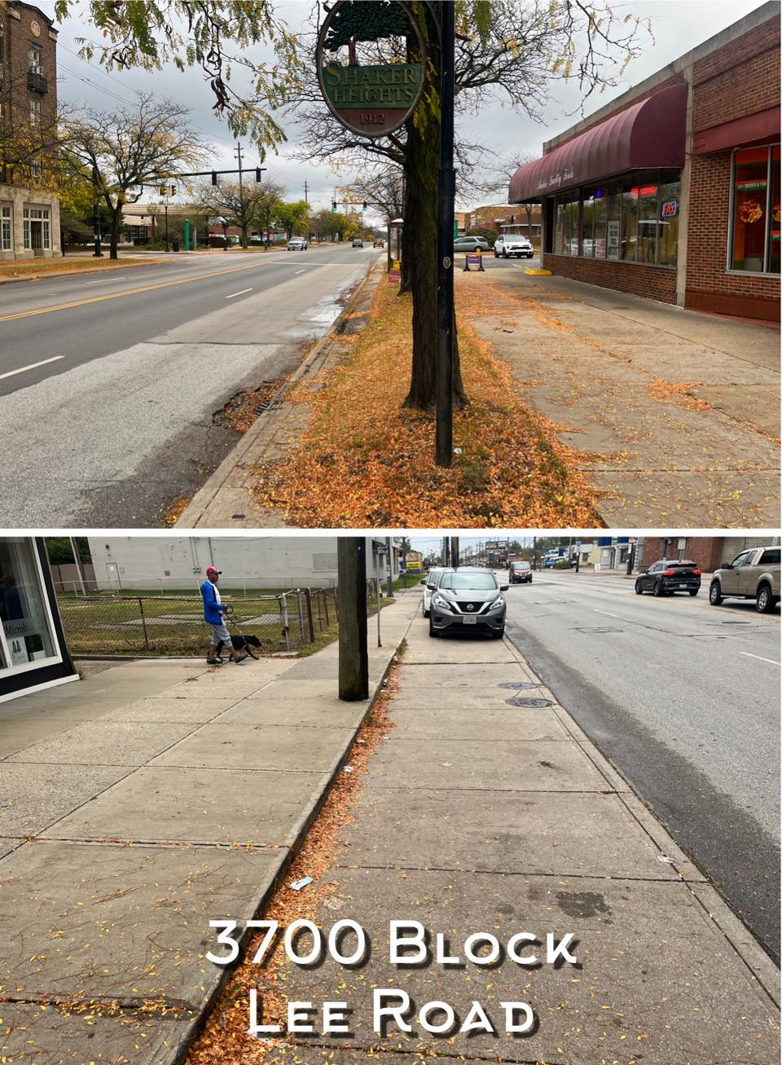
Existing Corridor Conditions

Slide 10
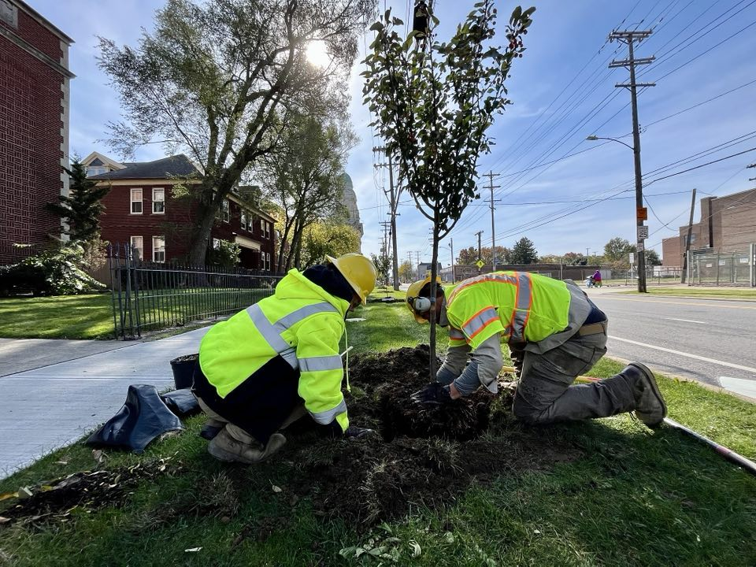
W. 65th Street (Detroit Shoreway)

Slide 11
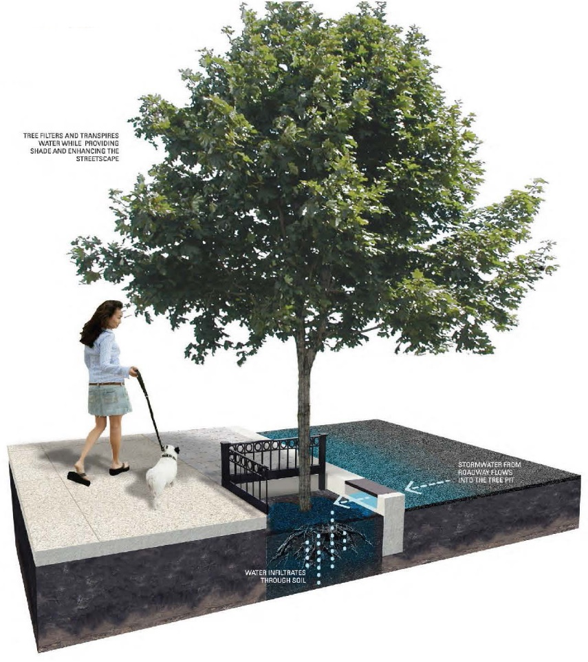
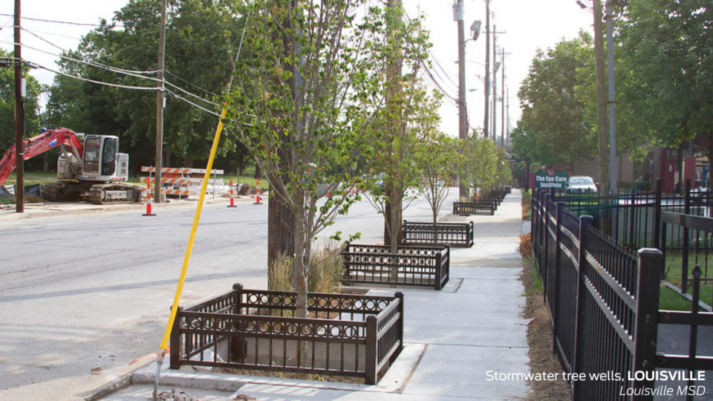
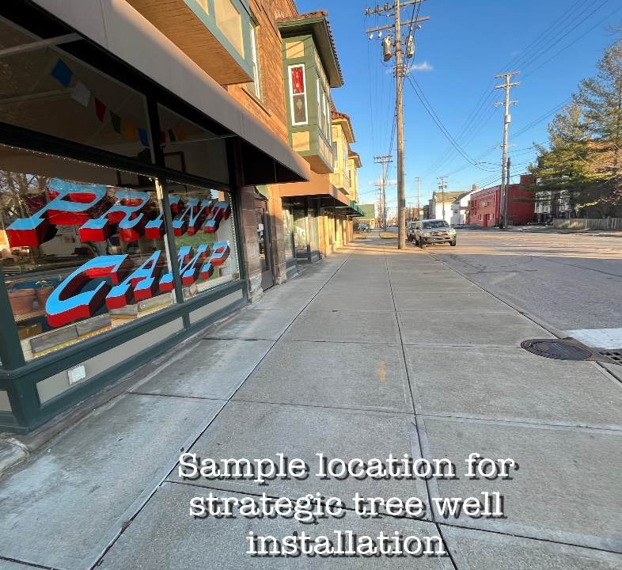
Stormwater Tree Wells

Slide 12
Upcoming Opportunities
CGS PROJECTS (2024):
Payne Ave (E. 13 to E. 30):
19,300 sqft (.73 mi) of tree lawn restoration
75 Street Trees (MOCAP + Urban Forestry)
‘No Mow’ grass
Carnegie Ave (E. 55 to E. 79):
18,950 sqft (.72 mi) of tree lawn restoration
50-75 Street (partnership with Midtown Inc)
‘No Mow’ grass

Slide 13
UFC Sub-Committee Report Outs (5 min each)
01
Policy: Schreiber (Chair); Bay, Hernandez, Kipp, Spencer, Sridhar, Swiatalski
02
Maintenance: Leamon (Chair); Jackson, Jean-Baptiste, Kipp, Olesky, Sridhar, Tokars
03
Budget: Spencer (Chair); Kipp, Hernandez, Malone, O'Keeffe, Sridhar
Notes:
Sam ask each Chair to give 5 min report out
Purpose of committee
# meetings held
Significant work carried out to date?

Slide 14
ODNR Tree Commission Academy Report Out
Sarah O'Keeffe, UFC Secretary
Notes:
2 years completed by 10 commissioners due to unavoidable scheduling conflicts; may be other materials for 4 commissioners that were not able to complete both years
November 29 – Project scheduled in the field with Foresters – all commissioners invited to take part; need to complete as "sophomore homework"
Strong mutual understanding of urban forestry from perspective of ODNR + peer cities interaction valuable
$1,250 supported by Sustainability Office
NEXT:
Letter to ODNR about citations and interpretations of peer-reviewed studies
2024 – discussion for additional course work – Junior and Senior training?

Slide 15
Urban and Community Forestry Grant Report Out
Samira Malone, UFC Chair

Slide 16
Agenda
01
Call to Order
02
Roll Call
03
Chair’s Welcome / Remarks – Reminder to sign up for Public Comment at entrance to room
04
Approval of Minutes
05
Unfinished Business – Members appointed to Sub-Committees
06
New Business
Complete and Green Streets Report Out
UFC Committee Chair Report Outs
Tree Academy Report Out
Urban and Community Forestry (IRA) Grant application result
07
Public Comment – 3 minutes, at Chair's discretion, will be recorded in Minutes; commenters are reminded that impugning character or reputation of any individuals will not be allowed
08
Closing Remarks
09
Adjourn

Slide 17
Agenda
01
Call to Order
02
Roll Call
03
Chair’s Welcome / Remarks – Reminder to sign up for Public Comment at entrance to room
04
Approval of Minutes
05
Unfinished Business – Members appointed to Sub-Committees
06
New Business
Complete and Green Streets Report Out
UFC Committee Chair Report Outs
Tree Academy Report Out
Urban and Community Forestry (IRA) Grant application result
07
Public Comment – 3 minutes, at Chair's discretion, will be recorded in Minutes; commenters are reminded that impugning character or reputation of any individuals will not be allowed
08
Closing Remarks
09
Adjourn

