Slide 1
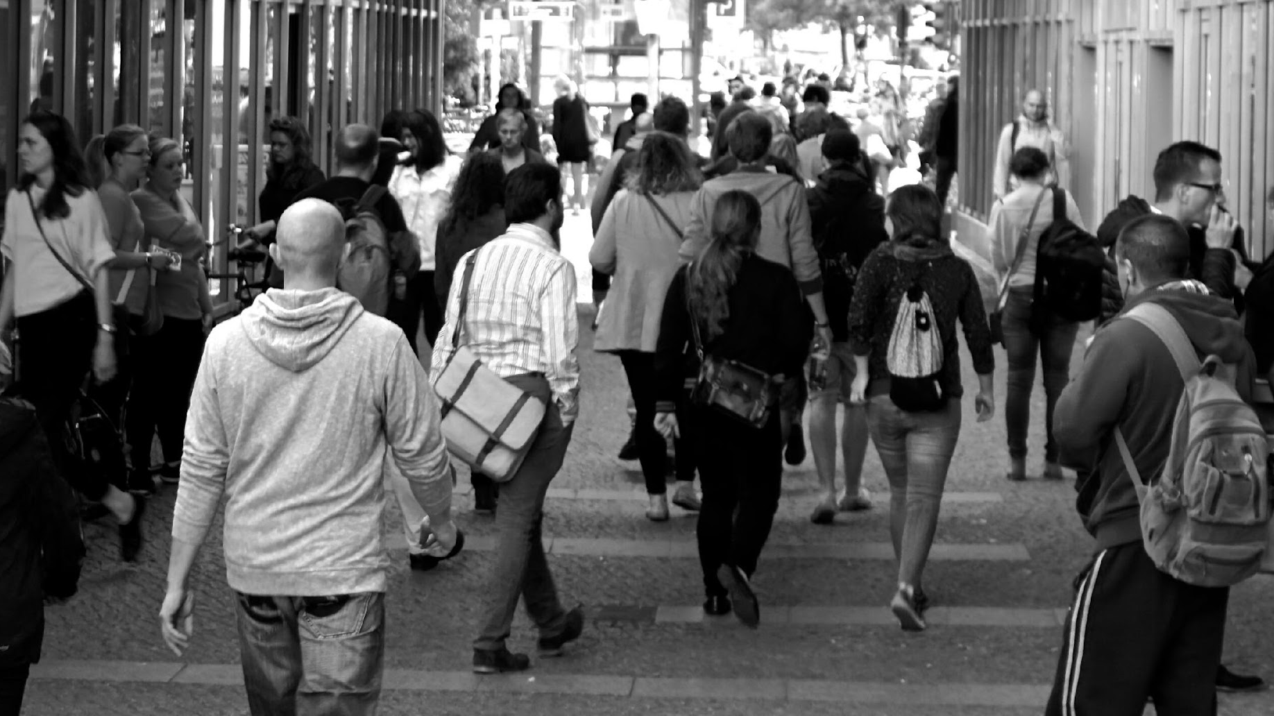

UNITE NY
New York Statewide Survey #2
January 2026

Slide 2




METHODOLOGY
Survey n=1,411 registered voters in New York, with an oversample in Buffalo, from January 5-8, 2026.
Respondents were recruited via dynamic online sampling to obtain a sample reflective of the population.
On behalf of Unite NY, Embold Research surveyed 1,411 voters in New York to further research voters’ perceptions of the current state of New York politics, and to measure the strength and actionability of support for potential election reforms in the state.
Post-stratification performed on age, gender, race/ethnicity, education, region, and 2024 presidential vote.
The modeled margin of error is 2.8%

Slide 3
KEY FINDINGS
01
Voters are deeply pessimistic about the health of New York’s political system and the state’s overall direction.
02
Despite widespread dissatisfaction, most voters believe the problems facing New York’s political system are at least somewhat fixable.
Dissatisfaction with New York’s political system translates into a strong appetite for reform, with voters showcasing broad support to changes to New York’s electoral system.
03
Voter familiarity varies across the election reforms tested, indicating voter education as a key avenue.
04
Voters broadly support the proposed five pillars of election reforms, with especially strong and bipartisan support for creating term limits.
Notes:
Yes voters are pessimistic BUT also - fairly widespread support for the 5 pillars (top 2 things). With RCV, people don’t have that understanding // education is a key window

Slide 4
STATE OF POLITICS
IN NEW YORK

Slide 5
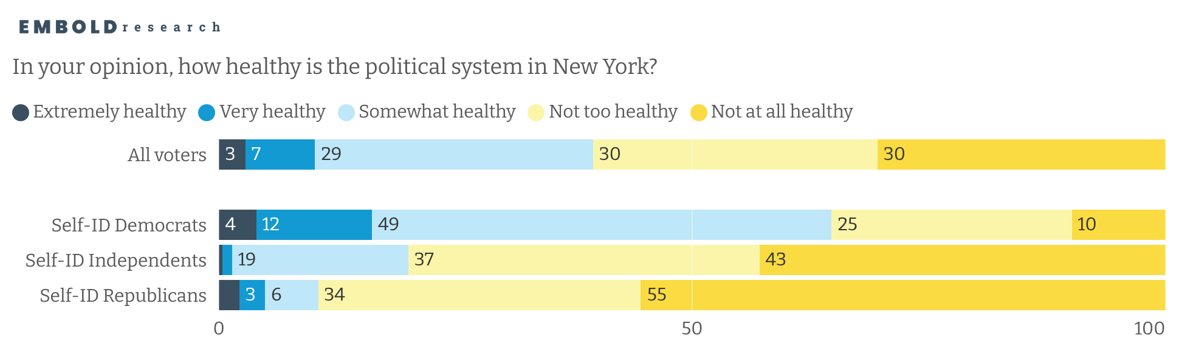

Overall, few voters consider the New York political system to be particularly healthy
However, self-identified Democrats feel much better about the health of the political system than Independents or Republicans
Notes:
Pitch as 6/10 NY have an unhealthy political system. Create the contrast to remedy something.

Slide 6
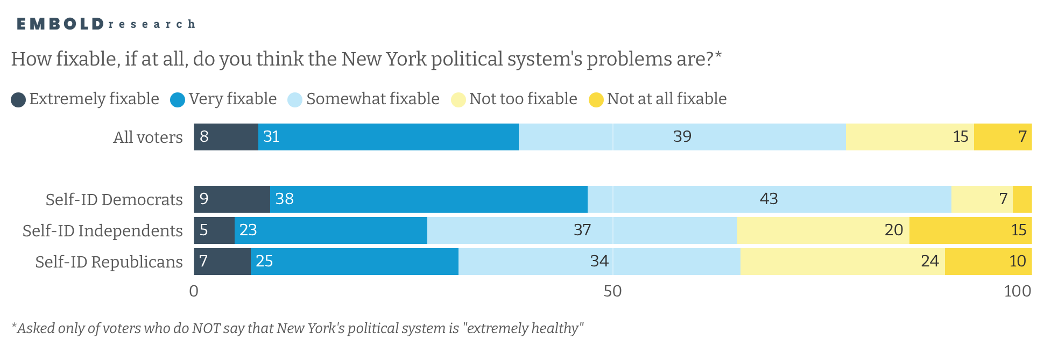
For those who feel the the system isn’t healthy, most still believe that the system’s problems are at least somewhat fixable
Notes:
A belief that there can be solutions

Slide 7
ATTITUDES TOWARD ELECTION REFORM

Slide 8
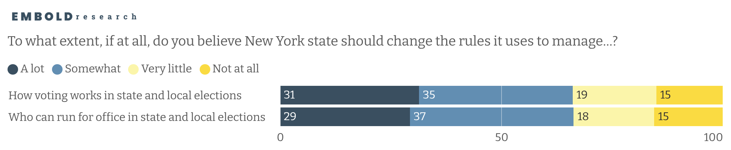
In the abstract, a clear majority of voters are interested in some level of change to how voting works and who can run for office at the state and local level

Slide 9
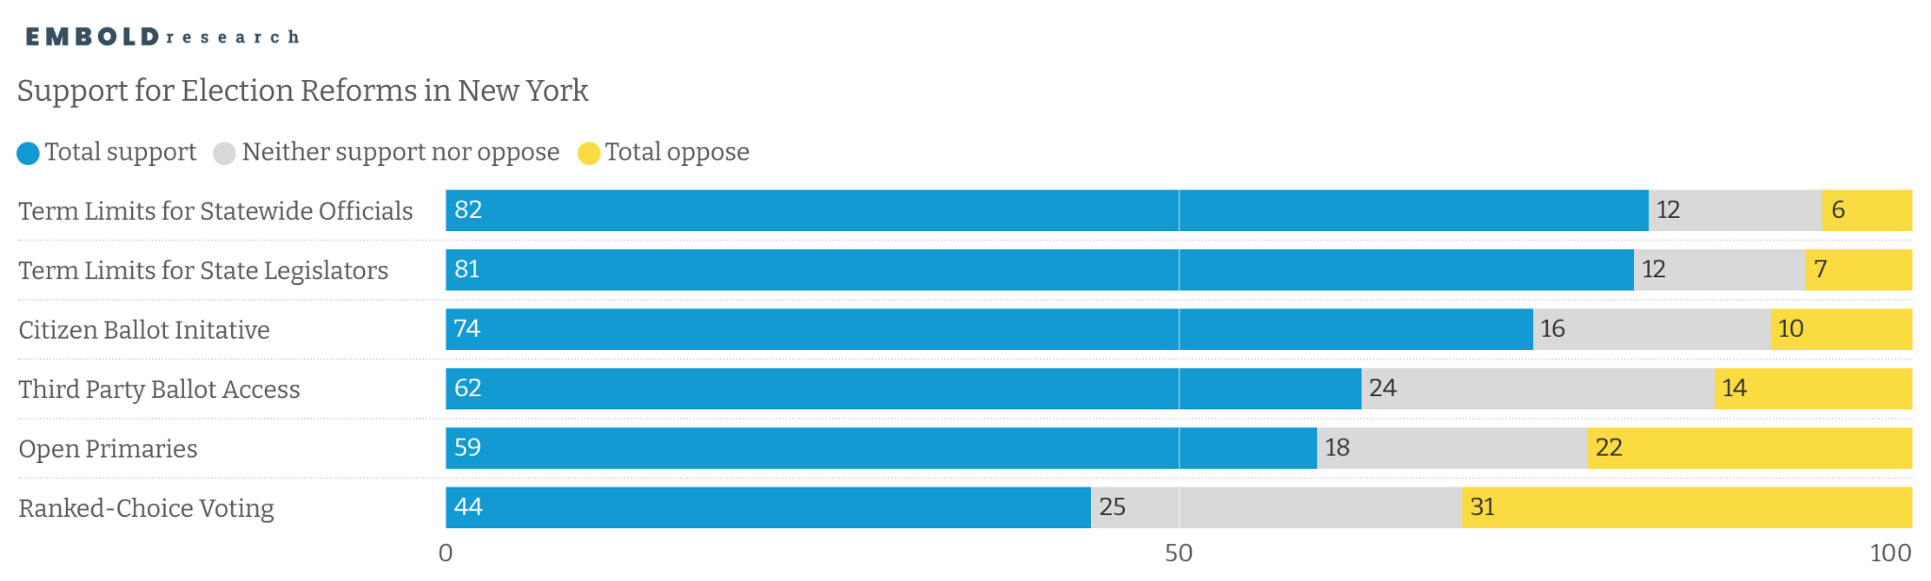
Overall, a majority of New Yorkers support a variety of proposed election reforms
The introduction of term limits and enabling voters to put issues directly on the ballot receive the highest support from voters
Notes:
WE want to be careful - talk about broad support/simplify graph. (update the graph with a 75% mark).

Slide 10
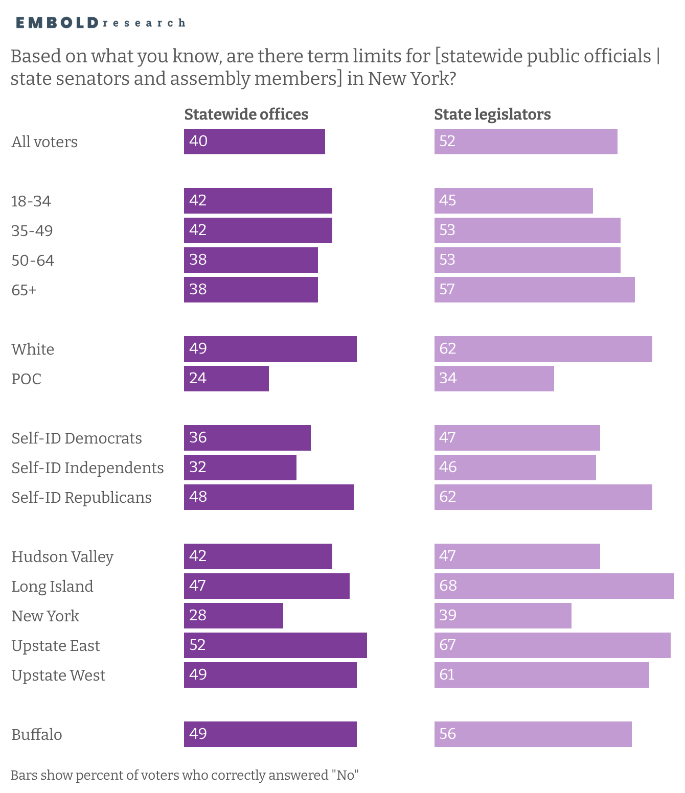
Across groups, many voters do not correctly identify the absence of term limits in New York, particularly for statewide offices

Slide 11
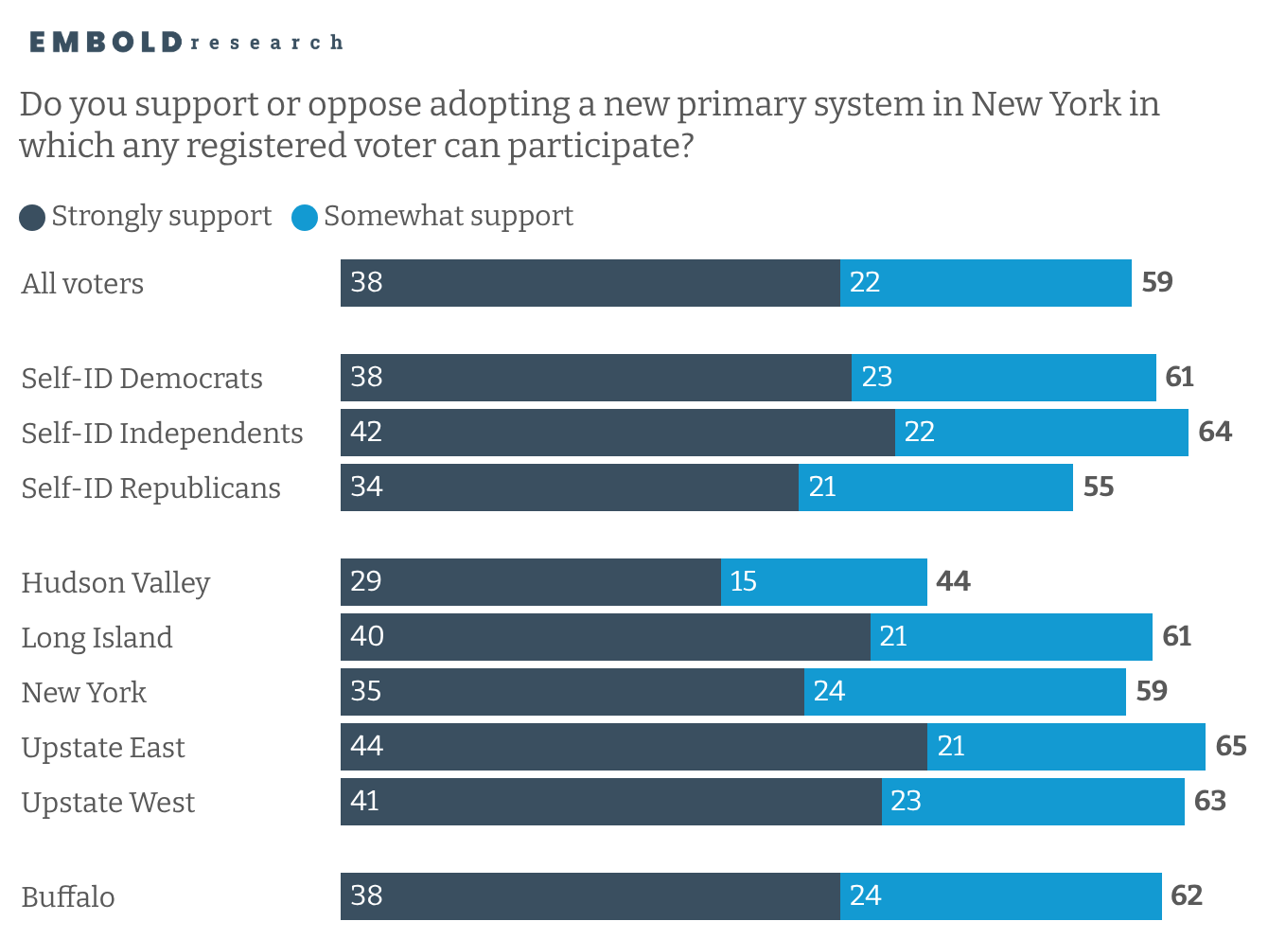
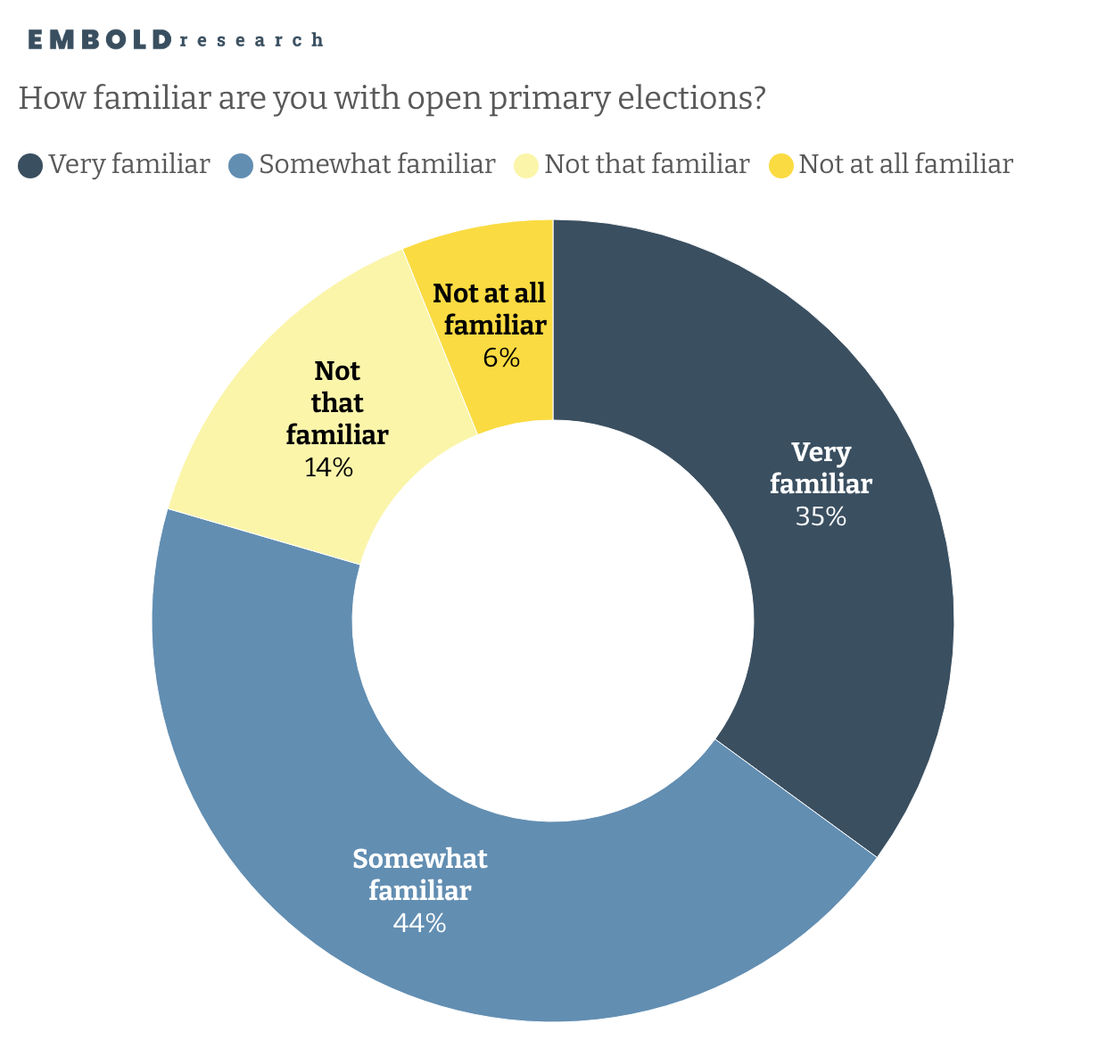
Most voters are familiar with open primary elections and a majority support a new primary system in New York

Slide 12
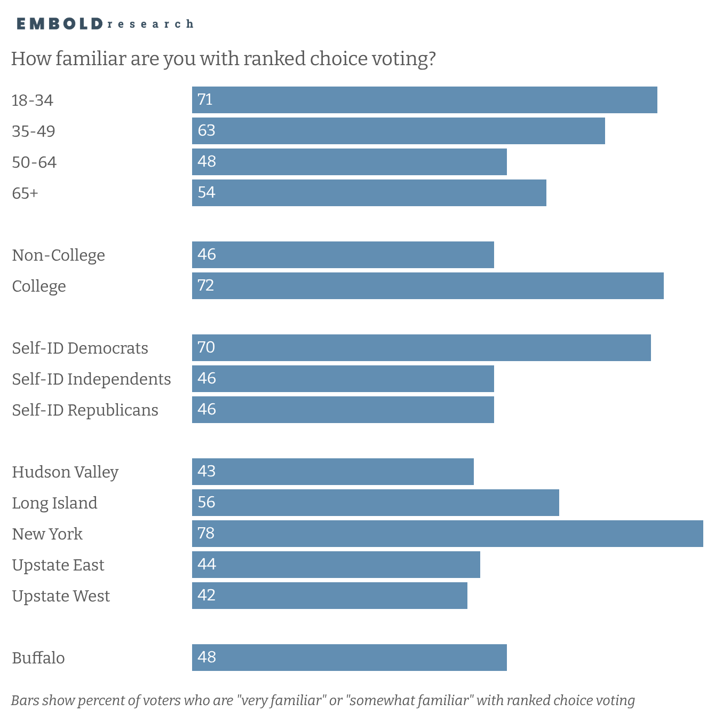
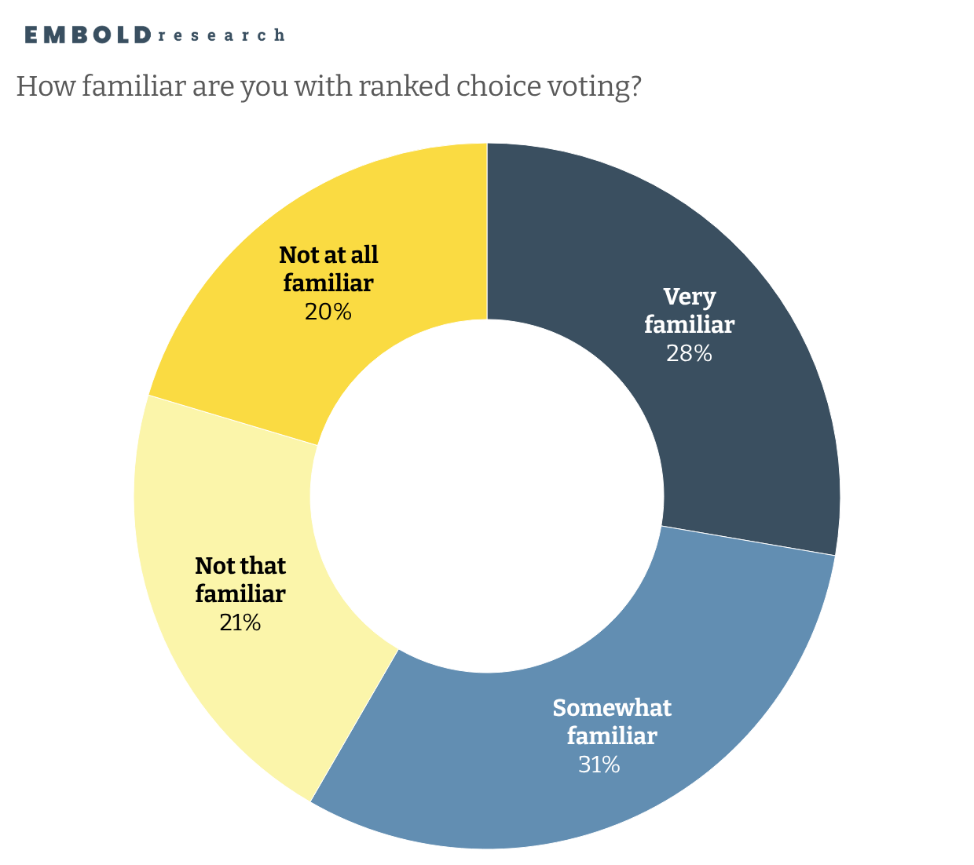
RCV familiarity varies, with higher awareness among younger voters, college-educated voters, Democrats, and those in NYC

Slide 13
Strategic Recommendations
Leverage dissatisfaction with the political system as a motivator for reform. Broad dissatisfaction with the political system – paired with a belief the system is at least somewhat fixable – creates an opening for messaging that frames election reforms as a path toward greater political accountability and responsiveness.
Pair education with persuasion. Varying levels of familiarity with election reforms, such as the creation of term limits or the adoption of ranked-choice voting, suggest the need for both informational messaging and reinforcement of existing support.
Use widely supported reforms as entry points for broader reform engagement. Proposals with strong, bipartisan backing – such as term limits and citizen ballot initiatives – can serve as effective starting points for advancing a broader reform agenda.

Slide 14
THANK YOU
QUESTIONS?

