Slide 1


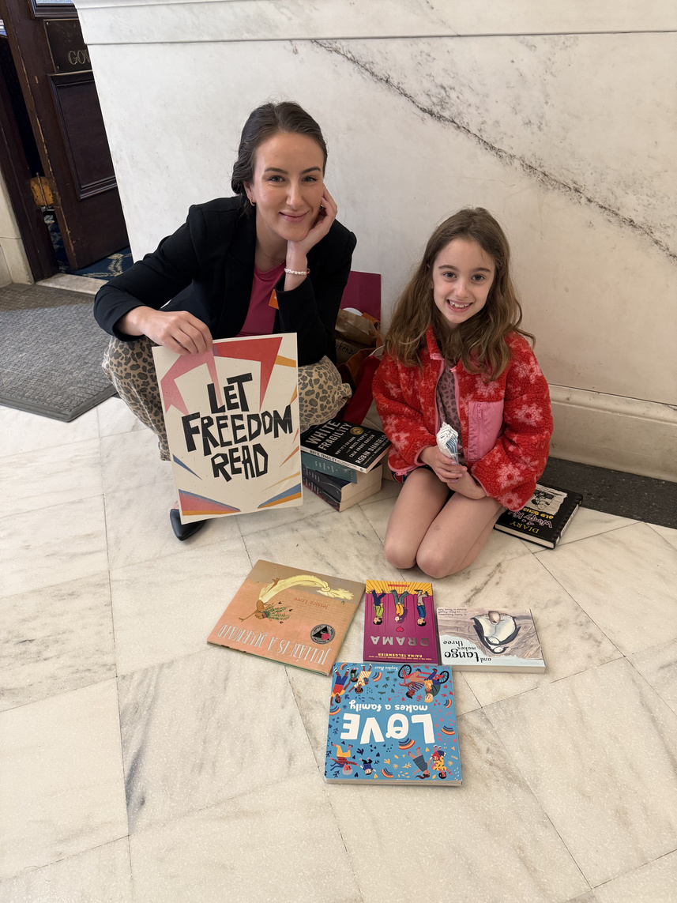
The EveryLibrary Institute 2025 Annual Report traces the responses we made to the great pressures put upon libraries by the Trump Administration, by state legislators and governors, and by school boards, library boards, city councils, and county commissions who wanted to radically subvert things as basic as the right to read and the idea that the library should serve everyone without fear or favor.
2025
ANNUAL REPORT
Resilience in a Time of Great Pressure

Slide 2

EVERYLIBRARY INSTITUTE 2025
2025 IMPACTS
The EveryLibrary Institute, a 501(c)(3) public policy, tax policy, and education policy think tank, is motivated by the idea that civil liberties, civil rights, and civil society all come together in a funding and legal framework that is the American library experience. In 2025, the strategic choices that guided our work and the concrete outcomes we achieved for the sector were made because of our consistent application of those principles and a willingness not to shy away from the fight. Across our research, policy, and field-building, one conclusion has remained constant: the health of libraries and the health of our democratic republic are inseparable.
2025 ANNUAL REPORT
The EveryLibrary Institute 2025 Annual Report traces the responses we made to the great pressures put upon libraries by the Trump Administration, by state legislators and governors, and by school boards, library boards, city councils, and county commissions who wanted to radically subvert things as basic as the right to read and the idea that the library should serve everyone without fear or favor.

Slide 3
EVERYLIBRARY INSTITUTE 2025
The EveryLibrary Institute was the only national library organization to sound not only a social alarm but also to issue direct policy warnings about the impacts of those proposals on libraries, archives, and museums:
  First library organization to issue guidance about the rule of law, congressional intent, and agency obligations.
  Argued that the administration would be in violation of the law if it acted to eliminate IMLS, a position taken by 21 state attorneys general in their Rhode Island lawsuit, which ultimately restored the agency.
  Continued to provide technical assistance and substantive guidance to library leaders in the states, including reports like “Contingency Planning for State Budgets for IMLS Funding Uncertainty,” and “The IMLS Public Library Survey: A National Asset at Risk.”
  Published “Culture War by Executive Order,” analysing the impact of E.O.s on library grant recipients.
OPPOSING PRESIDENT TRUMP’S PROJECT 2025 AGENDA
President Trump has, since his first term’s first federal budget in 2017, called for the defunding and dismantling of the Institute of Museum and Library Services (IMLS). On the campaign trail prior to his reelection in 2024, he promised to fire the Archivist of the United States and put the National Archives under the administration’s control, which he did shortly after Inauguration Day. The blueprint for these changes to the federal frameworks for libraries, museums, archives, K-12 education, higher ed, and the roles of the federal government and the states was clearly spelled out in Project 2025, the conservative Heritage Foundation's blueprint endorsed by the President.

Slide 4
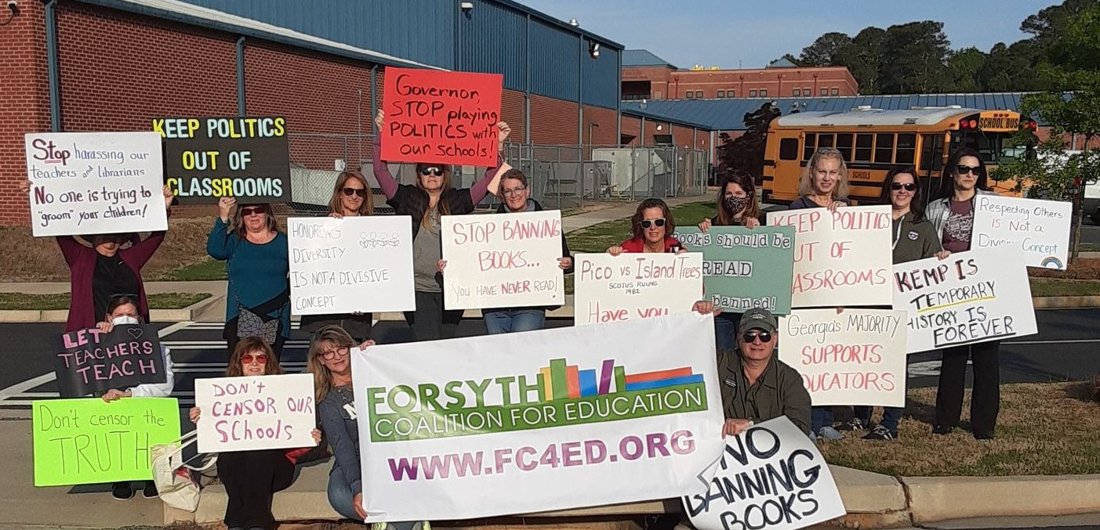
EVERYLIBRARY INSTITUTE 2025
As the lead national policy partner for numerous state library associations and coalitions, the EveryLibrary Institute helped write, shape, or pass Right to Read bills in Colorado (SB63), Connecticut (SB1271), Delaware (HB119), Rhode Island (S0238), and Nevada (AB386) in 2025. Our policy papers helped inform two veto campaigns, in North Dakota (SB2307) and New Hampshire (HB324), in support of state right to read coalitions about anti-access, pro-censorship legislation. Since 2023, the EveryLibrary Institute’s model “Libraries for All Act” has shown states how to best apply civil rights and public accommodation laws to library collection development, programming, and events policy.
WRITING LAWS THAT SAFEGUARD LIBRARIES AND THE RIGHTS OF READERS
Libraries today sit at the intersection of access to information, education policy, civil rights, and democratic resilience. The decisions made about libraries now carry implications far beyond individual institutions. Civil Liberties, Civil Rights, and Civil Society all must be engaged. Throughout its policy and advocacy work, we have maintained a consistent focus on the overlapping domains of civil liberties, civil rights, and civil society. Questions of free expression, equal access, institutional governance, and democratic participation were treated not as separate concerns, but as mutually reinforcing dimensions of the same institutional landscape.

Slide 5
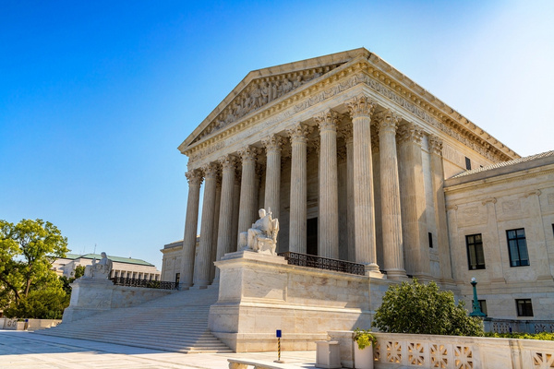
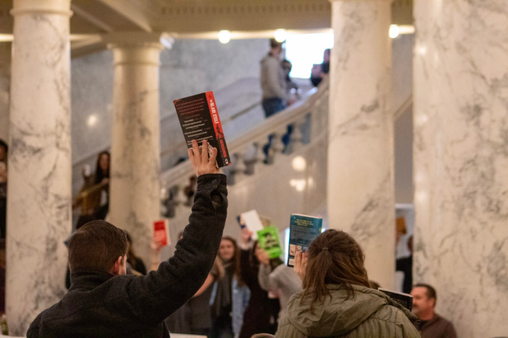
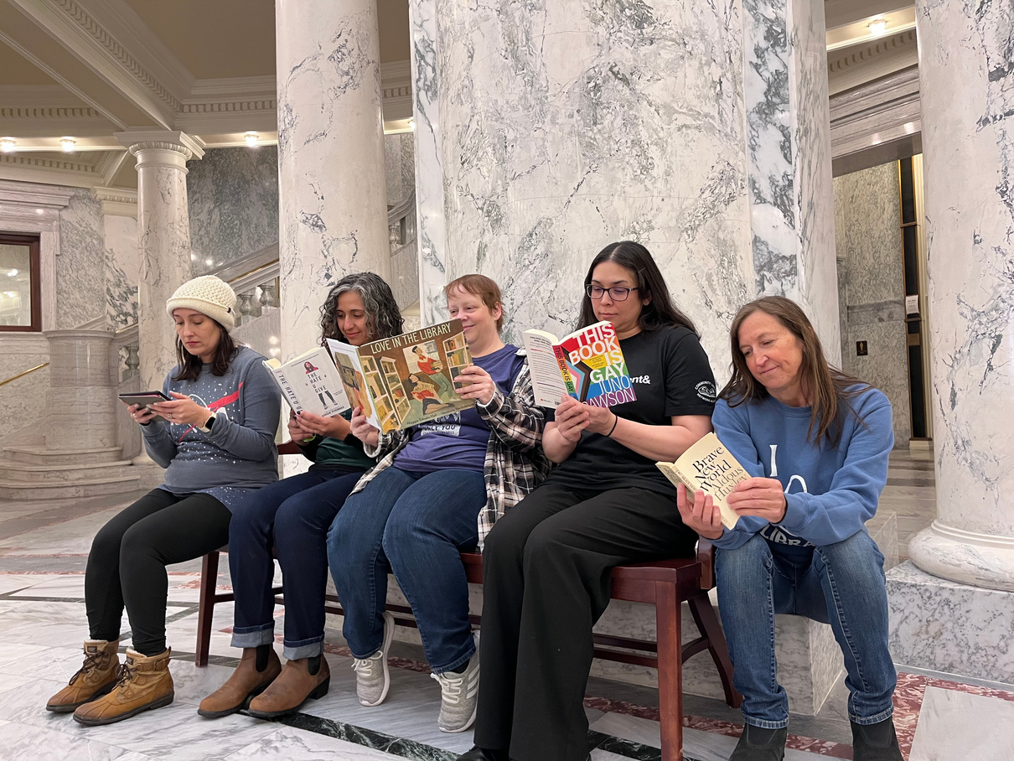
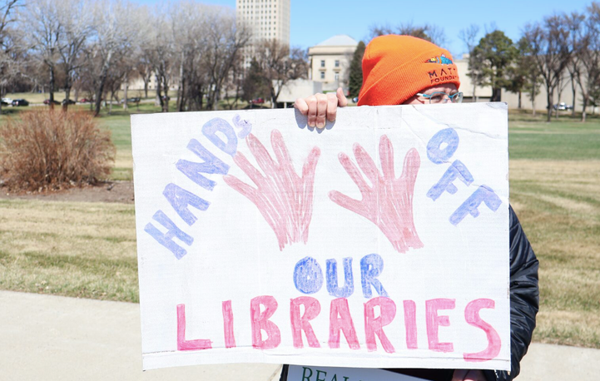
EVERYLIBRARY INSTITUTE 2025
OUR MODEL “LIBRARIES FOR ALL” ACT HAS BEEN ADOPTED IN DELAWARE (HB229) AND VERMONT (S.220) AND HAS BEEN INTEGRATED INTO SCHOOL LIBRARY LAW IN COLORADO (SB25-063) AND IS AT THE HEART OF NEW PROPOSALS IN MISSOURI (HB3178 - 2026) AND NEW MEXICO.
STATE BY STATE
When Indiana lawmakers considered SB283, which would have stripped public libraries of their ability to tax and govern themselves, we published “Caution & Concerns” to clearly lay out the problems that this misguided legislation would create, not solve. In Iowa, where the legislature passed HF718, which voided 94 local library levy elections by fiat, we partnered with local researchers to produce “Forecasting Closures Across Iowa Public Libraries and Museums” as a way to re-engage the legislative leaders in a policy discussion about restoring local mechanisms to fund these libraries. As rumors of the reintroduction of a significant anti-access bill began to circulate in Colorado, we published our “Protecting Student Access to Research and Information in Colorado Schools” to ensure that legislators, education stakeholders, and industry partners fully understand what is at stake for students, schools, and communities across the state.

Slide 6
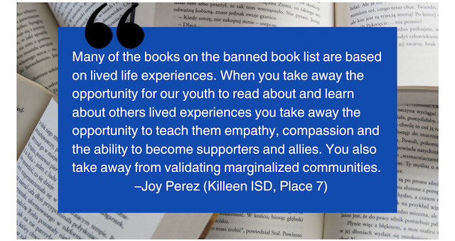
RESEARCH
In 2025, our research and thought leadership played a pivotal role in shaping how the library field understands itself and its place within the broader systems of law, education, civil rights, and democratic governance. Our goal is to ensure libraries are not navigating these challenging times alone and have the research, tools, and institutional support they need to succeed.
The cornerstone of our 2025 research agenda remained the ongoing development and dissemination of the robust, open-access Book Censorship Database, curated by Dr. Tasslyn Magnusson, a Policy Fellow with the EveryLibrary Institute and PEN America. Her independent research focuses on attempts to challenge books in school and public libraries, with particular attention to successful bans. The dataset provides insights into groups advancing censorship agendas, as well as local library alliances defending the First Amendment and library integrity.
We published “The Censorship Acceleration: An Analysis of Book Ban Trends After 2020,” a groundbreaking and comprehensive report examining the growing scale, coordination, and political motivations behind the recent surge in book censorship in American schools and libraries. Since 2020, book censorship efforts have shifted from isolated incidents to a nationwide movement, driven by well-funded political and religious organizations. This report explores how book bans have become a central tactic in a broader campaign to destabilize public education, promote school privatization, and suppress historically marginalized voices.
EVERYLIBRARY INSTITUTE 2025

Slide 7
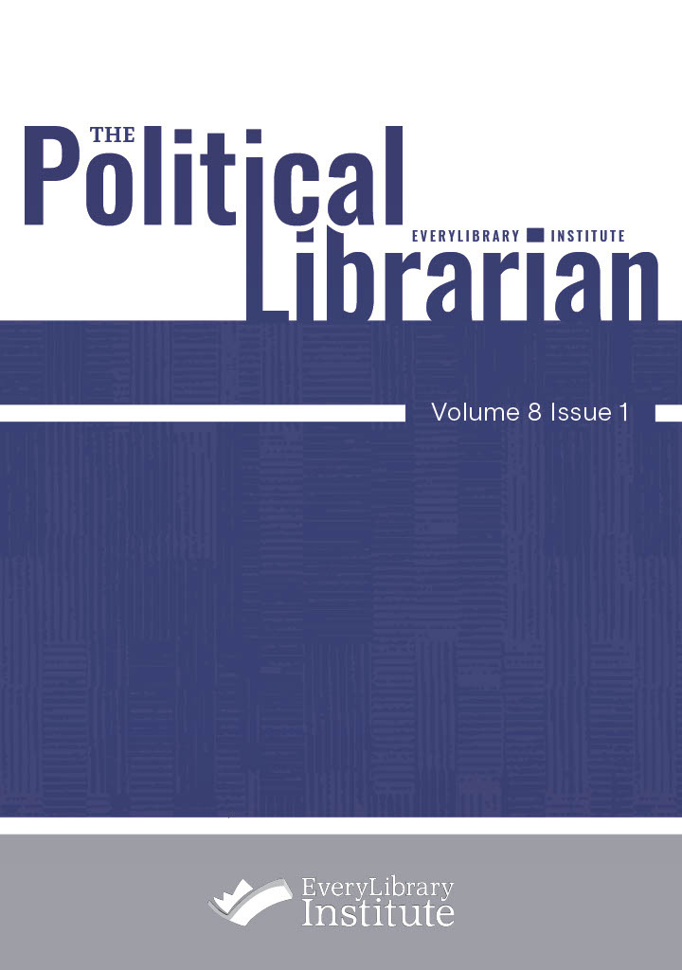
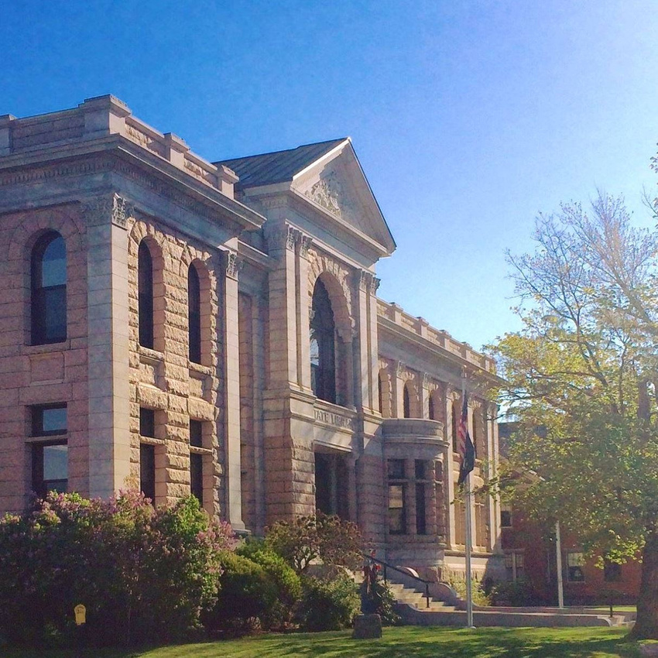
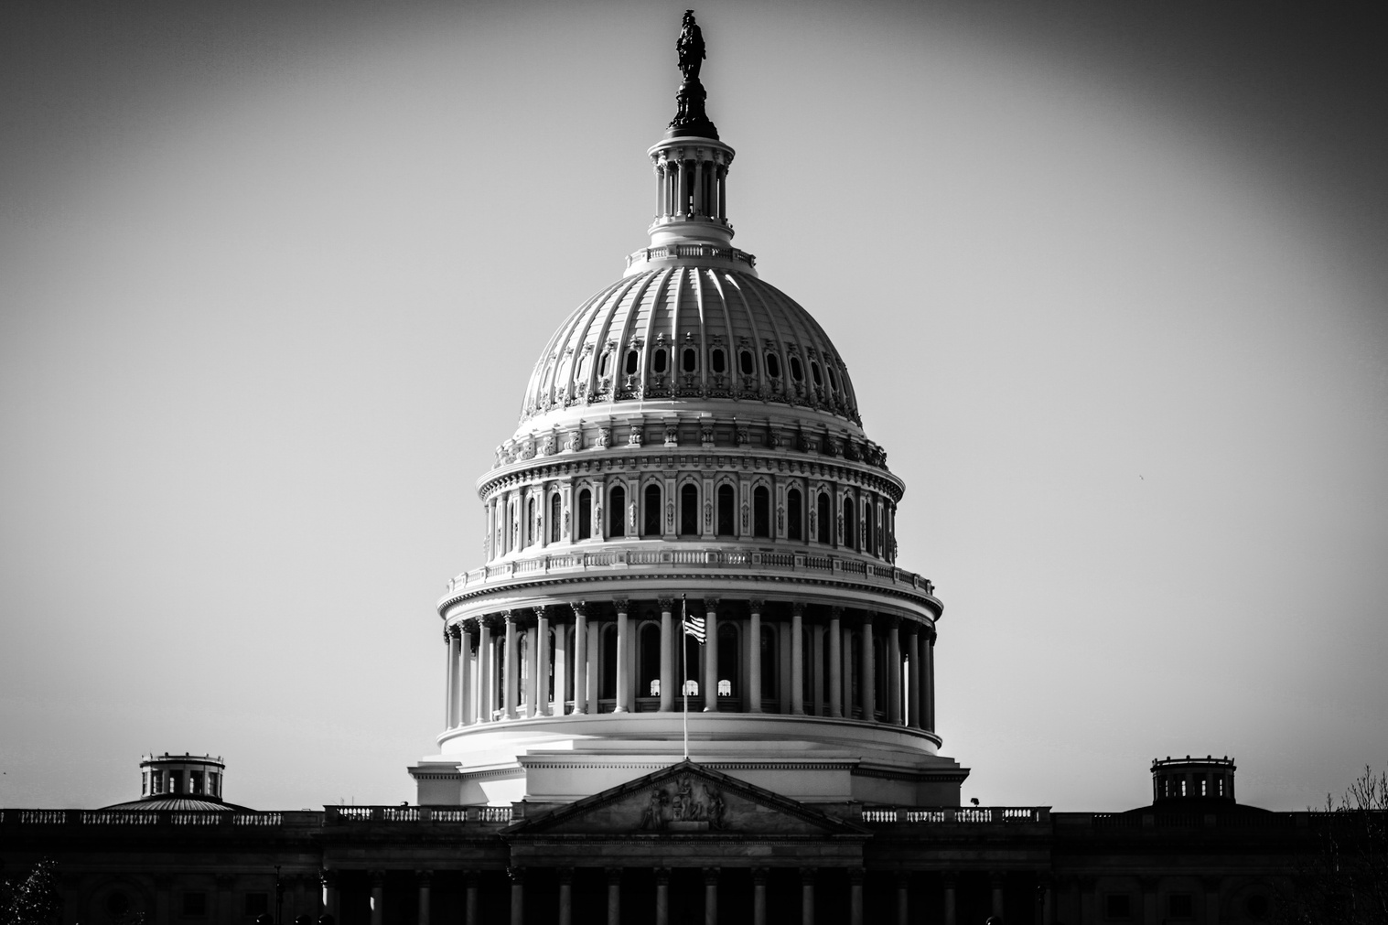
THE POLITICAL LIBRARIAN
In 2025, The Political Librarian published two special issues exploring the landscape of libraries in America.
The spring issue, Volume 8 Issue 1, “Libraries After the 2024 Vote: The Future of Libraries in a Divided America,” was edited by Allison Jennings-Roche and Paul T. Jaeger and featured twenty articles examining what the 2024 election may signal for the future of libraries and library work, presenting a broad array of perspectives from educators, researchers, administrators, and professionals.
The fall issue, Volume 8 Issue 2, “Weaponized Politics and Dismantled Policies: Defending Diversity, Equity, and Inclusion in America's Libraries and Cultural Institutions,” guest edited by Dr. Nicole A. Cooke and Dr. Aisha M. Johnson, contains twenty-three articles analyzing the impact of Executive Orders from the Trump administration targeting DEI training, programming, and leadership in federal agencies such as IMLS, NEH, and NEA. These articles argue that the orders represent not only bureaucratic changes but a deliberate dismantling of longstanding commitments to access, equity, and representation, collectively offering a wide range of insights and ideas.
EVERYLIBRARY INSTITUTE 2025

Slide 8




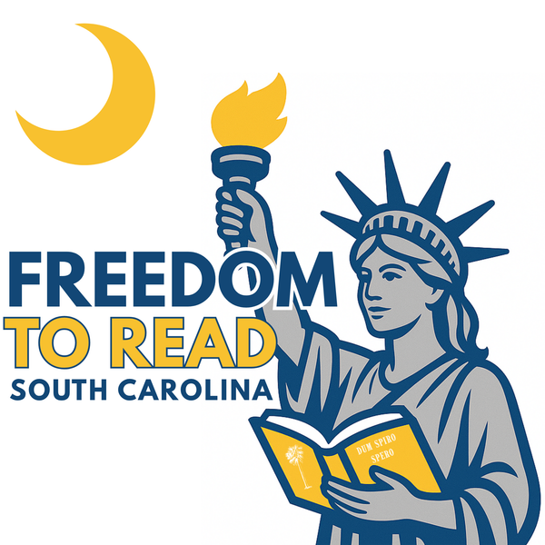
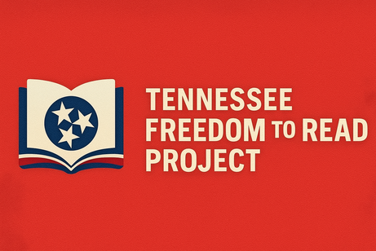
DURABLE COALITIONS
Coalition leadership is a defining feature of the EveryLibrary Institute’s work. We are a founding member of the Right to Read Working Group, alongside PEN America, the National Coalition Against Censorship, American Booksellers for Free Expression, and the Comic Book Legal Defense Fund, aligning library advocacy with national free expression and civil liberties efforts.
We are also a leading member in the national IMLS Coalition, convened by EBSCO and MCLS, working with all the national library, archives, and museum organizations to defend federal support for cultural and knowledge institutions. In higher education, ELI is an active partner in #DefendResearch, now comprising more than 175 member organizations committed to protecting research freedom and academic integrity.
EVERYLIBRARY INSTITUTE 2025

Slide 9
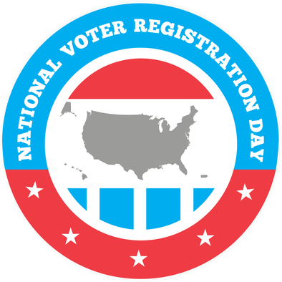
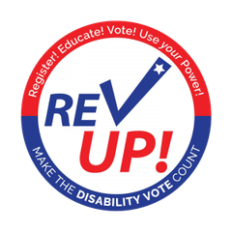

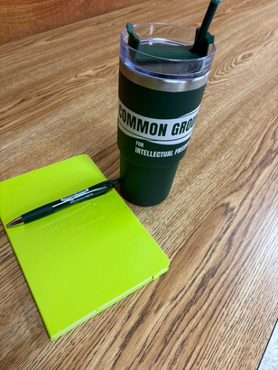


EVERYLIBRARY INSTITUTE 2025
COMMON GROUND CONFERENCE
CIVIC SEASON
In 2025, the EveryLibrary Institute became the first national library organization to formally engage with Civic Season, a national time of celebration between Juneteenth and July 4th to engage in civic learning and dialogue. Civic Season is designed to connect individual reflection on American history with active civic engagement, particularly for young and first-time voters.
As part of this partnership, the EveryLibrary Institute produced a Civic Season webinar series in collaboration with leading national organizations, including Nonprofit Vote, the League of Women Voters, Vote Early Day, and the American Association of People with Disabilities’ REV UP campaign. These sessions provided public libraries with practical tools for civics education, voter engagement, election accessibility, and partnership-building, while reinforcing libraries’ role as inclusive civic hubs.
In 2025, the EveryLibrary Institute made a significant investment in coalition leadership by co-convening the Common Ground for Intellectual Freedom Conference, a national gathering designed to meet escalating challenges to libraries with shared strategy, trust-building, and collective resolve. Held October 23–25, 2025, at the Vines Center in Little Rock, Arkansas, and supported by the Mellon Foundation, the convening brought together library workers, organizers, policy experts, and advocates from across the country at a moment when censorship, political interference, and erosion of public trust are intensifying nationwide.
The conference was organized in partnership with Urban Librarians Unite, Library Futures, and Library Freedom Project, reflecting a shared understanding that no single organization can meet this moment alone.

Slide 10

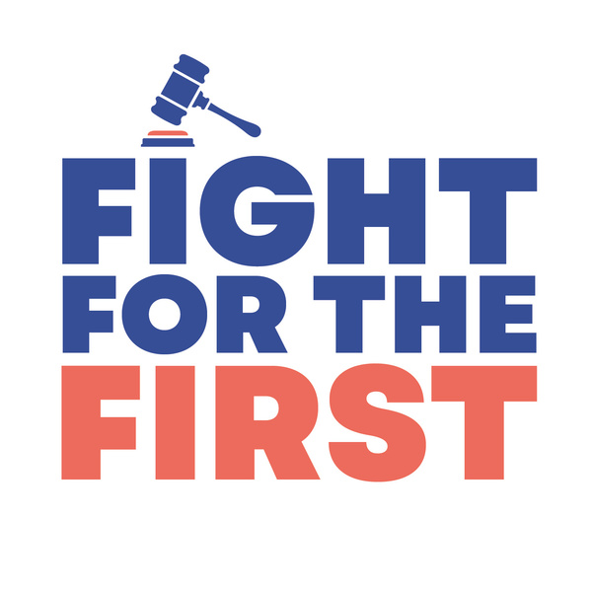
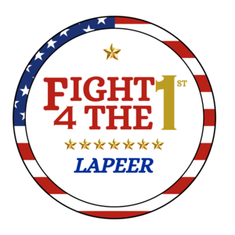

In 2025, the EveryLibrary Institute played a central role in defending the First Amendment in public and school libraries through FightForTheFirst.org, a co-managed initiative with EveryLibrary. Launched in 2023, Fight For The First was designed to meet a growing national need in local communities and schools facing coordinated censorship campaigns. They often lack the tools, infrastructure, and guidance required to respond quickly or effectively.
Throughout 2025, the EveryLibrary Institute helped local organizers launch and manage more than 150 petitions addressing censorship in schools and public libraries. These efforts activated over 55,000 people, generating 112,300 messages to school boards, city councils, and county commissions. According to PEN America’s October 2025 report, there were 87 local school systems that faced intense censorship campaigns nationwide the previous school year. We are proud to report that FightForTheFirst.org played a direct role in resisting censorship and restoring access to books in 70 of those communities. These results reflect not only scale but effectiveness, demonstrating that organized, local action can successfully counter coordinated attacks.
FIGHT FOR THE FIRST
EVERYLIBRARY INSTITUTE 2025

Slide 11
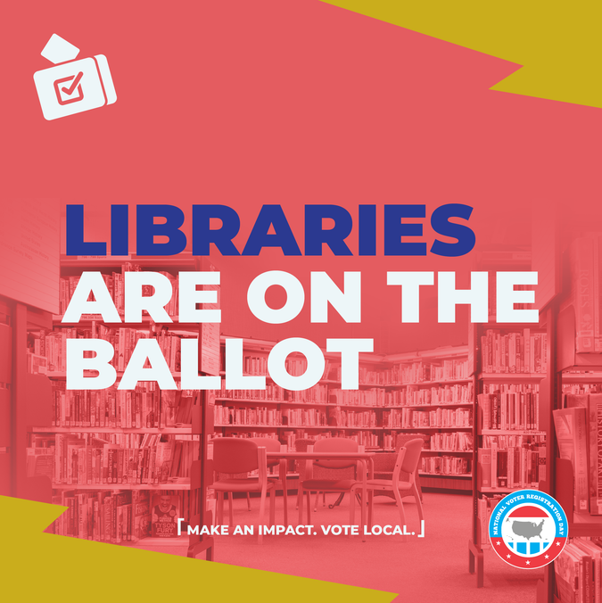
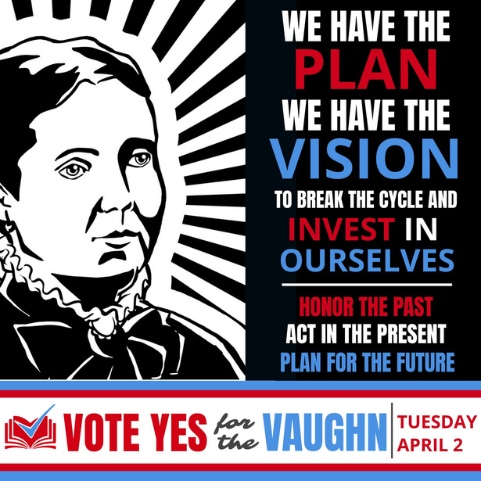
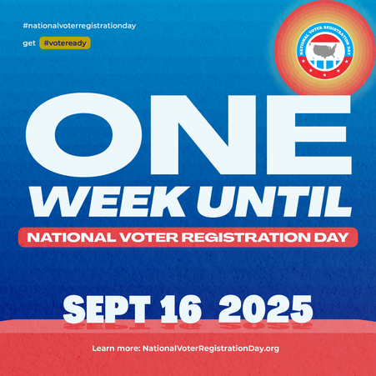

The EveryLibrary Institute’s focus on civic participation goes beyond civics. We understand the unique challenges that libraries face in supporting voter registration, ballot access, election administration, and voter participation. Our VoteLibraries initiative aims to empower and deploy libraries for the good of our democracy. Given the ubiquity of public libraries and the inclusivity of the populations they serve, our initiatives can have a profound impact on the civic participation of many underserved and disenfranchised communities.
We recognize that libraries are essential in increasing civic engagement and sustaining democracy. On VoteLibraries.org, we help libraries ensure that all citizens who want to vote are registered, informed, and empowered to cast a ballot. Through the VoteLibraries platform, the EveryLibrary Institute helps equip rural libraries, suburban outlets, and libraries serving urban cores with the skills, tools, and resources to host robust, nonpartisan voter information and election support programs year-round.
The EveryLibrary Institute is the only national library organization focused on increasing the number of libraries supporting voter registration and strengthening election administration. VoteLibraries strengthened nonpartisan voter engagement through key national partnerships that position libraries as trusted, accessible civic spaces. Working with the American Association of People with Disabilities’ REV UP campaign, we created a Library Guide to Disability Voting Rights Week to help libraries host accessible voter registration, provide civic education for the disability community, and support disability voting rights.
VOTE
LIBRARIES
EVERYLIBRARY INSTITUTE 2025

Slide 12
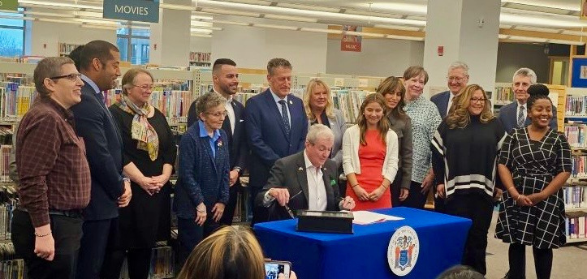


EVERYLIBRARY INSTITUTE 2025
Recognizing that academic libraries cannot confront these challenges alone, the EveryLibrary Institute has launched multi-year initiatives focused on institutional accreditation, academic freedom, and the role of libraries in institutional quality and research integrity. Throughout 2025, we produced several policy briefs and white papers, including “Institutional Accreditation and the Academic Library - A Strategy for Engagement and Representation”, “Emerging Accreditation Challenges – What Academic Libraries Need to Know”, and “NECHE 2026 Draft Accreditation Standards Drop Libraries”. We hosted webinars and national convenings with partners and provided technical analysis to academic librarians and consortia leaders. Across all of this work, the EveryLibrary Institute emphasized coalition-based approaches to defending research and knowledge institutions. We strengthened partnerships with civil liberties organizations, scholarly publishers, authors’ groups, and higher education advocates, including participation in the #DefendResearch movement.
FUTURE OF
ACADEMIC LIBRARIES
Academic libraries are facing the most significant policy-driven threats in a generation. In 2025, the EveryLibrary Institute expanded our education policy portfolio to include academic libraries. With the help of several key donors and supporters, including Clarivate, Emerald Publishing, and Library Juice Press, the EveryLibrary Institute significantly expanded its work in higher education policy to address the growing structural threats facing academic libraries.

Slide 13

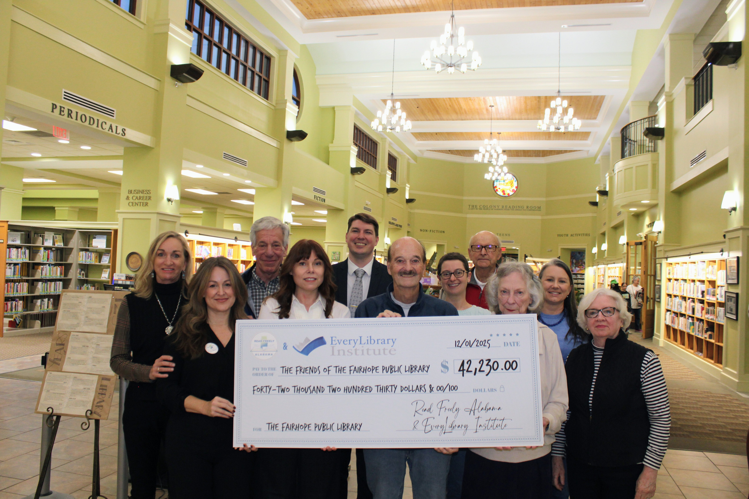
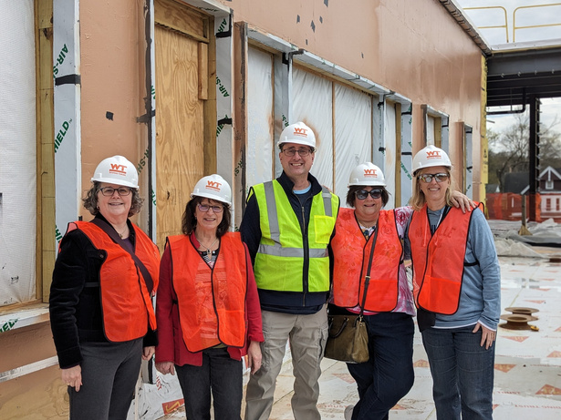
EVERYLIBRARY INSTITUTE 2025
FUNDLIBRARIES
The most powerful example of FundLibraries’ impact in 2025 came in Fairhope, Alabama. When the Alabama Public Library Service revoked more than $42,000 in state funding from the Fairhope Public Library in retaliation for the library’s refusal to censor LGBTQ+ inclusive books, the community responded immediately. Using FundLibraries.org, a rapid-response campaign replaced every dollar of lost funding in just six days, raising over $42,000 from 583 donors nationwide. The campaign not only protected the library’s operations but sent a clear message that communities will stand with libraries when political actors attempt to punish them for upholding the freedom to read.
Start a campaign today at FundLibraries.org
In 2025, the EveryLibrary Institute relaunched FundLibraries.org as a core part of our infrastructure to support libraries, literacy organizations, and grassroots advocates. FundLibraries.org is a purpose-built crowdfunding platform designed specifically for the library ecosystem, enabling libraries and their supporters to fund innovative programs, advance literacy projects, and respond rapidly to social and political threats. Since its relaunch, more than 100 libraries and organizations have used FundLibraries to turn community support into real, timely impact.

Slide 14

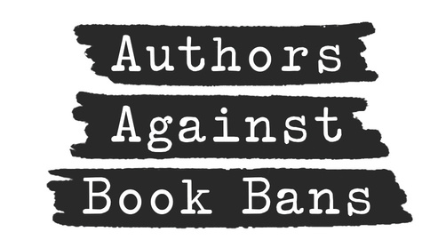

FISCAL SPONSORSHIP
In 2025, the EveryLibrary Institute continued to serve as a trusted fiscal sponsor and fiscal agent for mission-aligned library, literacy, and civic initiatives across the country. Fiscal sponsorship allows emerging projects, coalitions, and time-limited campaigns to launch quickly and responsibly without the cost, delay, or administrative burden of forming a new 501(c)(3). By providing charitable status, financial stewardship, and compliance support, the Institute helps partners focus on impact rather than infrastructure.
During the year, the Institute provided fiscal sponsorship or agent services for a diverse range of efforts, including the We Are Stronger Than Censorship initiative with IBPA to place banned books into local communities; Read Freely Alabama, the statewide grassroots right to read organization; the Philadelphia Alliance to Restore School Librarians which is focused on building PSD schools back from almost zero librarians on staff; the STEM Library Collaborative and its 2025 STEM Library Conference; and 451 Avengers, a Florida-focused initiative for public education and engagement about book bans.
In December 2025, we announced that we are the fiscal agents for Authors Against Book Bans (AABB), the national anti-censorship organization that mobilizes authors, illustrators, audiobook narrators, and translators to support the right to read.
EVERYLIBRARY INSTITUTE 2025

Slide 15
DONOR ROLL
If you find our work effective, please consider donating today. You can make a tax-deductible donation online at everylibraryinstitute.org/donate. Donors wishing to make a gift through a donor-advised fund, a corporate match, or a gift of stock should visit our “More Ways to Give” page for current information and connections.
The EveryLibrary Institute NFP is a registered 501(c)3 charitable organization with the IRS. Donations are tax-deductible to the full extent of the law. Please consult your tax advisor. We are a Platinum-Rated charity with GuideStar. You can view our 990s at guidestar.org.
We are honored to have had the support of numerous grant makers, benefactors, and family foundations in 2025, particularly through donor-advised funds. The EveryLibrary Institute is happy to thank the following for their gifts of support to our general fund:
Abrams Family Fund
Allison Rosen Family Fund
Bill and Donna Baumbach Fund
Bookey Family Charitable Foundation
Carmen Gaud
Cathy Kornblith
Crawley Family Foundation
The DECK Foundation
Dwight D. Opperman Foundation
Eric J. & Susan P. Baier Fund
Hay Family Giving Account
Jalila Watson
Joshua Bornstein
Jim and Karen Conyngham Fund
Kathleen Leary
Laura Zimmerman
Monica Donnelly
Moreau / Weinreb Family Fund
Pritchard Foundation
Rosai Charitable Fund
Schnapp Family Charitable Fund
Scotti Estes
Seal Island Fund
Steinmann Multiverse Fund
The Stuart Foundation
The Terra and Nate Fund
The Tow Charitable Fund
Vander Veen Fund
William Shain
EVERYLIBRARY INSTITUTE 2025

Slide 16



JOIN US
EVERYLIBRARY INSTITUTE 2025
The EveryLibrary Institute exists to provide unique kinds of support to librarians, library stakeholders, and library patrons. We serve as an anchor of research, policy, and professional infrastructure for a field whose responsibilities now extend far beyond any single institution or community.
Democratic institutions do not endure on principle alone. They rely on a complex network of educational, informational, legal, and civic support systems. As we look to 2026, the task before us is not merely to preserve libraries as they have been, but to strengthen them for the role they now play: as policy actors, civic institutions, and stewards of access to knowledge in a democratic society. Our key initiatives for the year are:
  Protecting the Rule of Law and Federal Support for Libraries
  Opposing Government Speech Doctrine
  Defending the Rights of Readers through FightForTheFirst.org
  Safeguarding the Role of Academic Libraries in Higher Ed Accreditation
  Writing Civil Rights into Library Laws through the “Libraries for All Act”
  Thinking about Emerging Issues Like AI
  Strengthening the Library Ecosystem through FundLibraries.org
We invite our partners, supporters, and colleagues to continue this work with us. Please consider making a sustaining donation today at EveryLibraryInstitute.org/donate.
312-574-0316
info@everylibraryinstitute.org
www.everylibraryinstitute.org

